Slide 1
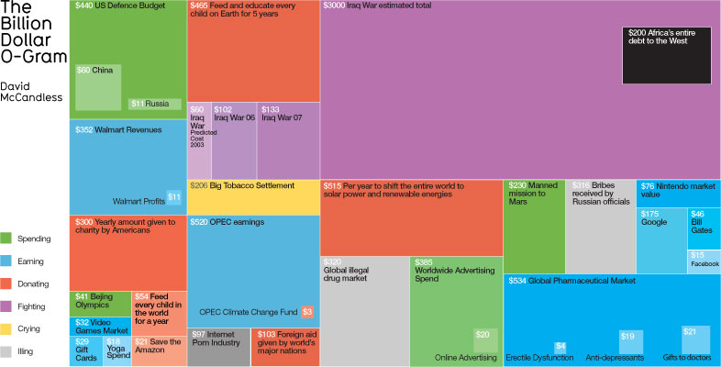


MSIM651
Analysis I
Topic 2 – Statistical Distributions
Dr. Andrew Collins
ajcollin@odu.edu

Slide 2
Statistics

Slide 3
Statistics
Statistics
  numerical facts or data themselves.
Descriptive Statistics
  Describes features of a collection of data
Inferential Statistics
  Drawing conclusions about data

Slide 4
Average
-1, 1, 0, 0, 2, -2
Mode
  Most frequent observation
    0
Median
  Ordered sample, value splitting into two
  If sample size is ‘odd’ then this is middle value
Mean
  Expectation value
  Σx / n or ∫x.P(x) dx
Notes:
Mean is used because easy to handle but can is easily effected by outliners. In book “how to lie with statistics”, the author disregards the mean.

Slide 5
Expectation
Discrete Case
E(X) = Σ_{x ∈ A} x.P(X = x)
Continuous Case
E(X) = ∫_{x ∈ A} x.P(X = x)
2, 3, 4, 5
Expected values is ‘3.5’, which is never observed

Slide 6
Expectation
E(f(X)) = Σ_{x ∈ A} f(x).P(X = x)
E(a.X + b) = a.E(X) + b
E(E(X)) = E(X)
E(X + Y) = E(X) + E(Y)

Slide 7
Expectation Warning
If E(X) = 0 does NOT imply that E(X²) = 0
-1, 1, 0, 0, -2, 2
E(X) = 0
E(X²) = 1.6666

Slide 8
Variance

Slide 9
Variance
A measure of spread of the data
Var(X) = E((x-E(X))²)
Sample {1,1,1,1,1}
  Var(X) = ?
Var(X) ≥ 0
Standard Deviation
    +√Var(X)

Slide 10
Indentities
E(E(X)) ≡ E(X)
var(a.X+b) ≡ a².var(X)
If X and Y are independent:
var(X + Y) ≡ var(X) + var(Y)
Notes:
Will prove these in the homework
Connected to tower rule

Slide 11
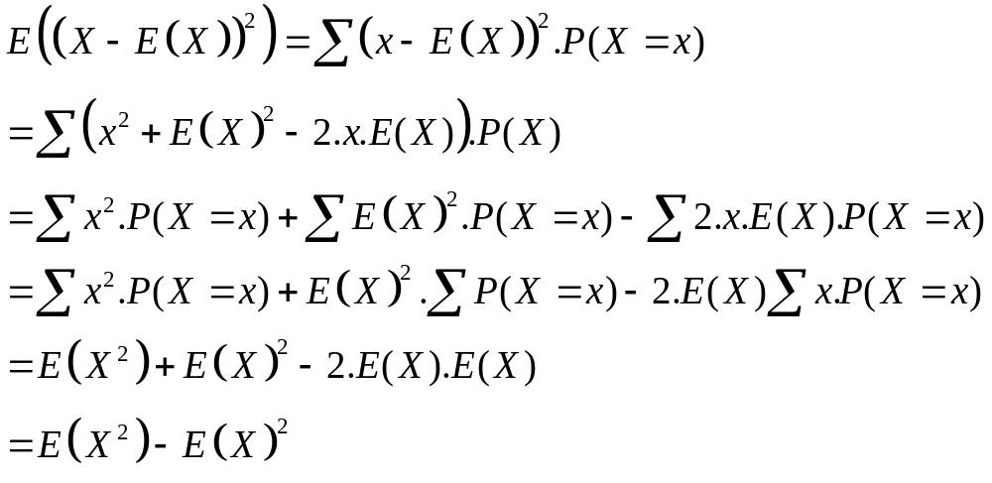
Variance
Var(X) ≡ E((X-E(X))²) = E(X ²) – E(X)²
Proof (Discrete case)

Slide 12
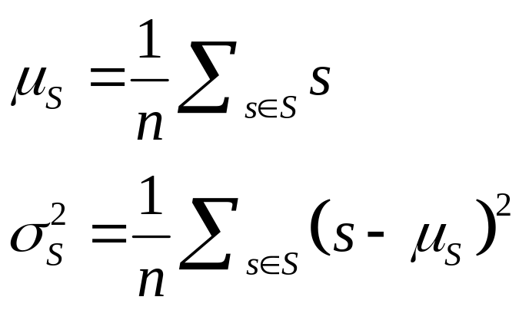
Sample
Given sample ‘S’ from population ‘P’
S ⊆P ; |S|= n; S = {s1, s2, …, sn}
Si are IID (Independent Identity Distributed)
For a finite sample, the mean and variance of the sample can be calculated:

Slide 13
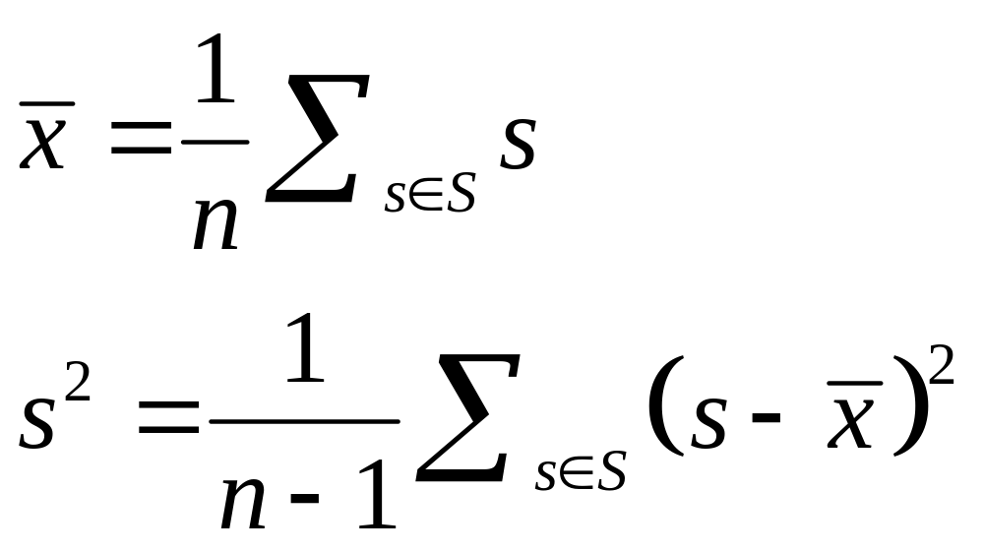
Estimators
However, we are really interested in the population mean (μ) and variance (σ²). For this we want unbias estimators of them from the sample:

Slide 14
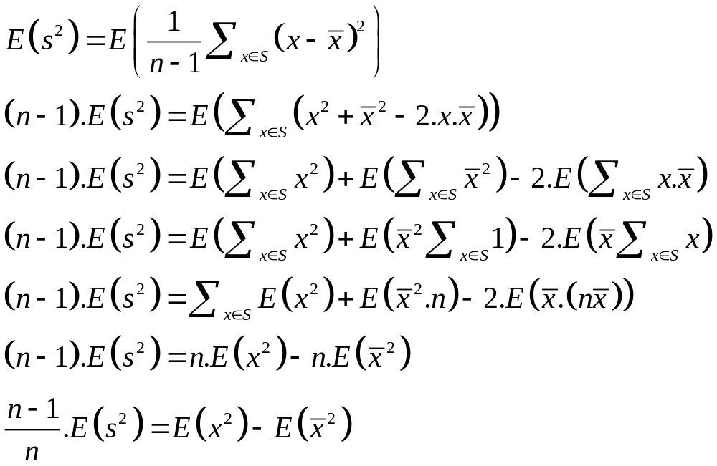
Estimate of Population Variance
E(s²) = σ²
Proof

Slide 15
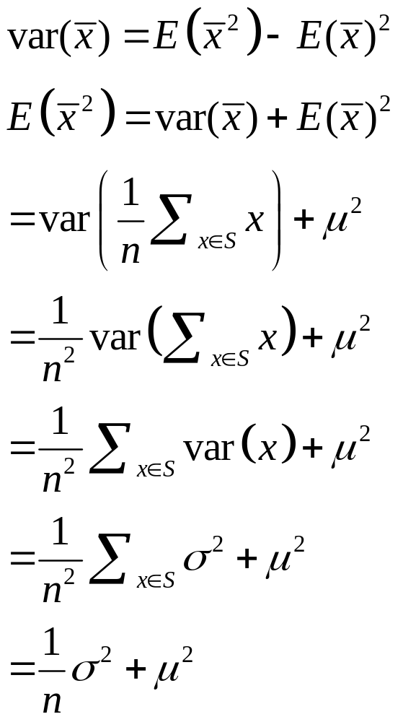
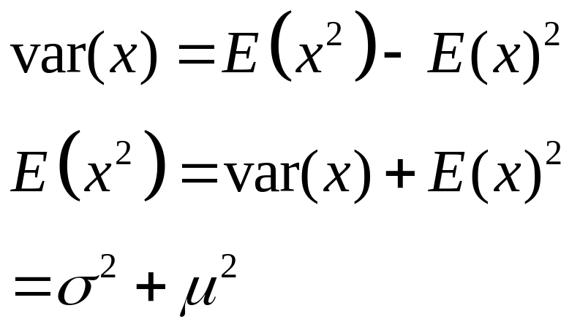
Estimate of Population Variance
Notes:
Were did the first line come from?

Slide 16
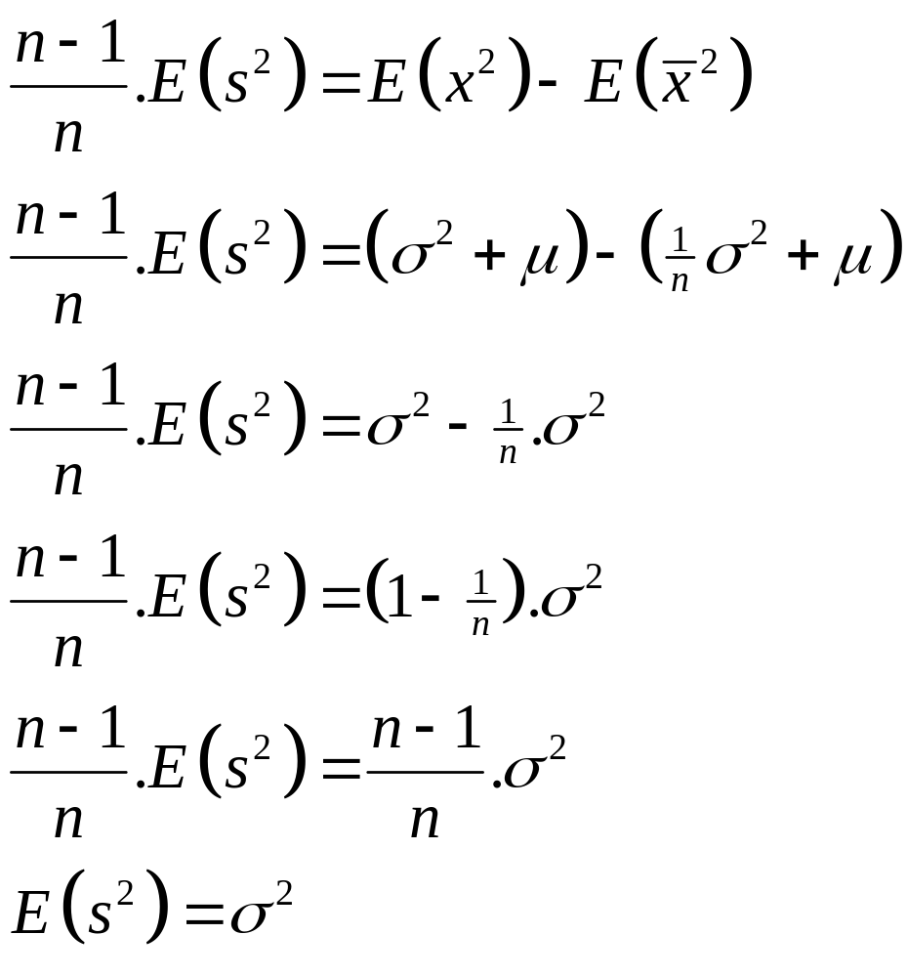
Estimate of Population Variance
QED

Slide 17
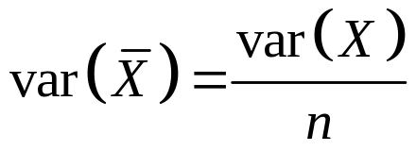
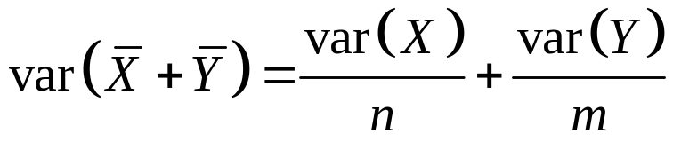
Midterm Question
Discrete random variables X₁, … , X_{n} are IID (Independent and identity distributed) with distribution ‘X’ and Y₁, … , Y_{m} are IID with distribution ‘Y’. Show that:
a)
b)
c) What assumption are we making about the variance of ‘X’ and ‘Y’?
Hint: You can use any result you have found from any previous lecture, assignment, or coursework.

Slide 18
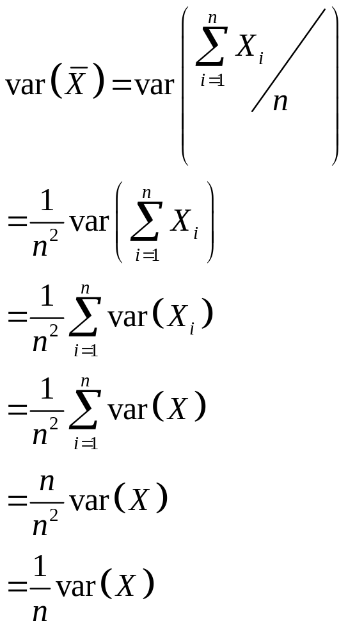
Question 5 - a

Slide 19
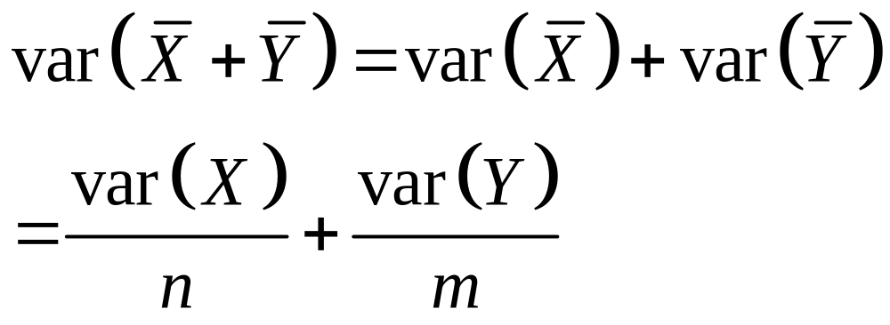
Question 5 - b

Slide 20
Question 5 - c
Assuming that:
Is a finite value
If you used the results from the previous assignment, then you assumed that:
They are discrete random variables.
Independence is already assumed within each sample but want about between X and Y?

Slide 21
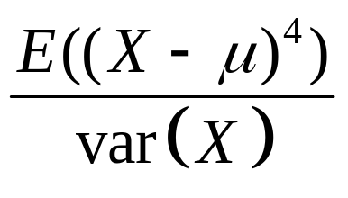
Kurtosis
How peak is the distribution?
High
Low

Slide 22
BAYES’ Theorem

Slide 23
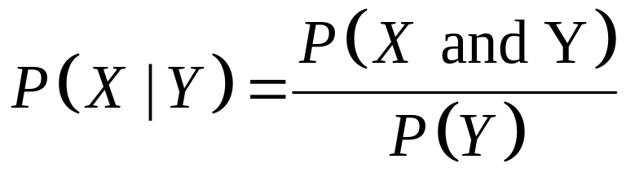
Bayes’ Theorem
Conditional probability
P(X|Y) is what is the probability of ‘X’ occurring given we know that ‘Y’ happened.
P(it rained|the grass is wet)
Bayes Theorem:

Slide 24
Example
W = Event that grass is wet
R = Event that it rained
P(W and R) = 0.5
P(¬W and R) = 0
P(¬W and ¬R) = 0.4
P(W and ¬R) = 0.1
1.0

Slide 25
Example
P(W) = P(W and R) + P(W and ¬ R)
= 0.5 + 0.1 = 0.6
P(R|W) = P(W and R) / P(W)
= 0.5 / 0.6
= 5/6

Slide 26
Example
P(R| ¬W) = P(¬W and R) / P(¬W)
= 0 / P(¬W) = 0
P(R) = P(W and R) + P(¬W and R)
= 0.5 + 0 = 0.5
P(R) = P(R|W) P(W) + P(R| ¬ W)P(¬ W)
= 5/6 x 0.6 + 0 = 0.5
Notes:
Can check calculations in multiple ways

Slide 27
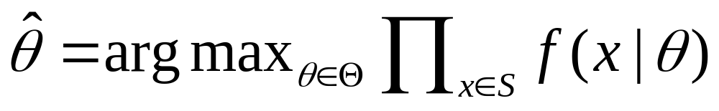
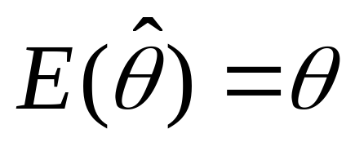
Maximum Likelihood Estimators
Is an estimator of a parameter based on sample found:
It is said to be unbiased if:

Slide 28
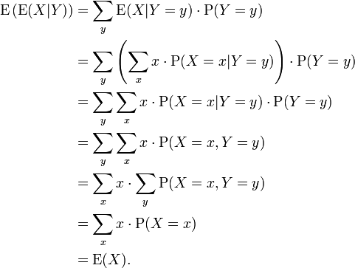
Tower Rule (or Law of Total Expection)
E(E(X|Y)) = E(X)
Proof (for discrete case):

Slide 29
Example
X = {Value from the roll of a fair dice}
Y = {Value is odd or even}
E(X ) = (1+2+3+4+5+6)/6 = 3.5
E(X | Y = Even) = (2+4+6)/3 = 4
E(X | Y = Odd) = (1+3+5)/3 = 3
E(E(X | Y)) = Σ_{Y} E(X | Y).P(Y)
= E(X|Y=even)P(Y=even)+E(X|Y=odd)P(Y=odd)
= 4x0.5 + 3x0.5 = 3.5

