Slide 1



MSIM895
ABMS
Input Analysis

Slide 2
Outline
Here is what is covered
Data Types
Notation
Probability
Statistical Distributions
Joint Probability
Scatter Graphs
Correlation

Slide 3
Prerequisite

Slide 4
Types of Data
This lecture assumes that you have some basic knowledge of probability and statistics
If you do not or need a refresher, I would suggest you do so now.
  There are many good probability and statistics books on the market

Slide 5
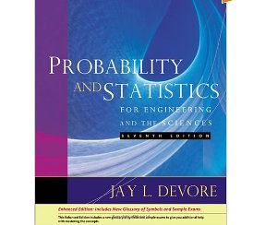
Example Refresher Book
Probability and Statistics for Engineering and the Sciences
  Jay Devore
  2009
  7th Edition
  Brooks Cole
$170

Slide 6
Math Symbols
%
√
∑
∏
≈
∀
∴
∃
⇒
⊥
s.t., :
Percentage
Square-root
Summation (x1 + x2 + x3 +…)
Product (x1 . x2 . x3 …)
Approximately
For all
Therefore
There exists
Implies
Contradiction
Such that

Slide 7
Math Symbols
~
∞
¬
#
o/w
F’
∫
Has distribution
Infinity
- Not a number
Not
Number
Otherwise
Differential of ‘F’
Integral

Slide 8
Numbers
Natural Numbers
N (0), 1, 2, 3, 4, 5, 6, …
Integers
Z …, -3, -2, -1, 0, 1, 2, 3, 4, 5, 6, …
Z⁺ , Z ⁻
Rational Numbers
Q 0, -1, 0.456, ½ , 1/3, -0.11…
Real Numbers
  R 0, -1, 0.456, π, e, 1/3, -0.11…
Complex Numbers
C √-1, 1/3 + ½. √-1, …

Slide 9
DaTA TYPES

Slide 10
Types of Data
Data can have different characteristics
Thus data collections are categorized in different ways:
  Nominal
  Ordinal
  Interval
  Ratio

Slide 11
Types of Data
Nominal: unordered categorical data
  E.g., Bill, Fred, Sue, June
Ordinal: order data but no implication of distance
  E.g., social class, Likert scale
Interval: There are equal differences between successive points on a scale
  Position of zero is arbitary
  E.g., Fahrenheit Scales, IQ

Slide 12
Types of Data
Ratio: relative magnitude of datum can be observed
  Position of zero is fixed
  Highest level of measurement
  E.g., 1, 2, 3.3, -7, (4, 5)

Slide 13
Types of Data
Why care about data types?
  Treat each type differently in statistics
  For example:
    Median of nominal data is meaningless but mode is not
    Describing percentage increases of interval data is meaningless
      E.g. does having an IQ of 140 mean that you are twice as intelligent as someone with IQ of 70?
  Non-parametric statistics is usually used for all non-ratio data types (usually!)

Slide 14
Types of Data
An common example of problems is the Likert Scale:
  Strongly disagree
  Disagree
  Neither agree nor disagree
  Agree
  Strongly agree
Some people say it is an interval parameter so the mean has meaning. Other disagree.

Slide 15
Continuous or Discrete
Continuous variable: a variable that takes a real number value(s) or derivation off
  Real numbers ratio data
  E.g., 3, ½, 0.75, -6.2, e, π
  Between any two real numbers exist another at least one other real number
    In fact there are infinite real numbers there
  (Aside: complex numbers are also continuous)
  Vectors can also be continuous
    E.g., (1.5, 3)

Slide 16
Continuous or Discrete
Discrete variable: a variable that takes a value from a finite or countable set of possibilities
  Integers numbers are discrete and ratio data
    E.g., -1, 0, 1, 2, 3
    Integers are countable: 0, 1, -1, 2, -2, …
  Countable set just means that a direct (1 to 1) correspondences between the set and the natural numbers exist in theory.

Slide 17
Continuous or Discrete
Continuous and discrete variables are handled differently in probability and statistics
For example:
  Distributions of continuous variables are represented using the Probability Density Function (PDF): f(x)
  Distributions of discrete variables are represented using the Probability Mass Function (PMF): f(x) = P(X=x)

Slide 18
Types of Data
In Agent-based Modeling and Simulation (ABMS), a developer is likely to use a number of different data sources.
Be conscious of the data type
For example:
  If you label your agents say 1, 2, …, 10 then saying the average agent is 5.5 is meaningless as you are using arbitrary labels.

Slide 19
Notation

Slide 20
Probability
Probability is a function that returns the chance of some event.
P(event ‘A’) ∈ [0, 1] ⇒ 0 ≤ P(event ‘A’) ≤ 1
‘P(A) = 0’ means that event ‘A’ never happens
  0% chance
‘P(A) = 1’ means that event ‘A’ always happens
  100% chance

Slide 21
Random Numbers
Random Variable ‘X’
  Is some variable with associated probability distribution
  Represent with a CAPITIAL letters
Random Variate ‘x’
  Is a single sample of the random variable
  Fixed and realized
  Represent with lowercase letters

Slide 22
Example
X = {Value from the roll of a fair dice}
P(X ≤ 6) = 1
P(X ≤ 5) = 5/6
P(X > 5) = P(X=6) = 1/6
= 1 - P(X ≤ 5) = 1/6

Slide 23
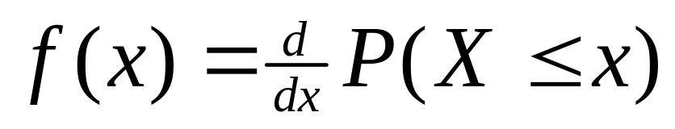
Continuous or Discrete
Discrete
  ∃x s.t. P(X = x) > 0
Continuous
  ∀x∈R P(X = x) = 0
  Probability density function

Slide 24
Measure Theory
Might see P(∀s ∈S : X(s) = x)
  Same as P(X = x)
  ‘S’ is the sample space of the universe (man)
  ‘S’ includes all things so P(X = 6) will include:
    When I rolled a ‘6’ and I sneezed
    When I rolled a ‘6’ and I did not sneeze
    Etc
Do not worry about this notation

Slide 25
Probability

Slide 26
Probability
If ‘X’ ∈ R a random variable
P(X ≤ x) is an increasing function on ‘x’
x < y then P(X ≤ x) ≤ P(X ≤ y)
P(A) = 1 – P(¬A)
P(x > b) = 1 – P(x ≤ b)
P(a ≤ x ≤ b) = P(x ≤ b) – P(x ≤ a)
Notes:
Notice that P(x ≤ b)

Slide 27
Comparison
A = <a₁, a₂, …, a_{n}>⊆ R B = [b1, b2]
X is a discrete random variable on ‘A’
  P(X ≤ a_{k}) = F(a_{k}) = Σ_{ai < ak} P(X = a_{i})
  Σ_{ai ∈ A} P(X = a_{i}) = 1
X is continuous random variable on ‘B’
  P(X ≤ b) = F(b) = ∫ _{z ∈ (-∞, b)} f(z) dz
  ∫ _{z ∈ B} f(z) dz = 1

Slide 28
Example
X = {Value from the roll of a fair dice}
P(X ≤ 3) = P(X=1) + P(X=2) + P(X=3)
= 1/6 + 1/6 + 1/6
= 1/2
U~U(0,6)
P(U ≤ 3) =∫ _{u ∈ [0, 3]} 1 du = [u] _{u ∈ [0, 3]} = 0.5

Slide 29
Statistical Distributions

Slide 30
Discrete Distribution
Cumulative Distribution Function (CDF)
1
P(X≤ x)
1/6
X
F(x) = P(X ≤ x)
F(x) is increasing
0 ≤ F(x)≤ 1

Slide 31
Discrete Distribution
Probability
Mass Function
P(X = x)
1/6
X
Frequency of ‘a’ = (# occurrence of ‘a’)/(# occurrences)
Notes:
Use to make empirical distristributions

Slide 32
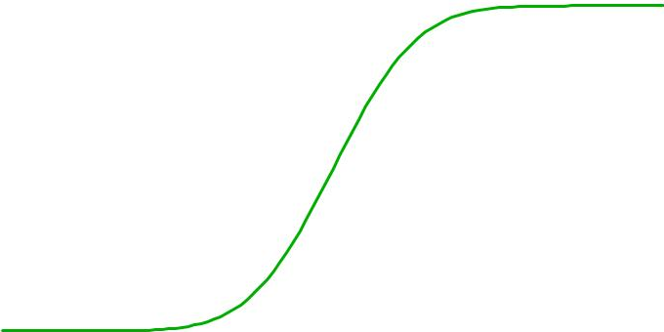
Continuous Distribution
Cumulative Distribution Function
1
P(X≤ x)
0
X
F(x) = P(X ≤ x)
F(x) is increasing
0 ≤ F(x)≤ 1

Slide 33
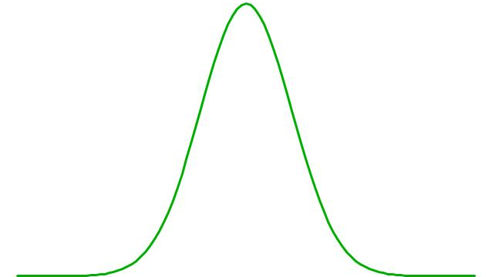
Continuous Distribution
Probability
Density Function
0.4
f(x)
0
X
P(X = x) =0
P( -a < X < a) > 0
F’(x) = f(x)

Slide 34
Histogram
Histograms can be used to approximate the PDF of a continuous variable
A histogram is a representation of tabulated frequencies, shown as adjacent rectangles, erected over discrete intervals (bins), with an area equal to the frequency of the observations in the interval.
http://en.wikipedia.org/wiki/Histogram

Slide 35
Histogram
Area = P(a ≤ X≤b)
f(x)
Height
a
b
Width

Slide 36
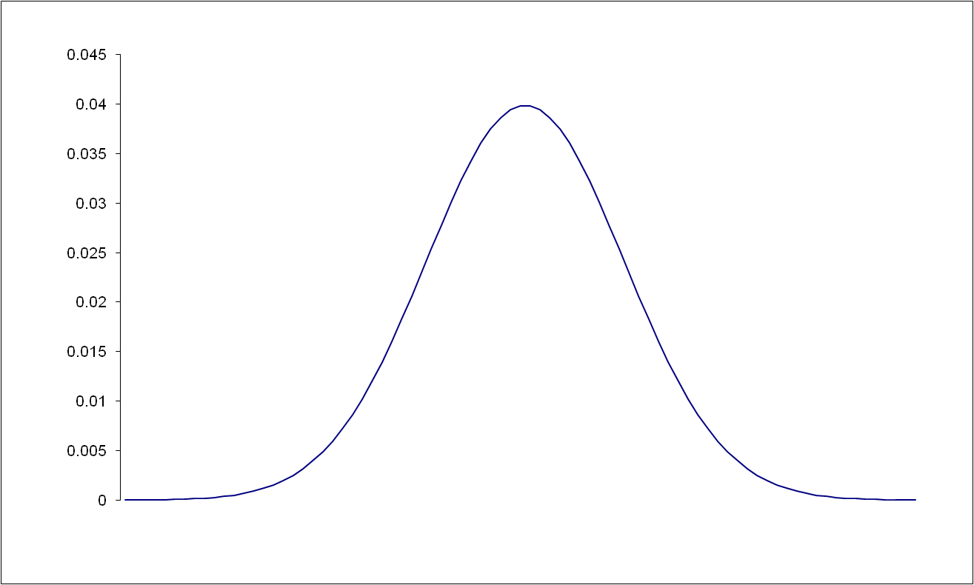
Normal Distribution
Frequency per unit Area

Slide 37
Normal Distribution
Frequency per unit Area
Notes:
This is how the do it with hard-core maths

Slide 38
Normal Distribution
PDF

Slide 39
Comparison
A = <a1, a2, …, an>⊆ R B = [b1, b2]
X is a discrete random variable on ‘A’
  P(X ≤ ak) = F(ak) = Σ_{ai < ak} P(X = ai)
  Σ_{ai ∈ A} P(X = ai) = 1
Y is continuous random variable on ‘B’
  P(X ≤ b) = F(b) = ∫ _{z ∈ (-∞, b)} f(z) dx
  ∫ _{z ∈ B} f(z) dz = 1 ∫ _{z ∈ R} f(z) dz = 1

Slide 40
Discrete Distributions

Slide 41
Distributions
Generalize complex things to a random distribution:
  Owner of 101 Smithfield Road, Suffolk.
    Distribution say has 80% being republican.
  If had more information, could make better estimate (i.e. sex, ethinicy)
  It is not random….
Top card of a deck is not random but we approximate to be

Slide 42
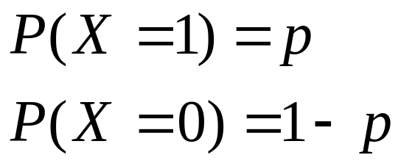
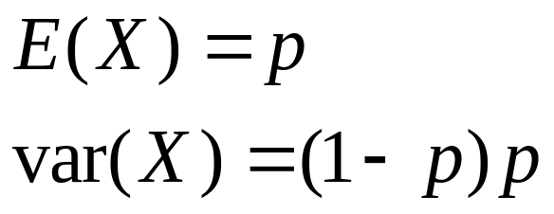
Bernoulli
Simple single probability distribution.
Toss of a coin
X ~ Bernoulli (P)
1-p
p
0
1

Slide 43
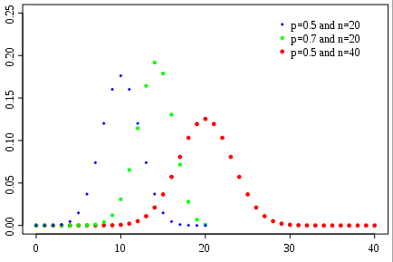
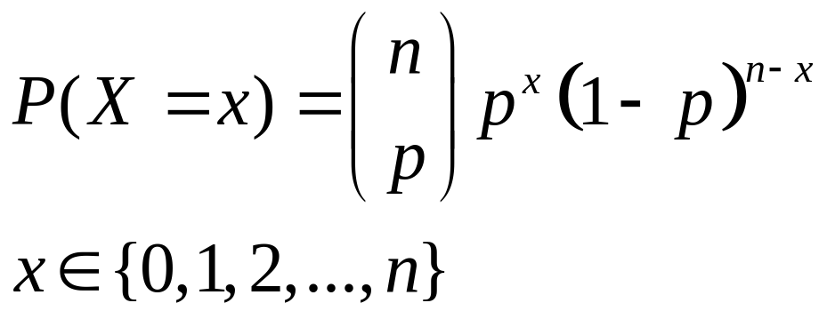
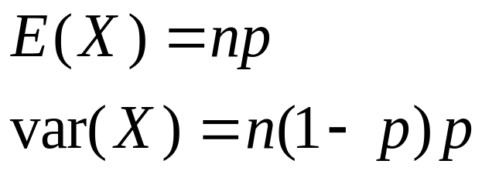
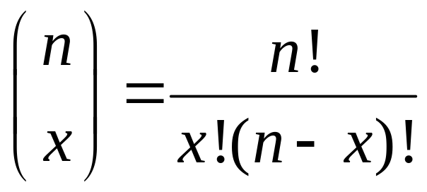
Binomial
# occurrences after multiple Bernoulli events (i.e. how many heads after ’n’ tosses of a coin).
X ~ b(n, p)

Slide 44
Binomial Distribution
Consider X_{i} IID s.t. X_{i} ~ Bernoulli (p)
ΣX_{i} ~ b(n,p)
As ‘n’ becomes large looks like Normal distribution.

Slide 45
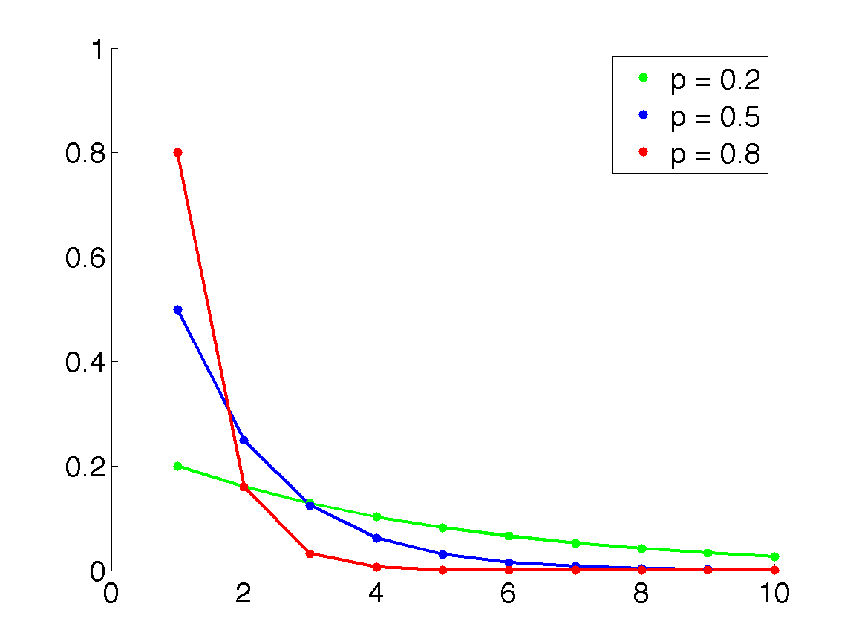
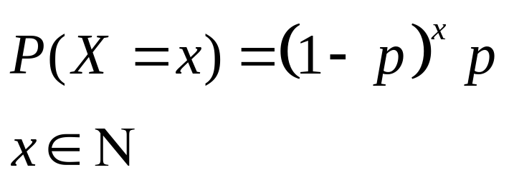
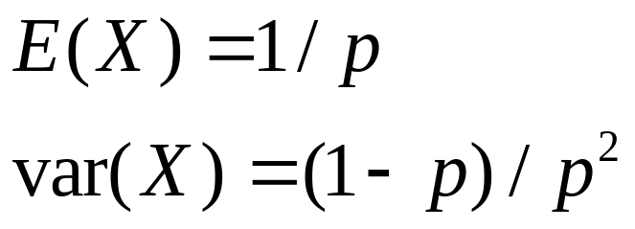
Geometric
Discrete version of the exponential.
Given Bernoulli distribution, the number of failures until a success.
X~Geometric(p)

Slide 46
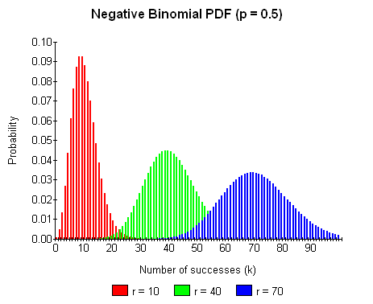
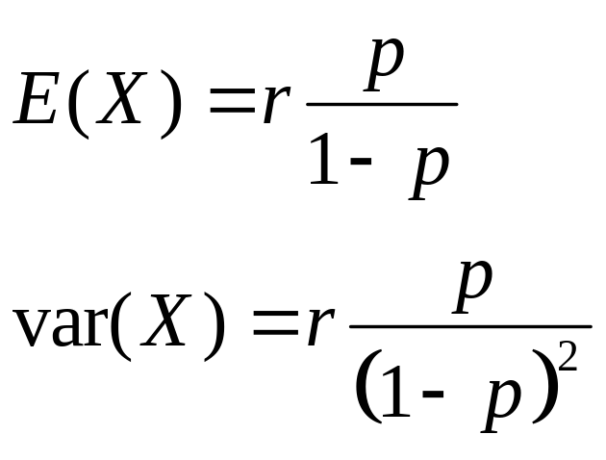
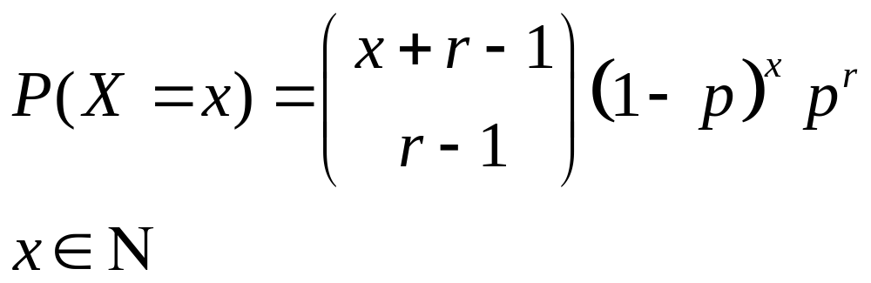
Negative Binomial
Total number of failures until a observed ‘r’ successes
X~nb(r, p)

Slide 47
Negative Binomial
If have ‘r’ geometric distributed events, then total times has this distribution.
X_{i} IID
X_{i} ~ Geometric(p)
then
Σ X_{i} ~ nb(r,p)

Slide 48
Example
Result from a flip of a single coin
  Bernoulli
#Heads in 10 flips
  Binomial
#flips till get one head
  Geometric
#flips till get 10 heads
  Negative Binomial

Slide 49
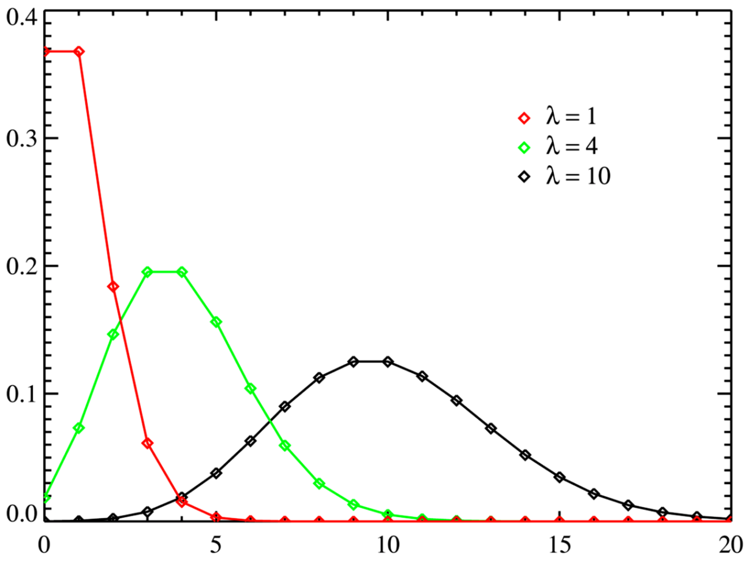
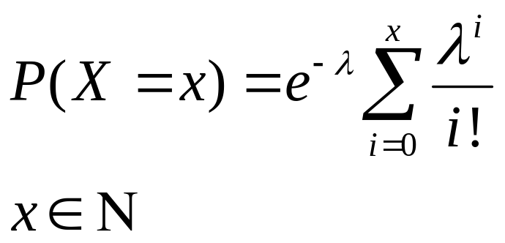
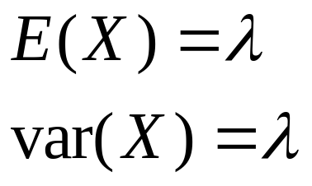
Poisson
Number of arrivals in a fixed period.
Poisson Process: Events are independent of each other.
X~pois(λ)
Notes:
Used for queues.

Slide 50
Poisson
If buses arrived with a Poisson distribution with an expected time of arrival of 20 mins then:
Expect time that bus will arrive given you just got to the bus stop is: 20 mins
Expect time that bus will arrive given you have around waited 15 mins: 20 mins
Notes:
Lack of memory property

Slide 51
Continuous Distributions

Slide 52
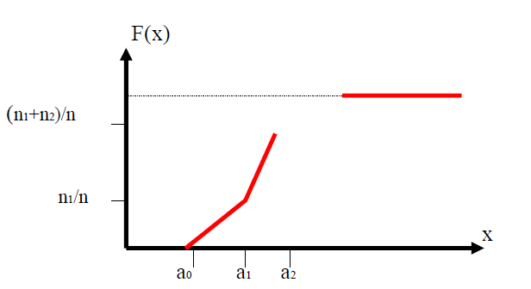
Empirical Distribution
=P(X≤ x)
If have finite data points, can construct a distribution.

Slide 53
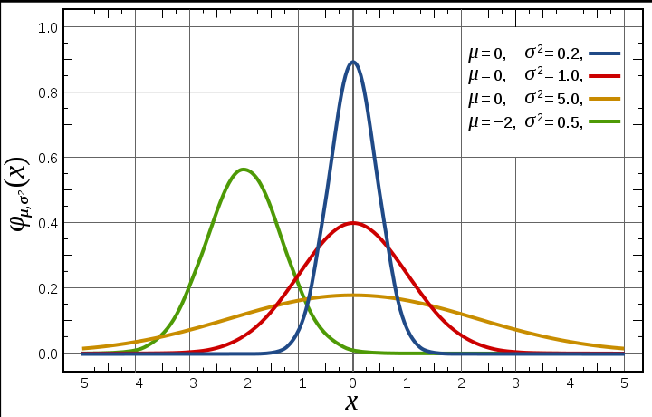
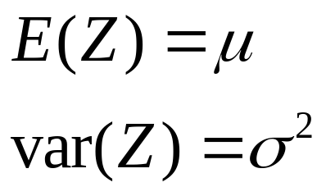
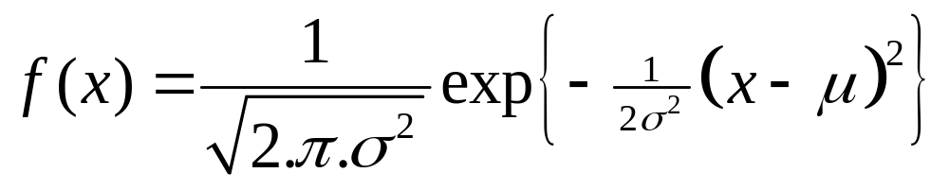
Normal
Found everywhere: heights, weight, etc.
Z~N(μ, σ²)

Slide 54
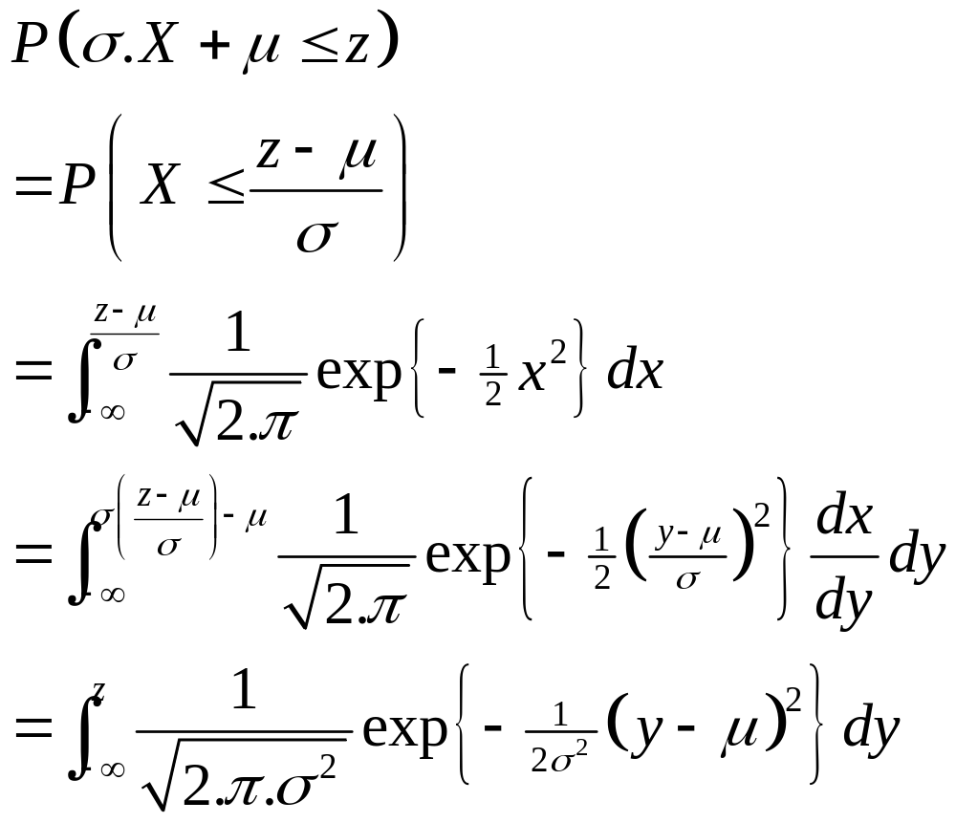
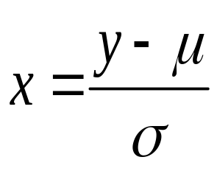
Normal Distribution
X~N(0,1) then Z = σ.X+ μ ~ N(μ, σ²)
Proof:

Slide 55
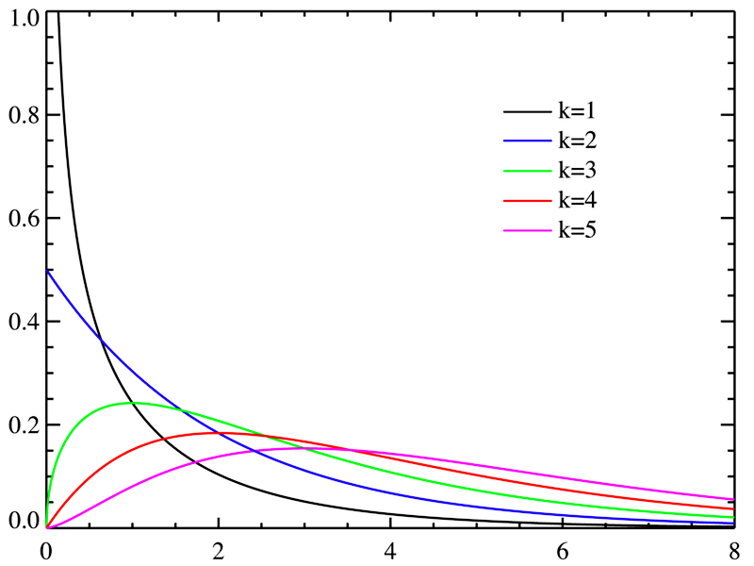
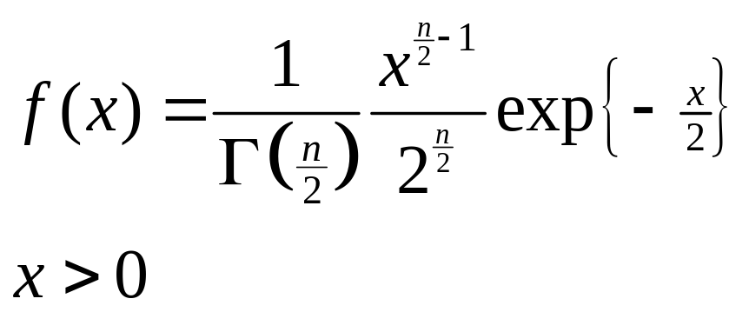
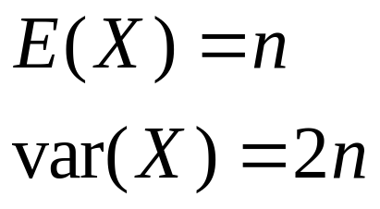
Chi-squared
The square of a normal distributed variable has a chi-squared distribution.
Used in the ‘Good of Fit’ test
X~χ²(n)

Slide 56
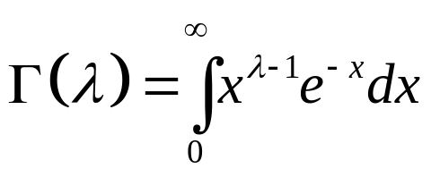
Chi-squared Distribution
If X ~N(0,1) then X² ~ χ²(1)
If Yi ~ χ²(1) IID then
Σ^{n} Yi ~ χ²(n)
If Y ~ χ²(r) and Z ~ χ²(s) IID then
Y+Z ~ χ²(r+s)

Slide 57
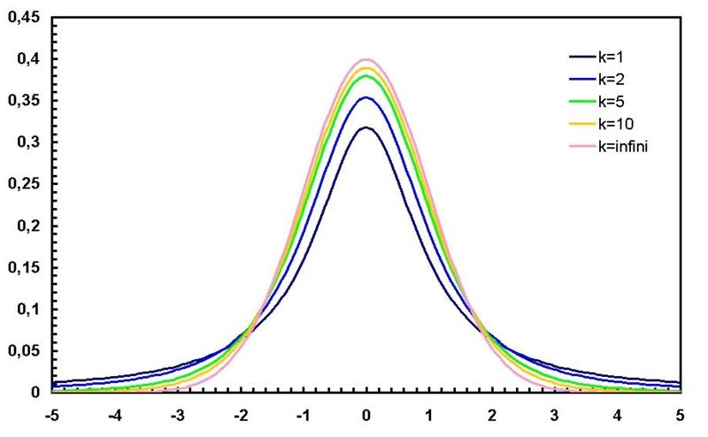
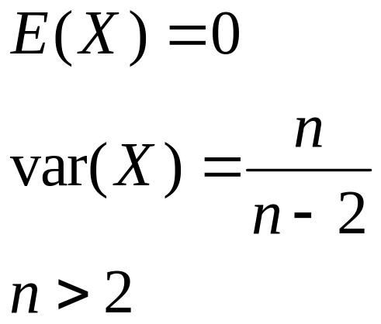
Student’s T-Distribution
Skinny version of the Normal.
Used to determine if two samples come from the same population.
X~t(n)

Slide 58
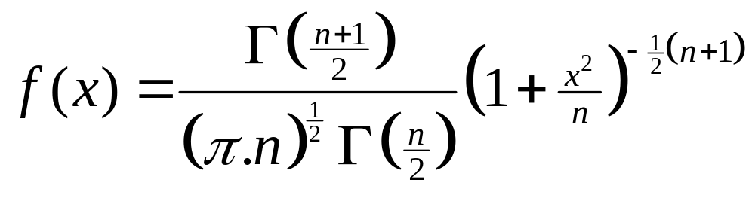
Student’s T distribution
If X ~N(0,1) and Y ~ χ²(n)
x/√(Y/n)~ t(n)
As n become large t(n) ~ N(0,1)

Slide 59
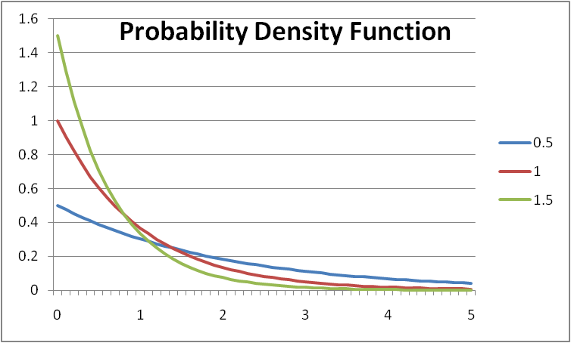
Exponential Distribution
Has the “lack of memory property”:
P(X>x +y | X > y)
= P(X > x)
Used for inter-arrival time because of this property
ONLY continuous distribution that has this property!
http://en.wikipedia.org/wiki/List_of_probability_distributions

Slide 60
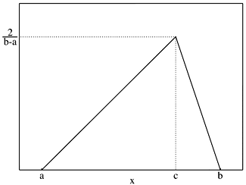
Triangular
Use this when got limited data and have no reason to assume got the normal distribution or uniform.

Slide 61
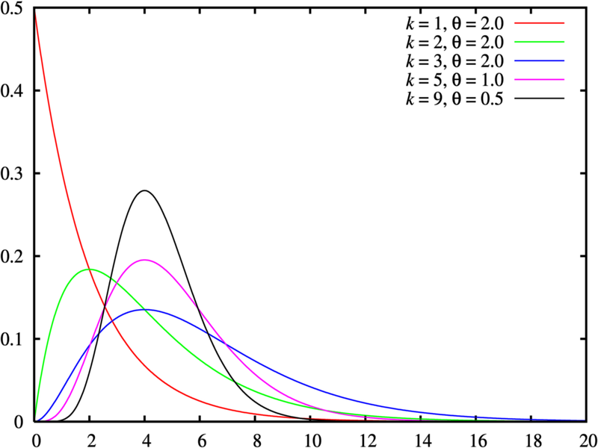
Gamma
Family of distributions
  Exponential
  Chi-squared
Time until ‘n’ exponentials arrive

Slide 62
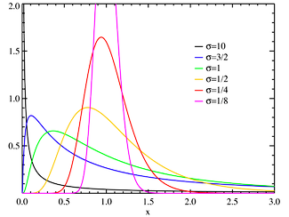
Lognormal
Some consider a better version of normal because is always positive
Examples
  Number of words written in sentences by George Bernard Shaw
  Bombing radius!

Slide 63
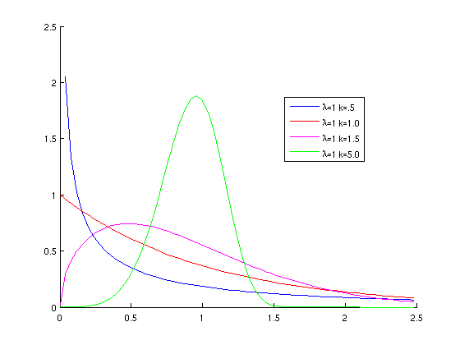
Weibull
Related to Exponential distribution.
Example
  Life-time of light bulbs!

Slide 64
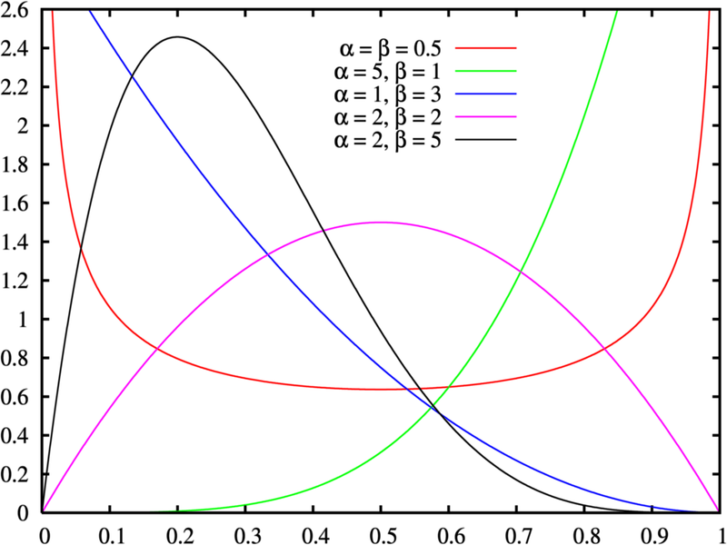
Beta
Used in Bayesian statistics, if prior is Beta then so is posterior.

Slide 65
Representing Continuous value

Slide 66
Representing Continuous Data
Computer can only represent discrete variables accurately
Current computers are limited to the number of decimal place that the can hold in memory
  Thus, approximate continuous variables as discrete ones
There are some ways to represent some irrational numbers analytical, e.g., i = e^{-π}

Slide 67
Machine Code
Machine code is binary
0 ⇒ 0, 1 ⇒ 1, 10 ⇒ 2, 11 ⇒ 3
bit ∈{0, 1}
1 byte = 8 bits
4 byte example: 10011001100110011001100110011001

Slide 68
Machine Code
Int (4 bytes)
  -2,147,483,648 to 2,147,483,647
Float (4 bytes)
  1.2 x 10⁻³⁸ to 3.4 x 10³⁸
Double (4 bytes)
  2.2 x 10⁻³⁰⁸ to 1.8 x 10³⁰⁸
Long Double (10 bytes)
  3.4 x 10⁻⁴⁹³² to 1.1 x 10⁴⁹³²
≈ 7 x 10⁹
  people
≈ 1 x 10²²
  Stars in universe
≈ 1 x 10⁸⁰
  atoms in universe
≈ 1 x 10⁻¹⁴ m
  Size of atom
Notes:
Byte is 8 bits

Slide 69
Rounding errors
Microsoft Excel 2007
  =exp(700)
    e⁷⁰⁰
  =exp(800) not
I used long doubles on exp(1/λ)
Wanted ‘λ’ as small as possible
Min (λ) = 0.0001

Slide 70
Continuous or not
Ability to measure?
Example of continuous variable:
  Height?
    ± 1 x 10⁻¹⁴ m?
    Space in-between atoms?
  Time?
If worried use Sensitivity Analysis

Slide 71
Joint Probability

Slide 72
Joint Probability
Discrete case:
P(X ≤ x, Y ≤ y)
= Σ _{u ≤ x}Σ _{v ≤ y} P(X = u, Y = v)
Continuous case:
P(X ≤ x, Y ≤ y)
= ∫ _{u∈(-∞,x]} ∫ _{v∈(-∞,v]} f_{XY}(u,v) dvdu

Slide 73
Marginal Probability
Discrete case:
P_{Y}(X ≤ x)
= Σ _{u ≤ x}Σ _{v ≤ ∞} P(X = u, Y = v)
Continuous case:
P_{Y}(X ≤ x)
= ∫ _{u∈(-∞,x]} ∫ _{v∈(-∞, ∞)} f_{XY}(u,v) dvdu

Slide 74
Joint Probability
Discrete case:
Σ _{u ≤ ∞} Σ _{v ≤ ∞} P(X = u, Y = v) = 1
Continuous case:
∫ _{u∈(-∞, ∞)} ∫ _{v∈(-∞, ∞)} f_{XY}(u,v) dvdu = 1

Slide 75
Independence

Slide 76
Independent
Two random variables ‘X’ & ‘Y’ are called independent if:
P(X, Y) = P(X).P(Y)
P(X≤ x, Y ≤ y) = P(X ≤ x).P(Y ≤ y)
Independence means that probability of one of the variables does not change if the other is known.

Slide 77
Example
X = {Value from the roll of a fair dice}
Y = {Value is odd or even}
P(X ≤ 3; Y = even)
= P(X=2) = 1/6
P(X ≤ 3) = 3/6; P(Y = even) = 3/6;
=> P(X ≤ 3).P(Y = even) = 1/4
They are not independent

Slide 78
Scatter Graphs

Slide 79
Scatter Graphs
Scatter graphs are a good way to explore relationships between variables including outputs
“Fuzzing” data can enable you see data points that would normally be overlapped on the graph
  Randomly perturb data point in each direction
    (x_{i}, y_{j}) -> (x_{i}+ ε_{i}, y_{j}+ ε_{j} )
    ε_{i} << x_{i}, ε_{j} << y_{j}

Slide 80
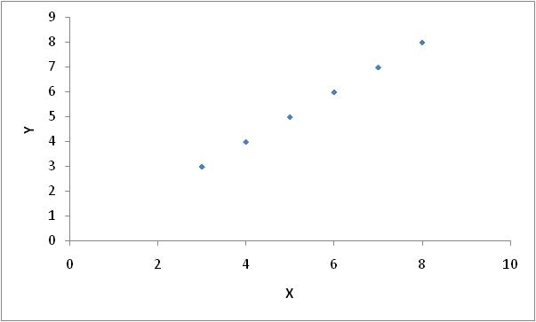
Scatter Graph

Slide 81
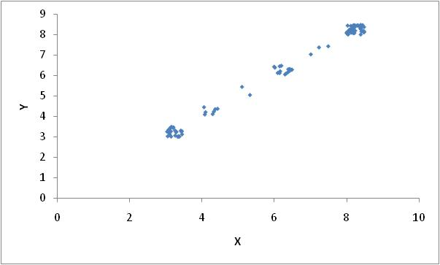
Fuzzed
Notes:
Sometimes lying is useful

Slide 82
BAYES’ Theorem

Slide 83
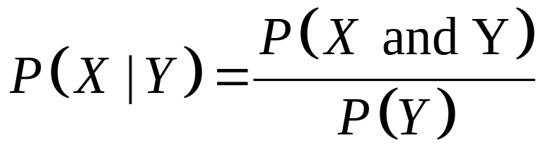
Bayes’ Theorem
Conditional probability
P(X|Y) is what is the probability of ‘X’ occurring given we know that ‘Y’ happened.
P(it rained | the grass is wet)
Bayes Theorem:

Slide 84
Example
W = Event that grass is wet
R = Event that it rained
P(W and R) = 0.5
P(¬W and R) = 0
P(¬W and ¬R) = 0.4
P(W and ¬R) = 0.1
1.0

Slide 85
Example
P(W) = P(W and R) + P(W and ¬ R)
= 0.5 + 0.1 = 0.6
P(R|W) = P(W and R) / P(W)
= 0.5 / 0.6
= 5/6

Slide 86
Example
P(R| ¬W) = P(¬W and R) / P(¬W)
= 0 / P(¬W) = 0
P(R) = P(W and R) + P(¬W and R)
= 0.5 + 0 = 0.5
P(R) = P(R|W) P(W) + P(R|¬W)P(¬W)
= 5/6 x 0.6 + 0 = 0.5
Notes:
Can check calculations in multiple ways

Slide 87
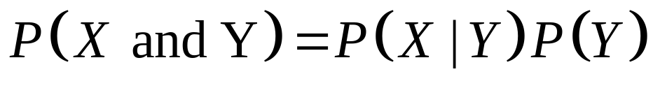
Input Data
What do if got dependent input data?
  Joint distribution can be hard to manipulate
  Suggest use Bayes theorem for selection

Slide 88
Example
Need to determine agent weight, W, and height, H, how both have normal distribution:
  W ~ N(μ_{w}, σ_{w}²) to realize weight “w”
  Use “w” to determine parameters of mean and variance for the height parameter
  H ~ N(μ_{H}(w), σ_{H}²(w))

Slide 89
Statistics

Slide 90
Statistics
Statistics
  numerical facts or data themselves.
Descriptive Statistics
  Describes features of a collection of data
Inferential Statistics
  Drawing conclusions about data

Slide 91
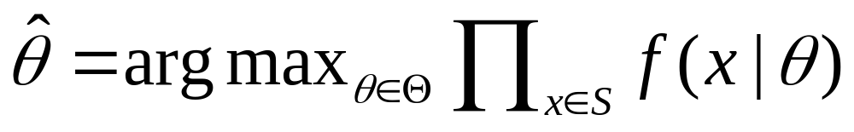
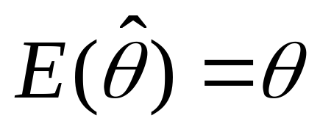
Maximum Likelihood Estimators
Is an estimator of a parameter based on sample found:
It is said to be unbiased if:

Slide 92
Correlation

Slide 93
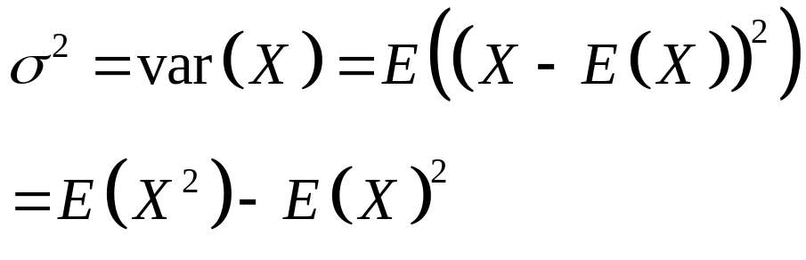
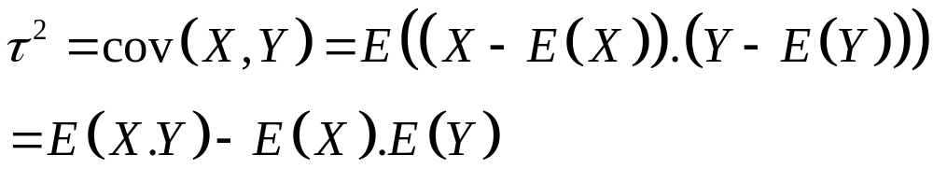
Variance
A measure of spread of the data:
Standard Deviation
    σ = +√Var(X)
Co-variance is a measure of how much two variables change together

Slide 94
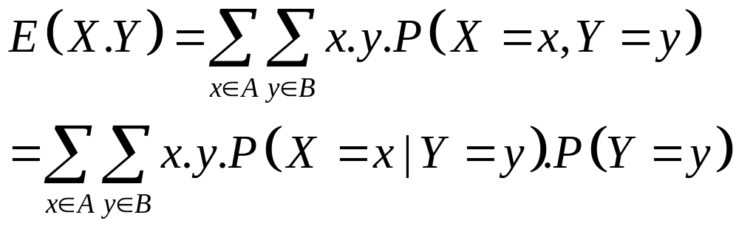
Joint Expectation
For a discrete random variables ‘X’ and ‘Y’

Slide 95
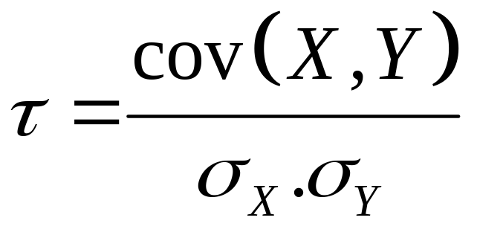
Pearson product-moment correlation coefficient
Correlation is a measure linear dependence between variables
τ∈ [-1, 1] or [-100%, 100%]
τ = 0 no correlation between variables
τ = 1 positive correlation between variables
τ = -1 negative correlation between variables

Slide 96
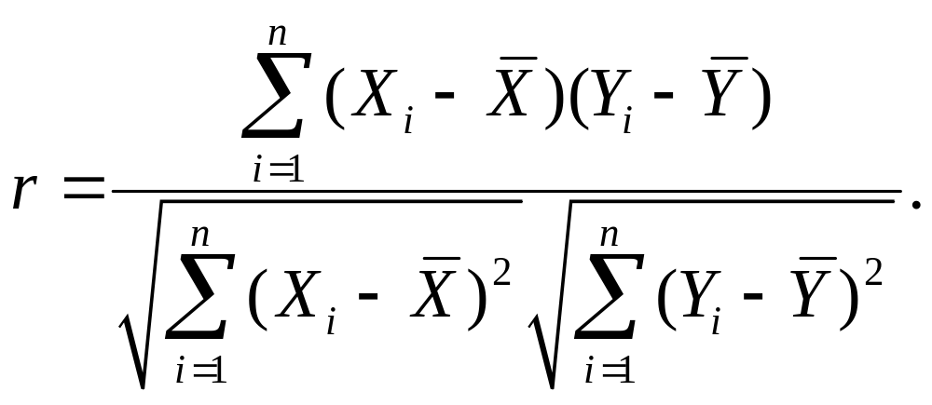
Sample
When dealing with sample, the sample correlation coefficient statistic ‘r’ can be found using:

Slide 97

Correlation

Slide 98




Correlation
τ = 1
τ = 0.96885
τ = 0.867281
τ = 0.252032

Slide 99




Correlation
τ = 0.031317
τ = -1
τ = ?
τ = -0.04806

Slide 100
Causation
“Correlation does not imply Causation”
  Cancer causes smoking!
Possible reasons for correlation of ‘A’ and ‘B’
‘A’ causes ‘B’
‘B’ causes ‘A’
By chance
Third-party
Self-reinforcing or vicious circle
Notes:
Causation: smoking cause cancer
Third-party: sleeping in shoes causes headaches, actually going to bed drunk
Vicious circle: Bankrun
By chance: SUV drivers say global warming and carbon emissions

Slide 101
Police Statistics
High vice-crime figures in city reported in newspaper
Mayor is upset, tells police chief to clean up city
Police chief setups squad to deal with vice-crime
Lots of arrests are made
Following week, Mayor even more upset. WHY?
Notes:
Newspapers report that crime is up because there have been so many arrests in the last week

Slide 102
Post hoc ergo propter hoc
Latin for "after this, therefore because of this",
logical fallacy that states:
  "Since that event followed this one, that event must have been caused by this one.“
post hoc
false cause, coincidental correlation, or correlation not causation
-Wikipedia

Slide 103
Correlation Test

Slide 104
Correlation Usage
Rule of thumbs are:
80% rule
70% rule
There is a test but:
  Approximation
  Requires ‘normally distributed’ data
  Useless for small samples

Slide 105


Test Statistic
If X and Y are uncorrelated, the sample correlation coefficient ‘r’ from a sample of ‘n’, then:
This is a two-tailed test, so need consider is
P(|T| >|t|)

Slide 106
End Presentation

