Slide 1
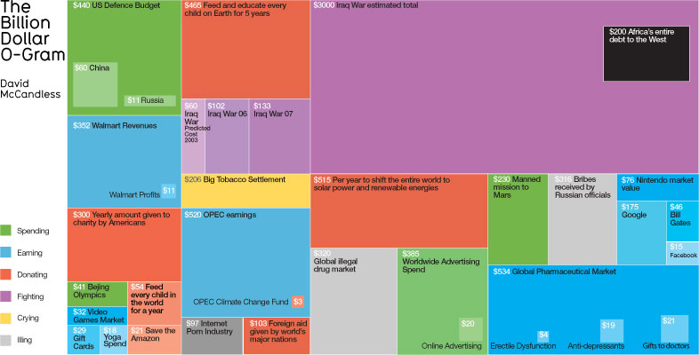


MSIM651
Analysis I
Topic 6_1 – VV&A
Dr. Andrew Collins
ajcollin@odu.edu

Slide 2
Philosophy of Science

Slide 3
Naïve View
“A model is a representation of the real world, or of a least part of it. Therefore, the validation of the model is really quite straightforward – in principle. All we have to do is check that the simulation behaves as the real world does under the same conditions. If it does, then the model is valid. If it doesn’t, then it isn’t.”

Slide 4
Why is this naïve view bad?
Historical:
  Thomas Kuhn’s “Paradigm Shift”
  Epistemological:
    How do we know what we know?
Sociology:
  Peer-pressure / power-play to accept
Bias:
  We are not unbiased observers
  Connected to the system

Slide 5
Why is this naïve view bad?
Our view of the real-world is limited, an approximation
Our view is, in fact, a …
Model
“Essentially, all models are wrong but some are useful”
Notes:
If not, you must be god.

Slide 6
Validation is Impossible
Consider statistical tests:
Only real way to know the average life of an light bulb is to test them all
95% confident at a Type I Error has not been made:
  What about Type II?
  What about Type III?
    Maybe you are testing against the wrong thing in the first place

Slide 7


Fit for Purpose
Notes:
Going up a trail
Painting a picture.

Slide 8
Example
Consider a combat model where the bigger force always wins.
Not always true:
  Pre-WWII, France had largest army in the world
This model would not be appropriate to validate the USA’s military size
This model might be appropriate as a simple sub-model in a larger logistic model.

Slide 9

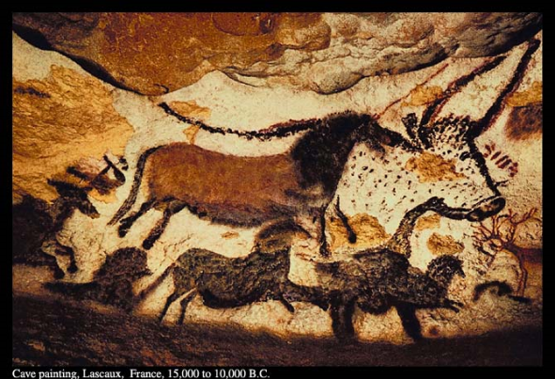
Ockham's razor
“Art is a lie that makes us realize truth”
  Pablo Picasso (1881-1973)
Ockham's razor: “Entities must not be multiplied beyond necessity”
  Hamilton, W. R. (1852). Discussions on philosophy and literature, education and university reform. London.
Notes:
Guernica
1937
Simplist explanation is the best one. Used in Phd to say why only looked at a few things.
Used a lot in economics

Slide 10
Ockham’s Razor
So when apply Ockham’s Razor, which is a well established principle of Science, when comparing two models for a purposes, you should:
Choose the simpler model
NOT the more realistic
Fidelity vs. Resolution

Slide 11
Philosophy of science

Slide 12
Controversy
Physicist Richard Feynman (1918-1988), who won a noble prize in 1965, is quoted:
“Philosophy of science is about as useful to scientists as ornithology is to birds.”
In response, the philosophers have pointed out that it is likely that ornithological knowledge would be of great benefit to birds, were it possible for them to possess it!

Slide 13
Definitions
Decision Science or decision-aid science?
  Bernard Roy
  European Journal of Operational Research
  1993
  66: pp. 184 -203

Slide 14
Viewpoints
Qualitative
Quantitative
Realism
Axiomatic
Instrumentalism
Roy (1993)

Slide 15
Realism

Slide 16
Realism
The view that the world described by science is the real world, as it is, independent of what we might take it to be.
Related to Positivism
  Only real data is source of authentic knowledge
Black-box validation

Slide 17
Realism
Advocating that realism should not be the “Be all and End all” of validation but it is still important for:
  Comparing to the real-world.
  Understanding the model.
Notes:
The model must MAKE SENSE

Slide 18
Realism Problems
When using a model to consider an adaption to a systems, e.g. maybe you would like to know the effect of adding a new machine to your factory, you should consider:
The model might be valid when compared to the current system, does not mean it is valid with the adaption
Example

Slide 19
Example
Consider a model of a retail shop with two servers. We have collected data on the number of customers that arrive on a given day.
This data could be used to validation the base model.
Now consider an adaption. The model adaption assumes that the number of customers is due to the number of servers. So if an extra server is added, the number of customers increases by 50%.
How much would it actually increase by?

Slide 20
Axiomatic

Slide 21
Axiomatic
Is the model consistent with our frame of reference?
  How we currently understand the system
    Current Theory
      Thomas Kuhn’s “Paradigm Shift”
Related to constructivism:
  Scientific knowledge is constructed not discovered
  Anti-realism
Open-box validation

Slide 22
Answers
Normative results
  How things should be
  E.g. Game Theory
Prescriptive results
  How things are
  E.g. Statistical analysis

Slide 23
Instrumentalism

Slide 24
Instrumentalism
Is the view that a scientific theory is a useful instrument in understanding the world:
Not worried about the truth but whether the model helps the organization of the situation / problems:
  Is the model useful?
  Does it increase our understanding of the problem?
Validation of these models is irrelevant as long as the model seems useful.

Slide 25
“Essentially, all models are wrong but some are useful”
George Box
Statistician
(Famous for Box-Jenkins method)
Notes:
Autoregressive moving average (ARMA) is box-jenkins model

Slide 26
Example
Newton Mechanics are still used even though they have been replaced, within the scientific community, by relativistic statistical mechanism.
Why?
  Simple to use and understand.

Slide 27
Conclusions
Realism:
  Does the model reflex reality?
Axiomatic:
  Is the model consistent with current theory of how the world works?
Instrumentalism:
  Is the model useful?

Slide 28
End Presentation

