Slide 1



MSIM895
ABMS
Sensitivity Analysis

Slide 2
Outline
Here is what is covered
Sensitivity Analysis
Sampling
Latin Hypercube Sampling
Input Variable Distribution Selection
Analysis
Partial Correlation Coefficient

Slide 3
Sensitivity analysis

Slide 4
Input Selection
A simulation will have an output and several input parameters.
It is not always true that we know exactly what the input parameters should be.
Need to conduct ‘sensitivity analysis’ to see the affects of our choices of input variables.
If dealing with a stochastic simulation:
  Output will derive from a distribution.
  Thus, usually concerned with its average.

Slide 5
Sensitivity Analysis
“Varying the input values of a simulation to determine their affect on the output values”
Actual what you are really concerned with is: does varying the input values change the conclusions drawn from the simulation
  For example, in a combat scenario simulation does varying the input parameters change who wins the battle

Slide 6
Sensitivity Analysis
Why?
  Test robustness of simulation results
  Determine which inputs really matter
    Simplification of model by removing factors that have no effect on output
    Helps communicate results to customers
  Verification of model as errors can be potentially found using SA
  Explore simulation results for emergent behavior

Slide 7
Sensitivity Analysis
Sensitivity analysis is not an exact science
Why?
  To vary an input parameter you need to make assumptions about what values it can take
    What is its maximum and minimum?
    What frequency distribution does it take?
  Sometimes these can be obvious
    See later on discussion on rounding errors
  … but most of the time you do not know
    You are uncertain about the input value so why would you know its exact frequency distribution?

Slide 8
Sensitivity Analysis
What do we want from SA?
  We hope that results are insensitivity to minor variation in input parameters
  Or we could explain any changes
In the old days (pre-1970s), it was assumed that little changes did not matter much
  Foundations of Calculus (before limit theory)
…then Chaos Theory arrived!

Slide 9
Chaos Theory
  Modern Chaos Theory was discovered by Edward Lorenz in 1961 when “errors” were observed in his weather predication simulation!
    Lorenz wanted to repeat results
    So entered in input feed from weather simulation back into the computer
    Got completely different results!
    Assumed made a mistake with either entering input values or a mistake with the printed out or a vacuum tube had gone bad (yes, that old type of computer)
    Only “mistake” found was that printed out inputs were round-up from 6 decimal places to 3 decimal places
Small things can and do matter

Slide 10
Chaos Theory
Chaos theory is related to the Butterfly affect
  Look this up if you have never heard of it
  Watch out for the hurricane butterfly!
Gleick, James. 2008. Chaos: Making a New Science. Penguin: New York.

Slide 11
For Want of a Nail
For want of a nail the shoe was lost.
For want of a shoe the horse was lost.
For want of a horse the rider was lost.
For want of a rider the message was lost.
For want of a message the battle was lost.
For want of a battle the kingdom was lost.
And all for the want of a horseshoe nail.

Slide 12

Notes:
Mandelbrot set

Slide 13
Sensitivity Analysis
If only one input you are uncertain of then vary input value and present range of outputs
  i.e. show if having the exact value really matters
  e.g. ‘5’ or ‘5.1’
If multiple inputs then could:
  Consider all feasible inputs combinations
    Not possible is variables are continuous
then use Latin Hypercube Sampling

Slide 14
Example
Consider the iterative function 4.x.(1-x)
Apply this function three times to 2.2
  Ans: -955679
Now apply to 2.21
  Ans: -1003752
The differences is 48073!
Now image all the iterative functions working in an ABMS!
Notes:
Check go add-ins now for later.

Slide 15
Modern Times
Knowing about chaos theory means we are more sophisticated in our modern times
… or are we?
Notes:
Check go add-ins now for later.

Slide 16
Modern Times
Pretty much all accepted Sensitivity Analysis techniques assume:
  A linear relationship between the input variable and output variable
    Using an approximation to test the accuracy of an approximation
      Compound errors
  Independence of input variables
Notes:
Check go add-ins now for later.

Slide 17
Multiple Input Variables
Most ABMS use multiple inputs
These multiple inputs can interplay with each other:
  They might be dependent on each other
    Causes problems when determining what cause variant of the output parameter
    Third-party correlation
  Compound effects of inputs
    The inputs might compound the effects on the output, i.e., Y = f(a,b) ~ a.b
    All standards SA techniques do not take this into account!
Notes:
Check go add-ins now for later.

Slide 18
Application Areas
M&S is not the only field that uses sensitivity analysis
Pretty much any field that uses empirical data to calibrate models uses sensitivity analysis
Mathematical programming also uses sensitivity analysis
Notes:
Check go add-ins now for later.

Slide 19
Linear Programming
Linear Programming has a mature collection of sensitivity analysis methods:
  Range of Optimality: determines the exact range of coefficient variables that the current solution remains optimal
  Dual Price: determines the worth of one extra resource in the problem formulation
Simulation usually too complex to find these exact ranges hence explore using multiple runs
Notes:
Check go add-ins now for later.

Slide 20
Sensitivity Analysis
There are always two steps in sensitivity analysis for simulations:
Sampling
  The selection of which values, and combination of values, will used to produce runs from the simulation
Analysis
  Looking at the runs results and drawing conclusions
These two steps are not independent!
Notes:
Check go add-ins now for later.

Slide 21
Sampling

Slide 22
Multiple Input Variables
Focus discussion on multiple input variables
Sampling is concerned:
  Choosing the right neighborhood for the input variables
    Standard approach: Ask a Subject Matter Expert (SME)
      (All kinds of problems with this but will not discuss here)
  Selecting the input values for the simulation runs
Notes:
Check go add-ins now for later.

Slide 23
Example: Fast Food Restaurant
Fast Food Restaurant:
  Concerned with the maximum length of queue within in the restaurant over 100 time periods.
    Queue includes individual being served.
We do not know:
  Do not know the exact service rate of customers.
    Estimate probability a server will complete a customers order is about 0.3.
    We think that this values lays within [0.1, 0.5].
  Do not know the exact arrival rates of customers.
    Estimate probability a new customer will arrive is about 0.2.
    We think that this values lays within [0.1, 0.3].
We need to conduct sensitivity analysis..

Slide 24
Example: Input Parameters
Ran simulation 30 times and found for each run the ‘Maximum Queue Length’:
Average maximum queue length was ‘3.7’.
Maximum maximum queue length was ‘8’.
But what if we are wrong about the input variables?

Slide 25
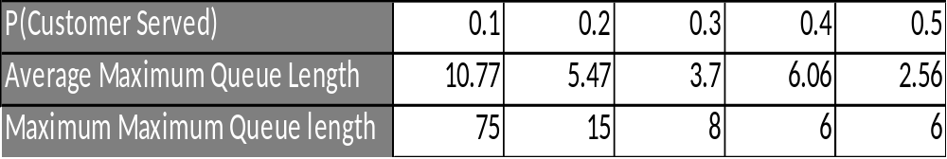
Example: Input Parameters
Varied the probability that a customer is served in a time step and got:
But all of these results assumed the same customer arrival probability of 0.2.

Slide 26
The Wrong Way
When dealing with multiple input, the wrong way to do sensitivity analysis is:
One-Factor-At-A-Time (OFAT)
Why?
Because all sensitivity runs would be based on model that contained a input variable that we are not sure about.
So if that second input variable is wrong, then all our sensitivity results would invalid.

Slide 27
Sampling
Therefore, we should consider all possible combinations of input variables.
However:
The number of runs required can get quite large.
  So if have 10 variables with 10 possibilities each then: 10¹⁰ = 10,000,000,000 = 10 trillion runs.
  Even worse if any variable is a continuous one. Why?
Luckily, there is a way around this.

Slide 28
Latin Hypercube Sampling

Slide 29
Latin Hypercube Sampling
Latin Hypercube Sampling is a way to sample the space of all combinations of the input variables s.t.:
As sustainably smaller number of runs is needed.
You get similar results to if you had sampled the whole space!
It was derived especially for simulation and the problems of sensitivity analysis.

Slide 30
Papers
McKay, M.D.; Beckman, R.J.; Conover, W.J. (1979). "A Comparison of Three Methods for Selecting Values of Input Variables in the Analysis of Output from a Computer Code“. Technometrics (American Statistical Association) 21 (2): 239–245.
Iman, R.L.; Helton, J.C.; and Campbell, J.E. (1981). "An approach to sensitivity analysis of computer models, Part 1. Introduction, input variable selection and preliminary variable assessment". Journal of Quality Technology 13 (3): 174–183.
Blower, S.M.; Dowlatabadi, H. (1994). “Senstivity and Uncertainty Analysis of Complex Models of Disease Transmission: An HIV Model, as an Example”. International Statistical Review 62 (2): 229-243
Marino, S.; Hogue, I.B.; Ray, C.J.; Kirschner, D.E. (2008); “A Methodology for Performing Global Uncertainty and Sensitivity Analysis in Systems Biology”. Journal of Theoretical Biology 254: 178-196

Slide 31
Latin Hypercube Sampling
Method imposes a grid over the space of all combinations of the input variables. This is used to take samples from
Comes from ‘latin square’, which is generalized to ‘Latin Hypercube’

Slide 32
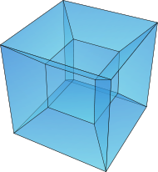
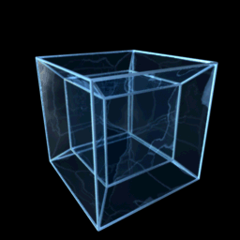
Hypercube
Stick to Euclid’s Elements:
We are only going to visualize 2-D in examples
Notes:
Second most published book in history
First is the bible

Slide 33
LHS Mechanism
STEP 1: Select the number of runs you will to carry out, say ‘n’.
STEP 2: For each ‘m’ input variable, choose a probability distribution that represents the range of possible values it could take.
STEP 3: For each input variable:
  Divide each probability distribution into ‘n’ equal-probable bins.
  Choose a value from each bin.
STEP 4: Randomly combine these values, take one value (without replacement) from each input variable.
STEP 5: Run the simulation ‘n’ times using the combinations from step 4.

Slide 34
LHS Mechanism
STEP 1: Select the number of runs you will to carry out, say ‘n’.
There is no exact rule on this but you will be performing statistical test on the results later, so I would say:
n > m
At least 30, ideally 100
  - Unless the simulation runs are too long
Your initial judgment to:
  - How complex is the simulation?
    More complex implies more runs needed.
  - How sensitivity do you think the simulation is to your input parameters?
    More sensitivity implies more runs needed.

Slide 35
Example: Fast Food Restaurant
For the fast food restaurant results, I believe that the out put is quite sensitive to input parameters. I will, however, choose a sample size of ‘4’ for this example, because:
Each runs has to be repeated at least 30 times because we are dealing with a stochastic simulation.
This is a toy example in a lecture and I am feeling lazy.

Slide 36
LHS Mechanism
STEP 2: For each ‘m’ input variable, choose a probability distribution that represents the range of possible values it could take.
See later in the lecture …
Remember: Yon need to be able to calculate probability of the bins.

Slide 37
Example: Fast Food Restaurant
From the earlier description, I have:
  P(customer service completion in a time-step) ∈ [0.1, 0.5]
  P(customer arrives in a time-step) ∈ [0.1, 0.3]
As I do not have any further information about these input parameters, I will assume that:
  P(service) ~ U[0.1, 0.5]
  P(arrives) ~ U[0.1, 0.3]

Slide 38
LHS Mechanism
STEP 3: For each input variable:
  Divide each probability distribution into ‘n’ equal-probable bins.
The uniformed distribution is quite easy to do this. However, other distribution can be hard to determine this.
Given ‘n’ bins for input parameter ‘X’ s.t.
P(X ∈ bin “i”) = P(X ∈ bin “j”) ∀i,j ∈ {1, 2, …, n}
Σ _{i ∈ {1, 2, …, n}} P(X ∈ bin “i”) = 1

Slide 39
Example: Fast Food Restaurant
  The bins for P(service) are:
  [0.1, 0.2], [0.2, 0.3], [0.3, 0.4], [0.4, 0.5]
  The bins for P(arrival) are:
  [0.1, 0.15], [0.15, 0.2], [0.2, 0.25], [0.25, 0.3],
These bins could be anything I like i.e.
  [0.1, 0.125] ∪ [0.275, 0.3], [0.125, 0.15] ∪ [0.25, 0.75],
  [0.15, 0.175] ∪ [0.225, 0.25], [0.175, 0.225]

Slide 40
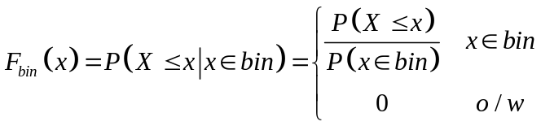
LHS Mechanism
STEP 3: For each input variable:
  Divide each probability distribution into ‘n’ equal-probable bins.
  Choose a value from each bin.
This can done as follows:
Define the a new probability distribution for each bin:
2) Determine the inverse function ‘F⁻¹_{bin}(x)’
3) Use the inverse method to generate a random value
  Generate U~U(0,1)
  F⁻¹_{bin}(U)

Slide 41
Example: Fast Food Restaurant
For the uniformed distribution bins this is relatively easy to do for a bin [a,b] , just:
  Generate U~U[0,1]
Take u.(b-a)+ a
The sample I got:
  From the bins of P(service) are:
  0.148, 0.216, 0.374, 0.444
  From the bins of P(arrival) are:
  0.135, 0.191, 0.247, 0.282

Slide 42
LHS Mechanism
STEP 4: Randomly combine these values, take one value (without replacement) from each input variable.
There are several ways that this can be done. In Excel, I put the parameter values next to uniformly random number in a list, then ordered the list using the ‘sort’ function.
There are many ways to do this sorting.

Slide 43
Bin Combinations
Sample Size: 2

Slide 44
Bin Combinations
Sample Size: 3

Slide 45
Example: Fast Food Restaurant
After ordering the values, the parameter pairs are:
P(service) P(arrival)
0.374 0.247
0.444 0.135
0.216 0.282
0.148 0.191

Slide 46
Questions about Method
Why not just take mid-point?
  Because might be some bias introduced due to the way we construct our bins
    Cycling effects could occur with input variables that just happen to be your midpoints values
    Y = Sin(X) is an example of a cycling relationship

Slide 47
Dealing with Complex Systems!
Sampling does not mean the we cover every possibility

Slide 48
LHS Mechanism
STEP 5: Run the simulation ‘n’ using the combinations from step 4.
Now just enter the sample input parameters into the simulation and run it the required time

Slide 49
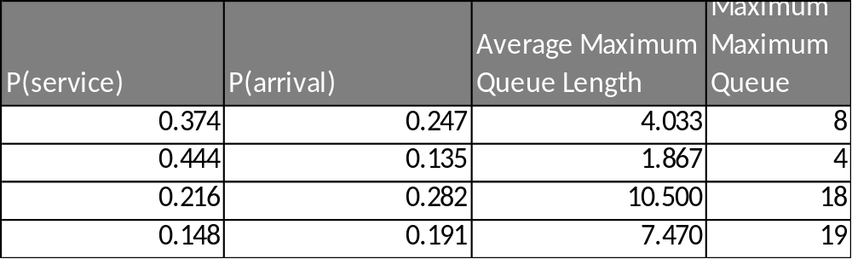
Example: Fast Food Restaurant

Slide 50
Choosing input variable Distributions

Slide 51
Input Variable Distributions
One of the problems of SA is that you are uncertain about the input variable so why would you be certain about the input variables distribution?
  Potentially jumping out of the frying pan into fire!
There are some rules-of-thumb you can follow for choosing the input variables distribution.

Slide 52
Choosing Input Distribution
There are varies qualities that you might already know about the input variables distribution:
I know the distribution of the input variable
  Then use that distribution!
I know the shape of the distribution
  Then approximate to an standard distribution or create an empirical distribution of the shape

Slide 53
Choosing Input Distribution
I am only worried about rounding errors
  Determine the maximum, M, and minimum, m, that the input variable could be
  Use X~U(m, M)
I only know the Maximum and minimum
  Then use a Uniform Distribution as above

Slide 54
Choosing Input Distribution
I only know the Maximum, minimum and average
  Then use a Triangular Distribution for these values
I only know average and variance
  The use the Normal Distribution for these values

Slide 55
Choosing Input Distribution
Use your common sense:
  What should the distribution look like?
    Remember descriptions of distributions also included what they could represent in the real world
      E.g., Bernoulli distribution can represent a coin toss
  Does the variable have to be positive?
    Then the minimum is at least zero.

Slide 56
(Sensitivity) Analysis

Slide 57
Analysis
Now you completed the runs, what next?
  You need to analysis the results to determine if there are any abnormalities with your results
  There are various standard ways to do this

Slide 58
Analysis Approaches
One-Factor-At-A-Time (OFAT)
  Look at the range of outputs compared to the input
  What is acceptable variation? SME
  Scatter graphs
Local methods
  Take partial differentiates of output variable to input variable
  Effectively OFAT

Slide 59
Analysis Approaches
Correlation between output variable and input variable
Linear regression
  Creating a meta-model of the simulation
Variance-based methods
  Look at variance of conditional expectation

Slide 60
Independence
All above methods assume independence between input variables. Some don’t:
Emulators
  Create model of relationship between input and output variables
  Making a metamodel!
    (Sounds like work and lots of assumptions to me)
Partial Correlation Coefficient (PCC)
  PCC not deal with Compound effects of inputs
  PCC assume linearity effects

Slide 61
A check
I have added this slide to check whether you have actual gone though the lecture notes
The answer to the question is that you should read the slides.

Slide 62
Partial Correlation Coefficient (PCC)

Slide 63
Partial Correlation Coefficient
Partial Correlation Coefficient is a correlation coefficient that tries to remove the effects on correlation between input variables when working out the correlation between the input variable and output variable.

Slide 64
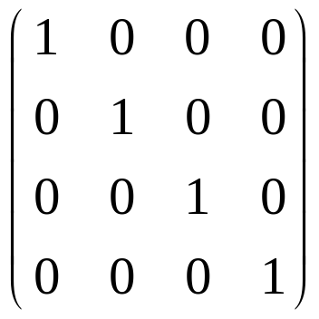
Matrix
A matrix: A = {a_{ij}}
A∈M_{nxm}(R)
    ‘n’ rows
    ‘m’ column
‘a_{ij} ‘ is an element of ‘A’
It represent the value in the;
    i-th row
    j-th column

Slide 65
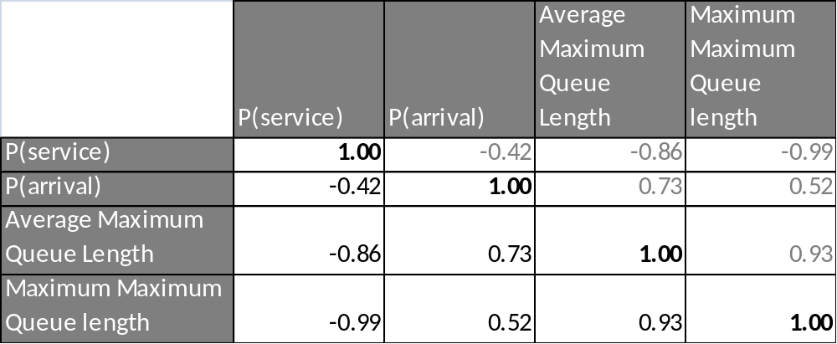
Example continued…
This is simply the correlation for each pair of inputs/outputs. Notice:
The diagonal is always ‘one’.
The values are reflects along the diagonal.

Slide 66
Correlation does not imply causation!
Output: Probability of developing lung cancer
# cigarettes smoked
# of ‘2.5 men’ Episodes Watch
“From the sensitivity analysis of our simulation, we found that not only does amount a person smokes affect the chance of developing lung cancer but also the number of episodes of ‘Two and an half men’ increase the risk”
- Very Important Study Team member

Slide 67
Causation
“Correlation does not imply Causation”
  Cancer causes smoking!
Possible reasons for correlation of ‘A’ and ‘B’
‘A’ causes ‘B’
‘B’ causes ‘A’
By chance
Third-party
Self-reinforcing or vicious circle
Notes:
Causation: smoking cause cancer
Third-party: sleeping in shoes causes headaches, actually going to bed drunk
Vicious circle: Bankrun
By chance: SUV drivers say global warming and carbon emissions

Slide 68
Partial Correlation Coefficient
When conducting sensitivity analysis on multiple input parameters, we need to remove the affects of the other input parameters within our correlation statistics.
This is done using the ‘Partial Correlation Coefficient’.

Slide 69
Partial Correlation Coefficient
The ‘Partial Correlation Coefficient’ is quite difficult to determine, we are going to take the matrix approach.
There are other approaches.
They are just as hard!

Slide 70
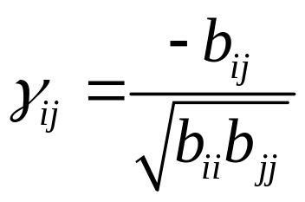
Partial Correlation Coefficient
Determine the ‘Correlation Matrix’ C = {r_{ij}} for all variables including the output variable
Determine the inverse of C. B = C⁻¹
  Matrix Inverses are tricky things
  Can be done in MS Excel
The Partial Correlation Coefficient between the i-th and j-th variable is:

Slide 71
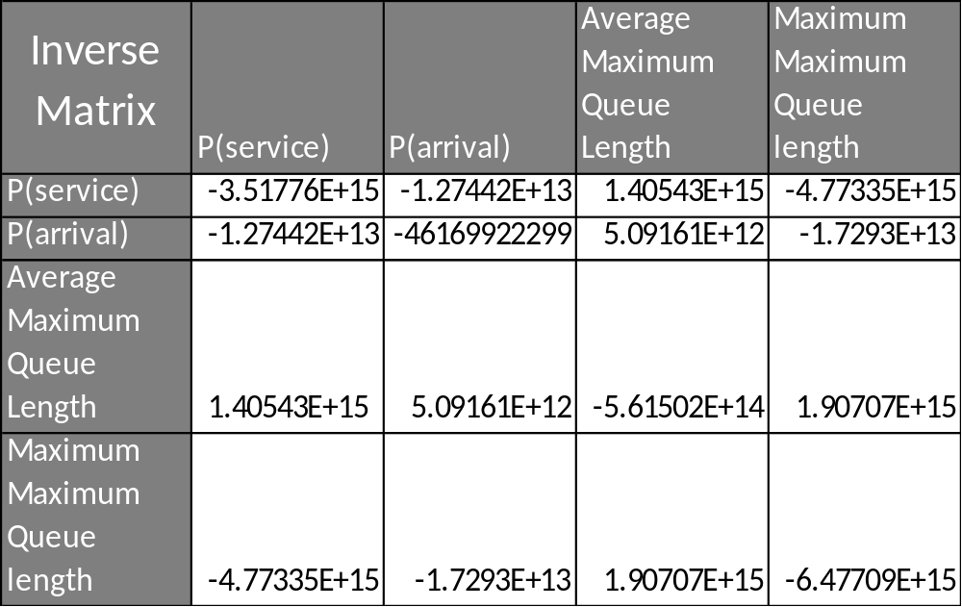
Example: Fast Food Restaurant

Slide 72
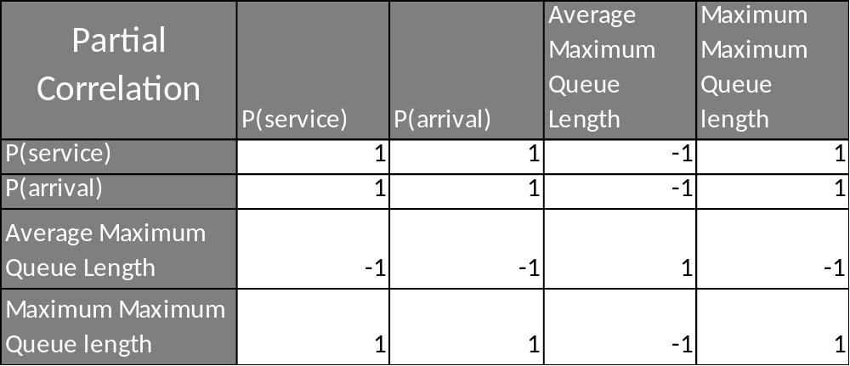
Example: Fast Food Restaurant

Slide 73
Test Statistic
As will normal Pearson’s correlation, there is a requirement to conduct a test to see:
H0: There is NO partial correlation between the input parameter and the output parameter

Slide 74
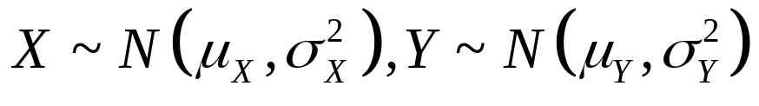
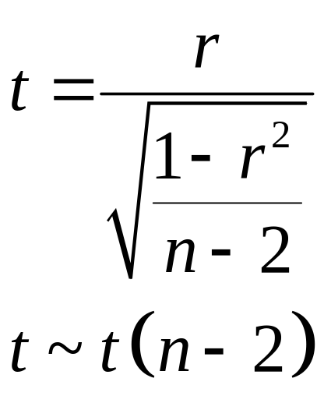
Test Statistic
← Dodgy Assumption
If X and Y are uncorrelated, the sample correlation coefficient ‘r’ from a sample of ‘n’, then:
This is a two-tailed test, so need consider is
P(|T| >|t|)

Slide 75
Hold On!
This is just the same test as for normal correlation!
Theory goes that if removed all outside influences that just normal correlation
  A little dodgy assumption
  But PCC doesn’t have own test statistic
Can at least take into account other variables!

Slide 76
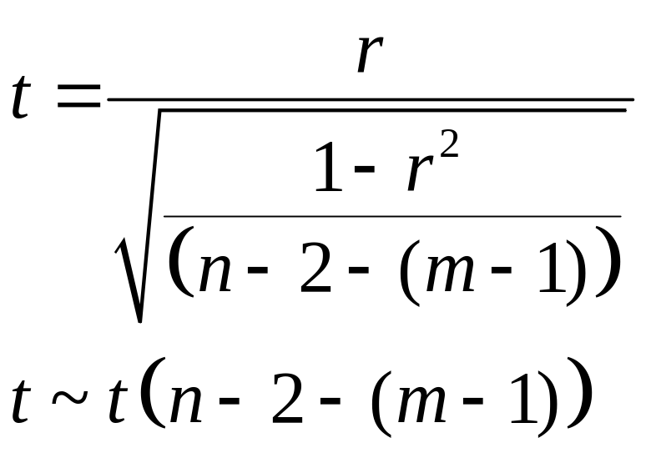
Test Statistic
← Dodgy Assumption
If X and Y are uncorrelated, the sample correlation coefficient ‘r’ from a sample of ‘n’, then:
m := # of input parameters (not including single Output parameter)

Slide 77
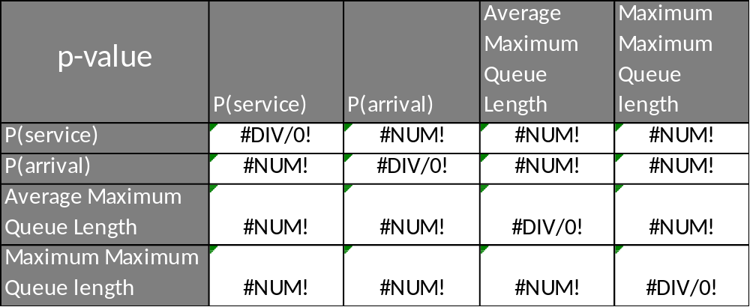
Example: Fast Food Restaurant
Not really a surprise! I get all errors for my test statistic
Because my sample size is too low

Slide 78
Second Example: Fast Food Restaurant

Slide 79
Second Example
Increase the sample size to 10.
Repeated the LHS and PCC process

Slide 80
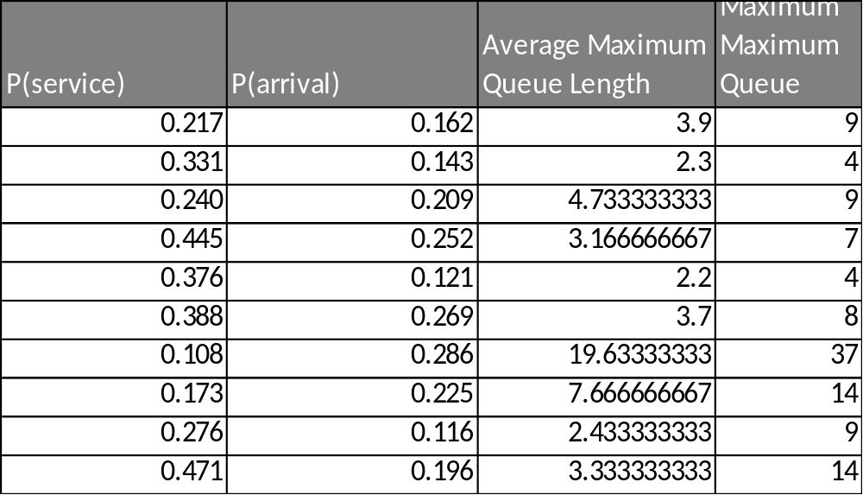
Example: Fast Food Restaurant

Slide 81
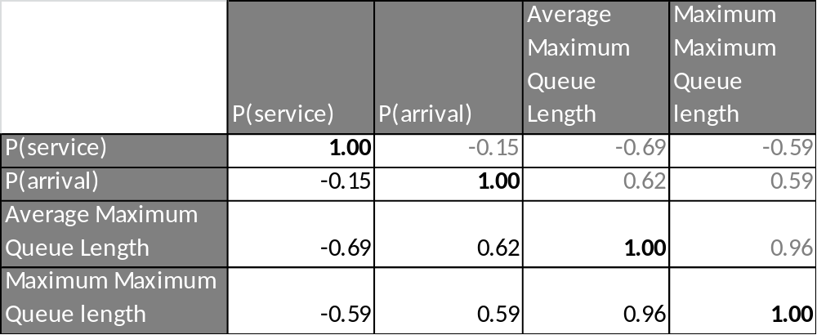
Correlation Matrix

Slide 82
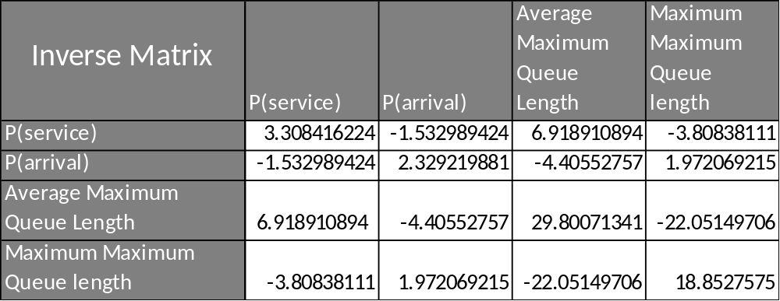
Example: Fast Food Restaurant

Slide 83
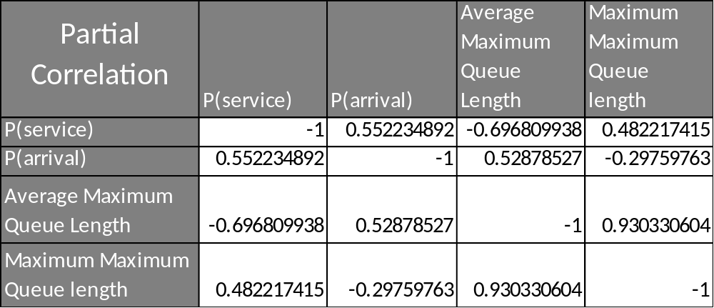
Example: Fast Food Restaurant

Slide 84
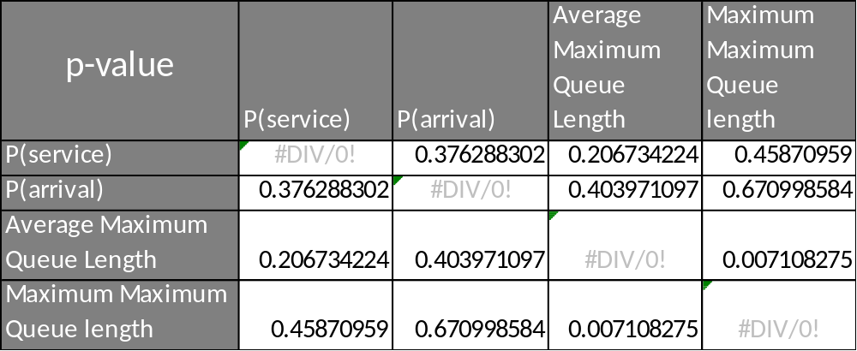
Example: Fast Food Restaurant

Slide 85
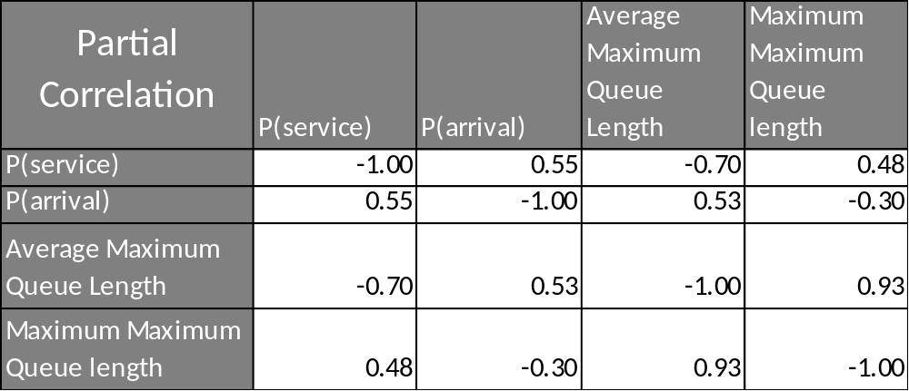
Example: Fast Food Restaurant

Slide 86
Question
So why the weird results with “maximum maximum queue length?”
  Consider example 3 where we remove Average maximum queue length

Slide 87
Third Example: Fast Food Restaurant

Slide 88
Correlation Matrix

Slide 89
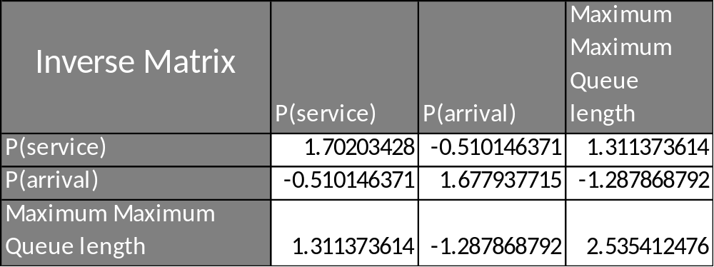
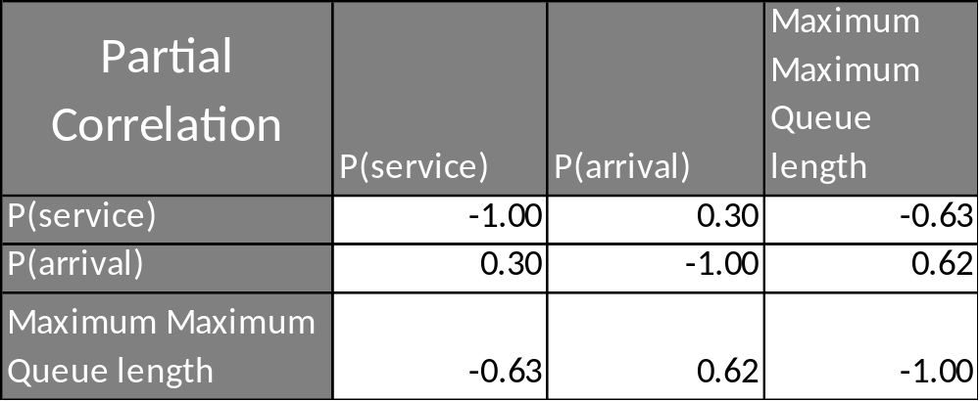
Example: Fast Food Restaurant

Slide 90
Question
So why the weird results with “maximum maximum queue length?”
When we remove the effects of “average queue length,” the PCC is as expected. Why?
  Because the original Max Max correlation had the effects from the average queue length removed!
SO: Be careful what you include!

Slide 91
End Presentation

