Slide 1



MSIM895
ABMS
Topic 6 – Output Analysis

Slide 2
Outline
Here is what is covered
Norms
Voronoi Diagrams
Cluster Analysis
Multivariate Regression (extra)

Slide 3
NOrms

Slide 4
Distances
For a n-dimensional vector x, mathematics uses 3 standards ways, called norms, to measure its distance from zero:
Manhattan norm or L¹-norm
Euclidean norm or L²-norm
Maximum norm or L∞-norm
The L²-norm is the most commonly used

Slide 5
Distances
Manhattan norm or L1-norm
||x||₁ = Σ |x_{i}|
Euclidean norm or L2-norm
||x||₂ = (Σ (x_{i})²)^{0.5}
Maximum norm or L∞-norm
||x||∞ = max{|x₁|, |x₂|, …., |x_{n}|}

Slide 6
Distances
Distance between points for p-norm? Easy, just use:
||x-y||_{p}
We will be using L²-norm unless otherwise stated

Slide 7
Voronoi DiAgrams

Slide 8
Voronoi Diagrams
Georgy Voronoy (1868-1908)
Voronoi diagrams are a way of visually splitting up a 2-D space based on the location of certain points
The approaches creates polygon around each point which indicates all locations which are closest to that point

Slide 9
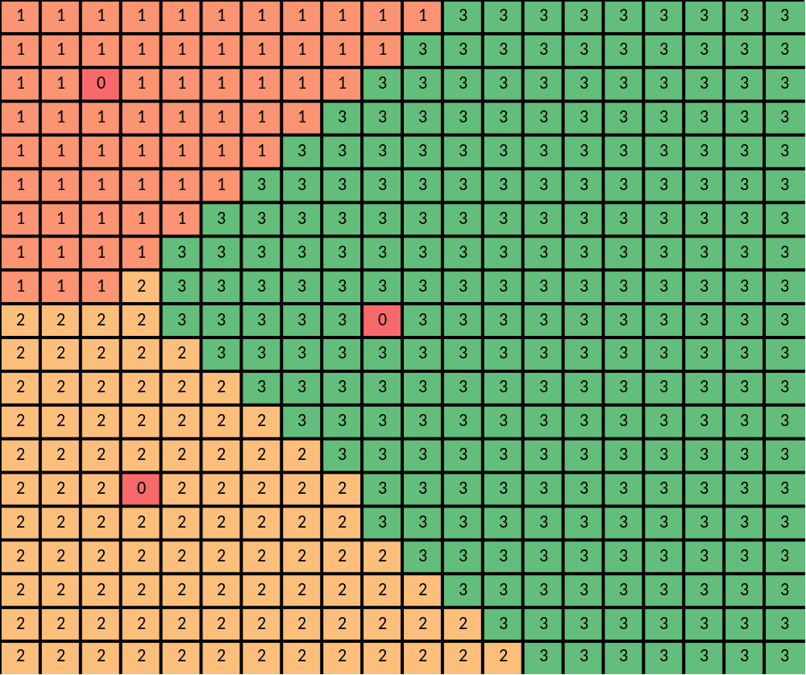
Voronoi Diagram

Slide 10
Voronoi Diagrams
Examples of use could be:
Potential Catchment areas for supermarkets
Determining the catchment area for polling stations
Determining the location of cellphone towers
Determining the rainfall in a area based on a limited number of collection points

Slide 11
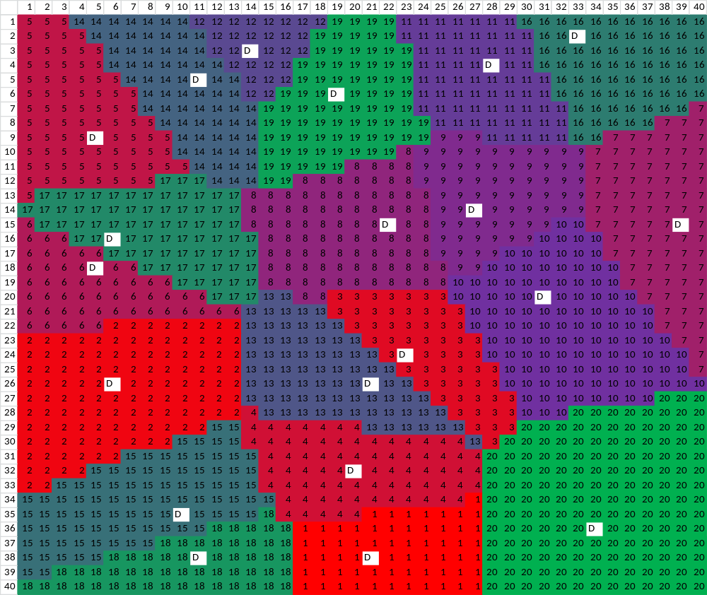

Slide 12
Voronoi Diagrams
Ever noticed that similar types of stores tend to be near each other, e.g., hardware stores, garages, etc.
Apart from a area become known for some industry, e.g., used car area, why else might shops wanted to be close to each other?
Why might you want to use the L¹-norm?

Slide 13
Cluster Analysis

Slide 14
Cluster Analysis
Cluster Analysis is an exploratory statistical method for splitting data into groups.
There are two main approaches:
  Hierarchical Clustering
  K-mean Clustering
Notes:
Check go add-ins now for later.

Slide 15
Hierarchical clustering
Hierarchical cluster is an iterative approach that builds ups groups of points that are close together, or clustered.
It is the groups that formed at each iterative step that is of interest
Notes:
Check go add-ins now for later.

Slide 16
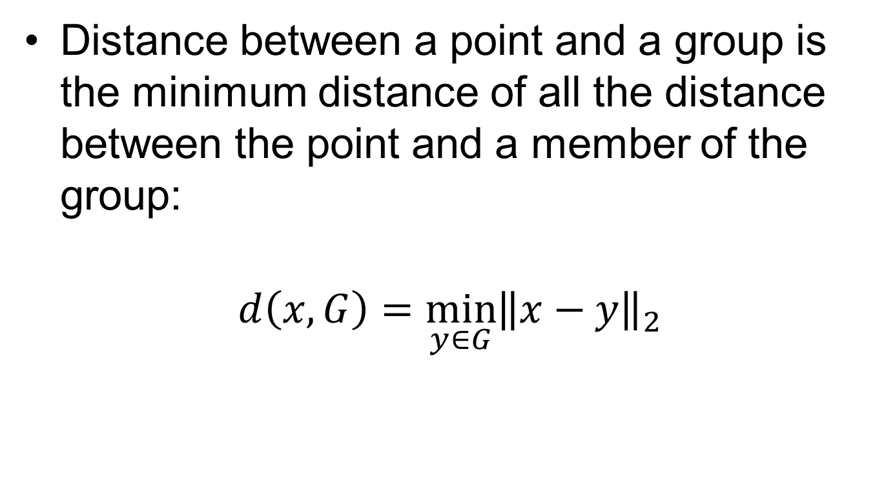
Hierarchical clustering
Distance between a point and a group is the minimum distance of all the distance between the point and a member of the group:
$$d\left(x,G\right)=\min_{y∈G}{{\left\|x−y\right\|}_{2}}$$
Notes:
Check go add-ins now for later.

Slide 17
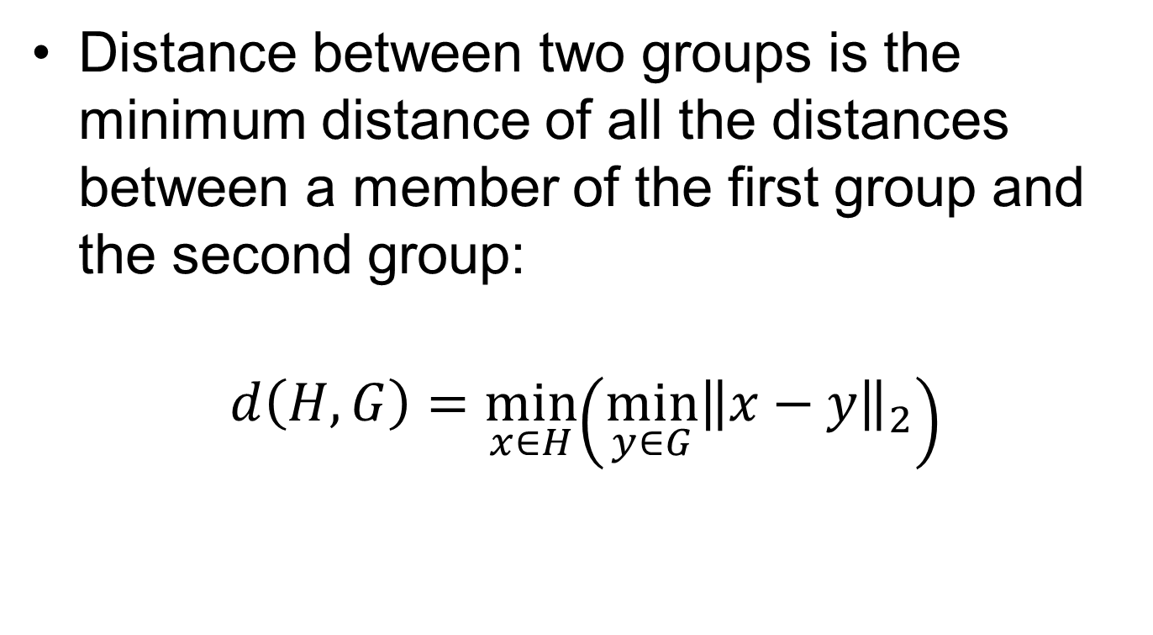
Hierarchical clustering
Distance between two groups is the minimum distance of all the distances between a member of the first group and the second group:
$$d\left(H,G\right)=\min_{x∈H}\left({\min_{y∈G}\left\|x−y\right\|}_{2}\right)$$
Notes:
Check go add-ins now for later.

Slide 18
Algorithm
Determine which two points are closest and form a group
Determine which two points or groups are closest and form/update a group
Return step two until all point in one group
Track distances and groups at each step

Slide 19
Dendrogram
Dendrograms are graphical representations of the results from hierarchical clustering
The graph shows the formation of groups by either connecting two points, a point to an existing group, or two groups
The x-axis shows the discrete points
The y-axis shows the distance the points/groups were connected at

Slide 20
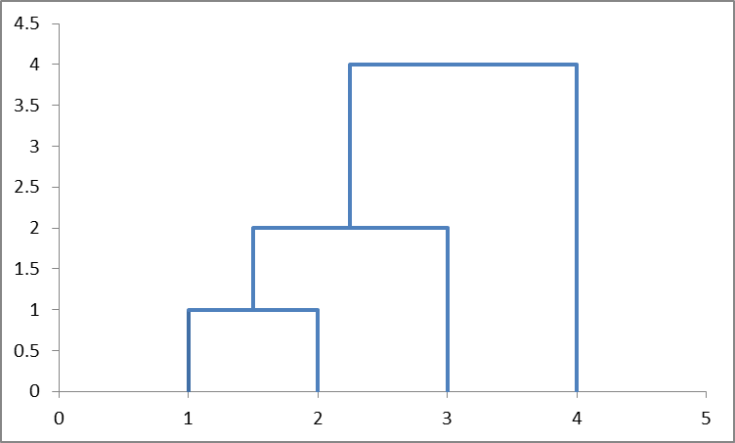
Dendrogram
Distance

Slide 21
Dendrogram
Dendrograms are draw in an hierarchical manner
  Connect all points that form a group of two at appropriate distances (in the y-axis)
    Reorder data points if overlap
  Connect all points that form a group of three with a group of two
    Reorder data points if overlap
  Connect all points that form a group of four with a group of three
    Reorder data points if overlap
  Connect all groups of two that form a group of four with another group of two
    Reorder data points if overlap
  Etc.
You can always draw a dendrograms without overlap

Slide 22
K- mean clustering
K-mean clustering is a different approach to hierarchical cluster. In K-mean clustering you split the data into “k” groups basis such to minimize the total distance between each point and the mean point of its associated group
Notes:
Check go add-ins now for later.

Slide 23
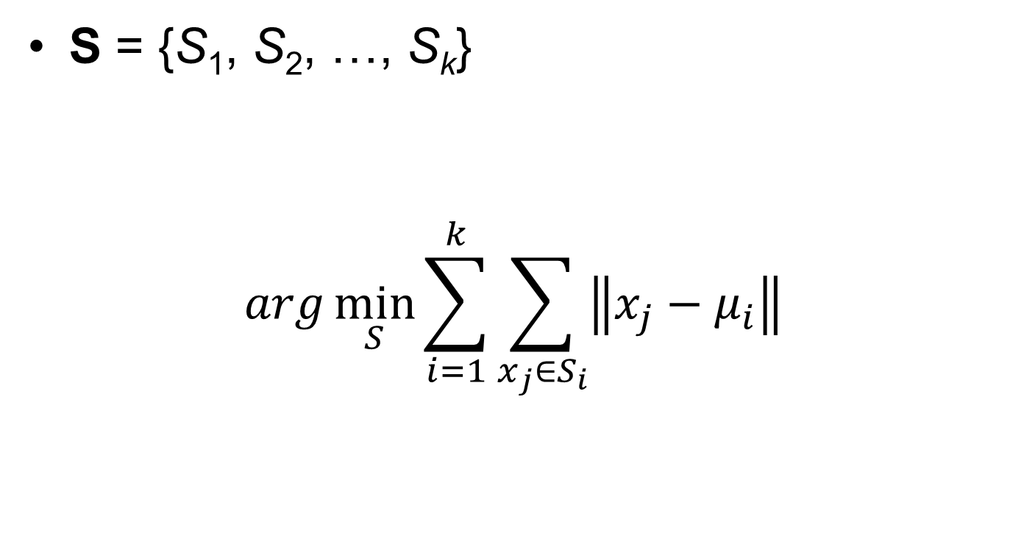
K- mean clustering
S = {S₁, S₂, …, S_{k}}
$$arg\min_{S}{\sum_{i=1}^{k}{\sum_{x_{j}∈S_{i}}{\left\|x_{j}−μ_{i}\right\|}}}$$
Notes:
Check go add-ins now for later.

Slide 24
K- mean clustering
Determining the grouping split can be done in a number of different way including using the solver add-on in Microsoft Excel
Notes:
Check go add-ins now for later.

Slide 25
K- mean clustering
In the following diagrams shows the split of some data into 2,3,4, and 5 groups
The means are shown at black dots and each group has its own color
(Ignore the black dot on the (0,0) point)
Notes:
Check go add-ins now for later.

Slide 26
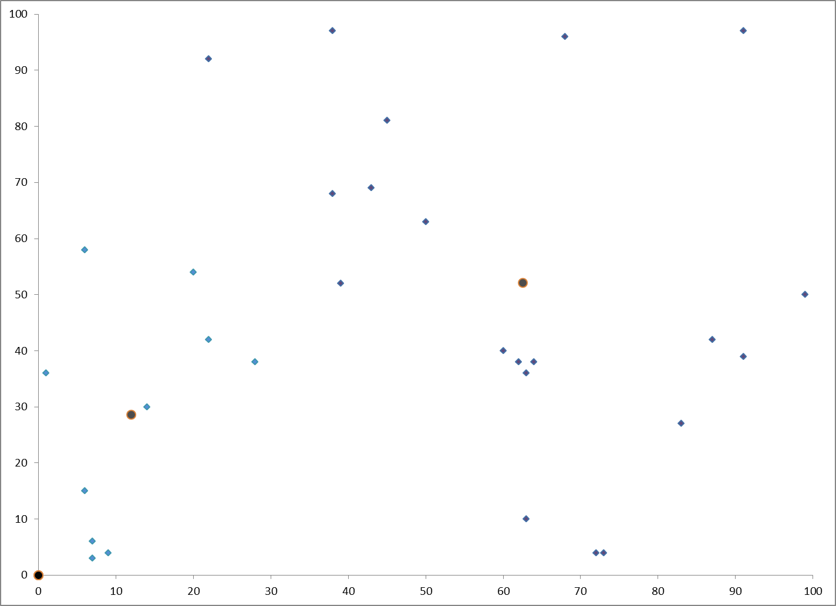

Slide 27
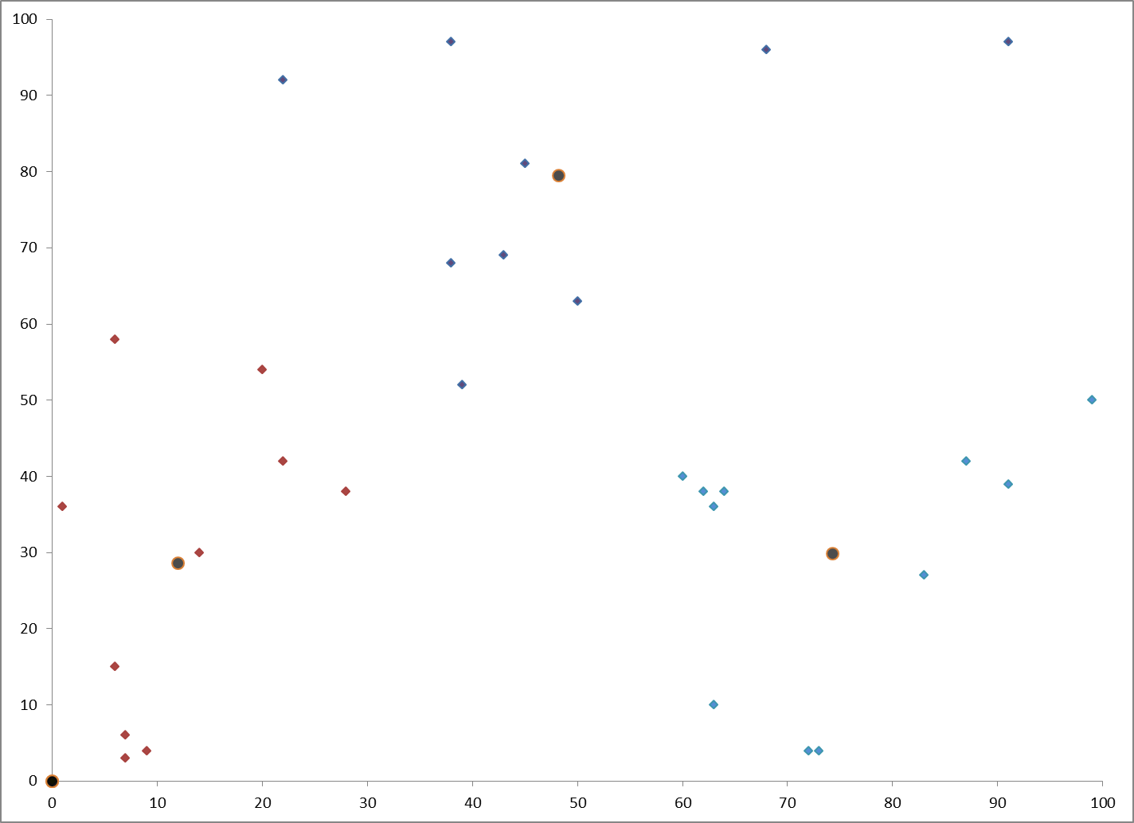

Slide 28
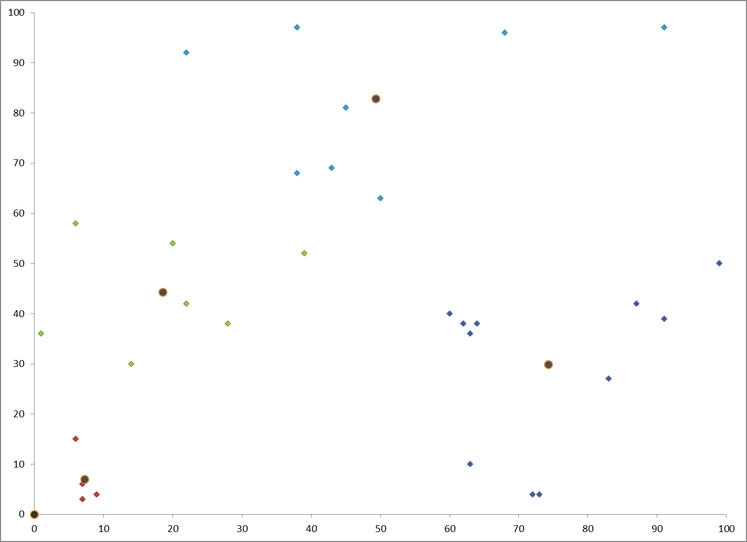

Slide 29
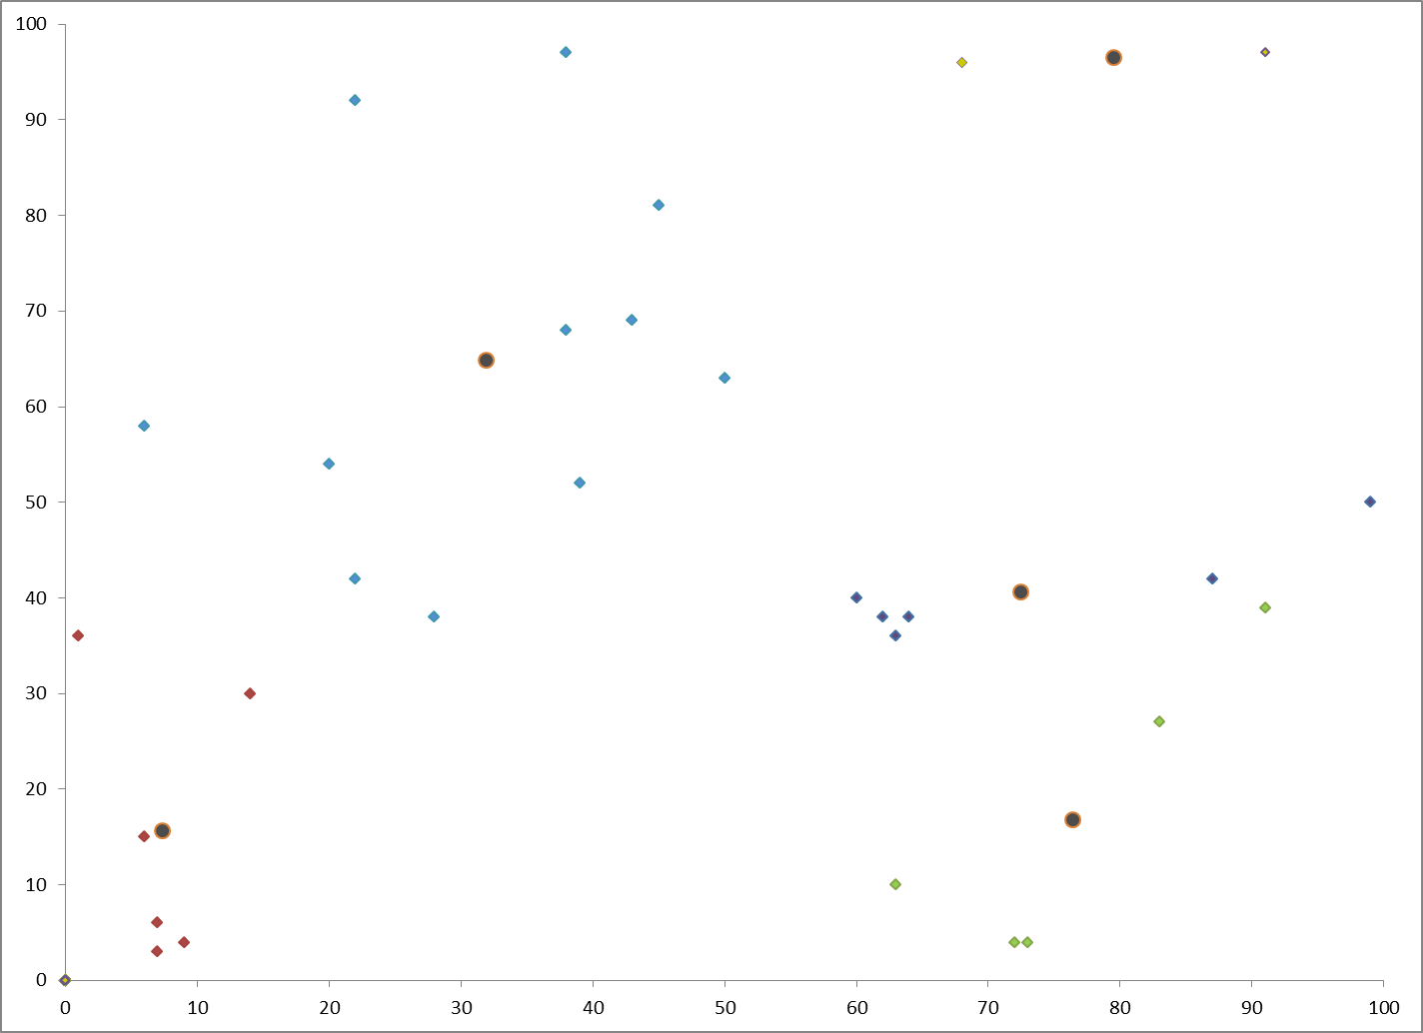

Slide 30
K- mean clustering
Determining how many groups should be used can be difficult and requires looking at the data.
What happens if k = 1?
What happens if k = n?
Notes:
Check go add-ins now for later.

Slide 31
Software Packages
Voronoi diagrams
  MATLAB, SPSS(?)
Hierarchical clustering
  MATLAB, SPSS
K-mean Clustering
  MATLAB, SPSS
Multivariate Regression
  MS Excel, SPSS, MATLAB

Slide 32
End Presentation

