Slide 1



MSIM895
ABMS
Topic 6 – Comments on Regression

Slide 2
Multivariate Regression

Slide 3
Multivariate Regression
NOT going to go over details of multivariate regression
AM going to go over some of the dangers
  Curvilinear
  Multicollinearity
  Outliners
  Heteroskedasticity
AM going to discuss relationship with linear regression

Slide 4
Equations
Y = α + β₁X₁ + β₂X₂ + … + β_{p}X_{p}
Y is a continuous dependent variable
X_{i} is a independent variable (or predictor variable)
α is the regression coefficient for the intercept
β_{i} is a regression coefficient

Slide 5
Solving
Solving is the same as for linear regression only in higher dimensional space.
You are trying to minimize the error in distance from all the data points to the regression line using one of the norms.
  Can use different norms so have different types of regression analysis!
  Ordinary Least Squares (OLS) is not the L2-norm

Slide 6
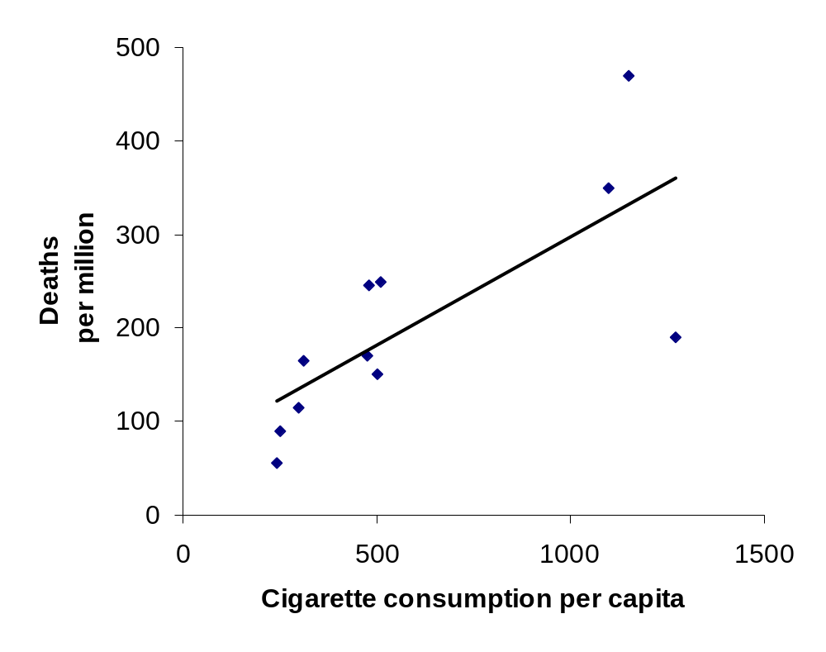
Solving (standard approach)
Solution: select the line with an intercept and gradient that ‘best fits’ the data
The line that does this is the one that minimises the sum of the squared values of the vertical distances between each point and the line
.. i.e. the line that minimises ‘the sum of squared residuals’
Y
X_{i}

Slide 7
Curvilinear
As with linear regression, the relationship between the dependent and independent variables might not be linear
If the relationship is a curve then called curvilinear
Can be a lot harder to spot a non-linear relationship
  Recommend graph each independent variable against the dependent
  Does not guarantee you will see a non-linear relationship

Slide 8
Multicollinearity
What if got a correlation between independent variables? This is called multicollinearity
Big problem because multivariate regression results are no longer valid if some variables are correlated
Need to remove independent variables until all independent of each other
  Rule of thumb: correlated > ±70% dependent
Run regression multiple times with different variables to compare results.

Slide 9
Outliners
ALL real world datasets seem to contain outliners.
You need to decided whether to remove them or not:
  Can you justify removing them other than they are an outliner?
    Could the data be a mistake?
    What other special properties does that outliner have?

Slide 10
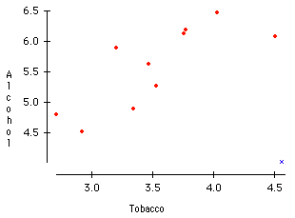
Average weekly household spending on alcohol and tobacco (£s), UK regions 1981
Correlation
r = 0.224 with N Ireland
r = 0.784 without N Ireland
N Ireland
Source: http://lib.stat.cmu.edu/DASL/Stories/AlcoholandTobacco.html

Slide 11
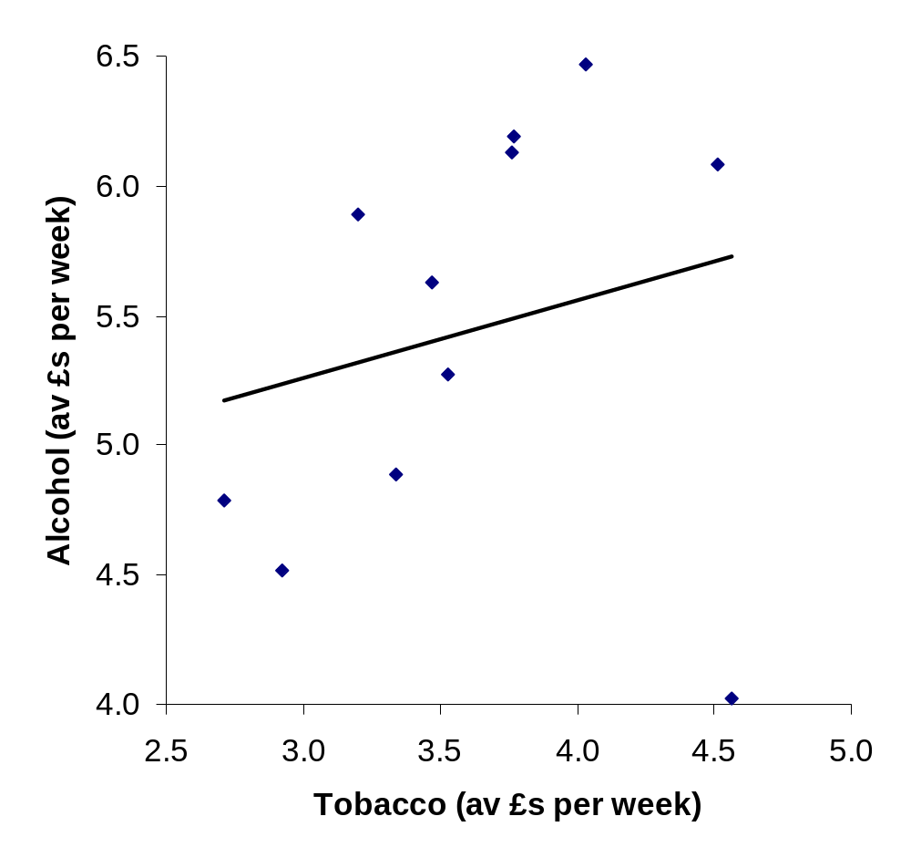
Regression line including N. Ireland
alcohol = 4.35 + 0.30 x tobacco
r² = 0.05
Warning: Cut-off graphs (source from a statistician!)

Slide 12
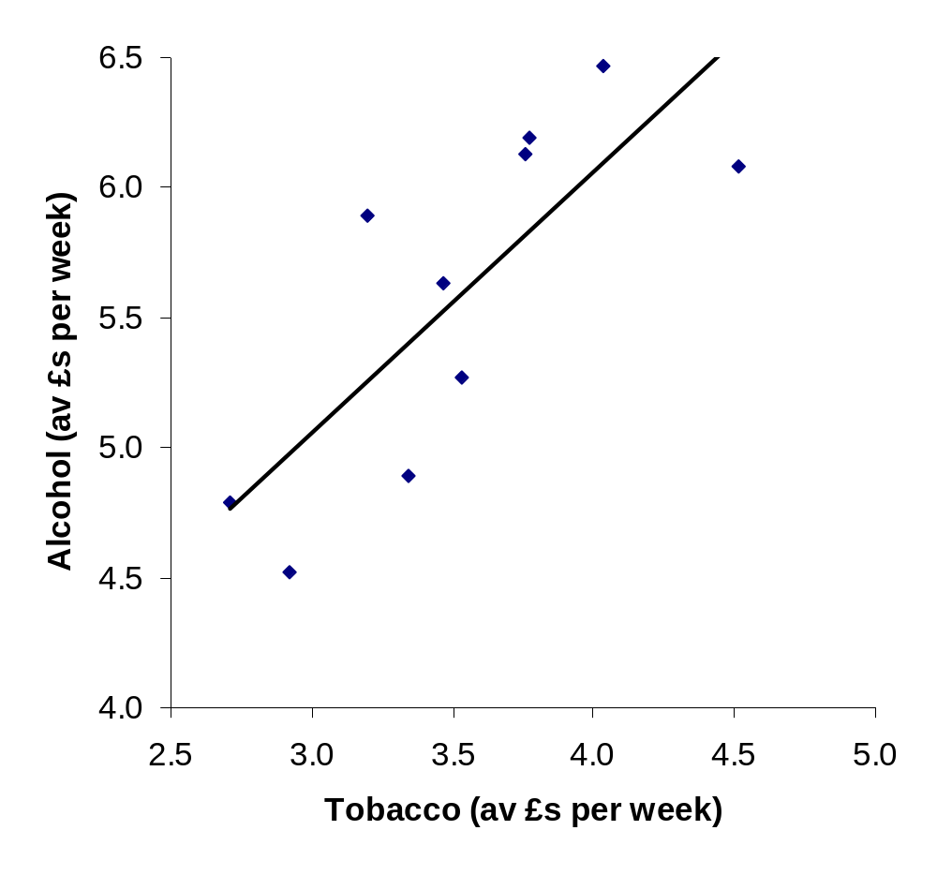
Regression line excluding N. Ireland
alcohol = 2.04 + 1.01 x tobacco
r² = 0.62

Slide 13
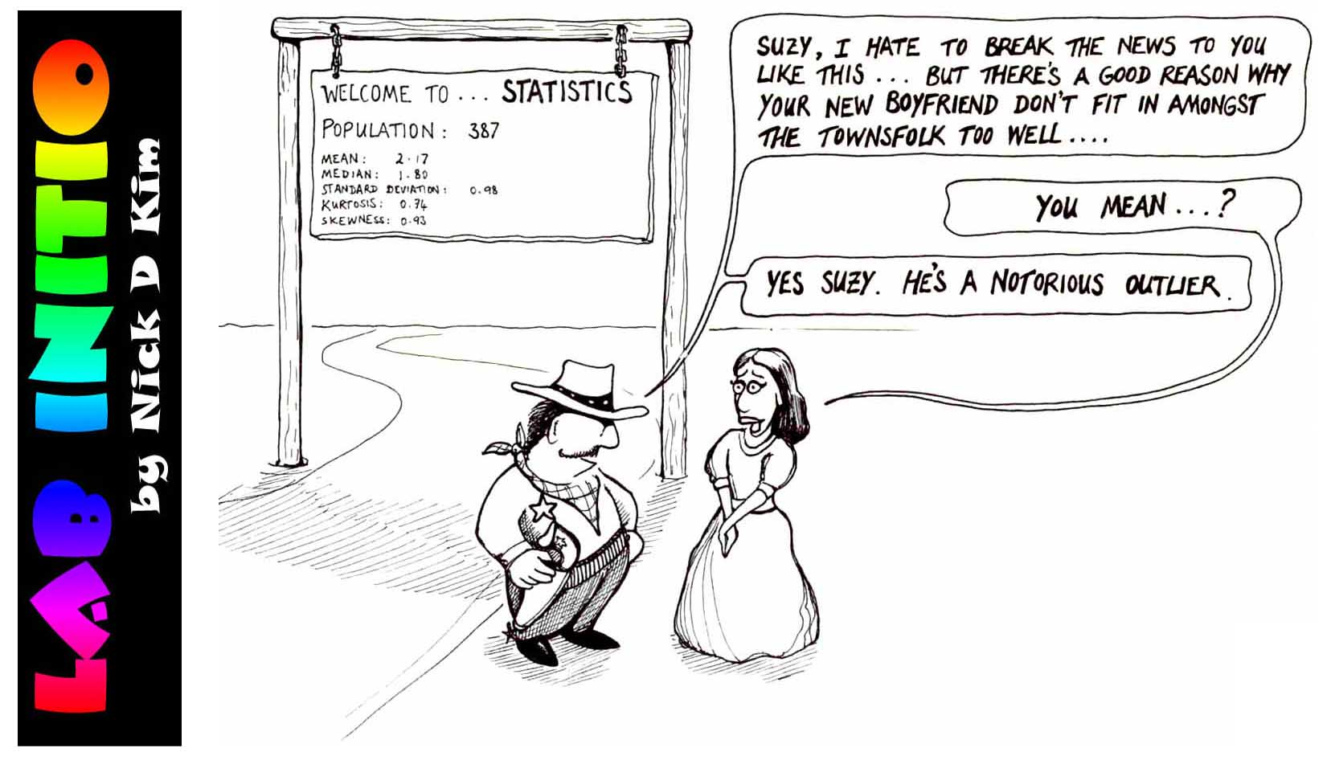

Slide 14
Heteroskedasticity
OLS assumes that, for any given value of the independent variables, the variance of residuals (errors), with respect to that value will be same no matter which value is chosen. This is called homoskedasticity
This is not always true! Then called Heteroskedasticity
Need to report if Heteroskedasticity in results or transform data by taking logs or normalizing somehow to make homoskedasticity

Slide 15
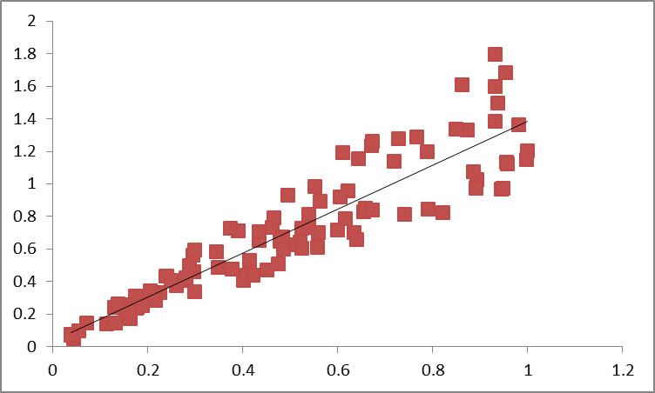
Heteroskedasticity

Slide 16
Using Regression
DO NOT make predictions outside the range of the data unless you are sure that this is a sensible thing to do
If in doubt, don't!

Slide 17
End Presentation

