Slide 1



MSIM895
ABMS
Repast Simphony

Slide 2
Outline
Here is what is covered
Zombie Tutorial
Background
Advanced Users
Helpful Hints
Batch Runs

Slide 3
Zombie Tutorial
Download and install Repast Simphony 2.0
  http://repast.sourceforge.net/download.html
Work through the Zombie Tutorial
  http://repast.sourceforge.net/docs/RepastJavaGettingStarted.pdf

Slide 4
GO through THE ZOMBIE Tutorial
(8 out of 10 class test questions on it)

Slide 5
Not working?
Try and get through as much as possible but it is likely that the tutorial will not work
Will try and help out in class

Slide 6
Background

Slide 7
Who?
Argonne National Laboratory
University of Chicago
Nick Collier
  Main Technical guy
Michael North
  Project Lead

Slide 8
Referencing Repast
Authors ask you to use reference
  North, M. J., T. R. Howe, N. T. Collier, and J. R. Vos. 2012. “A Declarative Model Assembly Infrastructure for Verification and Validation.” In Advancing Social Simulation: The First World Congress, edited by Shingo Takahashi, David Sallach, and Juliette Rouchier, 129–140. Tokyo: Springer Japan.
Notes:
Check go add-ins now for later.

Slide 9
I know that name?
Michael North is the repast lead
… and the same North as in:
  North, Michael J., and Charles M. Macal. 2007. Managing Business Complexity: Discovering Strategic Solutions with Agent-Based Modeling and Simulation. New York: Oxford University Press.
The mafia would call him “made” in ABMS

Slide 10
Which Repast?
Repast Simphony 2.0
Do not worry about:
  ReLogo
    Something for converting Net Logo into Repast
  HPC
    High Performance Computers
  Groovy
    This is being phased out (useless in my opinion)

Slide 11
Groovy
You want to be serious about Repast?
  DO NOT USE GROOVY
Why?
  No one else can help
  You still have to use all the same commands
Notes:
Check go add-ins now for later.

Slide 12

Java
Cadenhead, Rogers. 2012. Sams Teach Yourself Java in 21 Days. 6th ed. Sams Publishing.
Only need chapters 1–7
AM NOT EXPECTING YOU TO DO THIS FOR CLASS

Slide 13
Helpful Hints

Slide 14
Where go for help
If you think that you are going to seriously use Repast Simphony, then join the mailing list at:
  https://lists.sourceforge.net/lists/listinfo/repast-interest

Slide 15
Helpful Hints
If you are not sure about a repast command
  Highlight function in question and press ‘F3’
    Will open function declaration
Help can be found on the web:
    http://repast.sourceforge.net/docs/api/repast_simphony/overview-summary.html

Slide 16
Batch Runs
(Advanced users)

Slide 17
Batch Runs
Discussion on batch runs is not included in the tutorial so I have included here
Two things need to be done
  Change the batch run XML file
  Change the run parameters

Slide 18
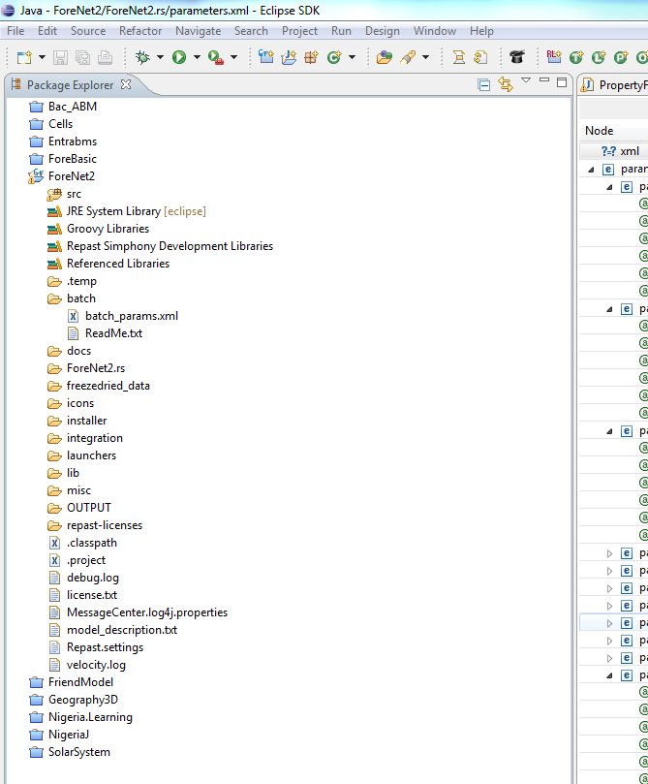
The Batch XML
File is located
hee

Slide 19
Example
<?xml version="1.0"?>
<sweep runs="200">
  <parameter name=“MyConstantName" type="constant" constant_type="number" value="0.5"/>
  <parameter name=“MyVaryParameterName1" type="list" value_type="int" values="6 8 9”/>
  <parameter name=" MyVaryParameterName2" type="list" value_type=“double" values="6.6 8.8 9.9”/>
</sweep>

Slide 20
Example
This just tells Repast how many runs to complete (i.e., 200)
<?xml version="1.0"?>
<sweep runs="200">
  …
</sweep>

Slide 21
Example
This is for controlling constants
  Notice that type is simply “number”
  Parameter will need to be define in parameter.xml
    See Tutorial
  <parameter name=“MyConstantName" type="constant" constant_type="number" value="0.5"/>

Slide 22
Example
This is for varying parameters
  Must define type “double”, “int”,
  Parameter will need to be define in parameter.xml
    See Tutorial
  Notices the “/” at end of declaration
    If left out, then will do one run for each value set for the other varying parameters
      i.e., Will do every permutation for all varying parameters
      Needs to be included in the last varying parameter
  <parameter name=" MyVaryParameterName2" type="list" value_type=“double" values="6.6 8.8 9.9”/>

Slide 23
Letting Repast where batch file is
What is important is that you tell it were the files are, therefore in batch configuration (found under the run buttom), you need:
-params "${workspace_loc:Project.Name}/batch/params.xml" "${workspace_loc:Nigeria.Learning}/nigerialearning.rs"
${workspace_loc:Project.Name} refers to where the project is. The “params.xml” can be called anything.
  I use “batch_param.xml”
By default, repast uses “-params {file_prompt: the batch run parameters file name: params.xml}”
  This will produce a prompt which is a pain so change it.

Slide 24
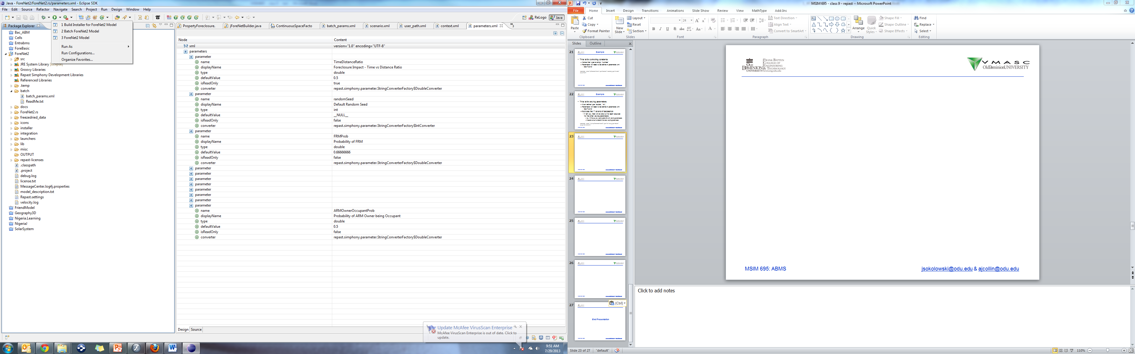

Slide 25
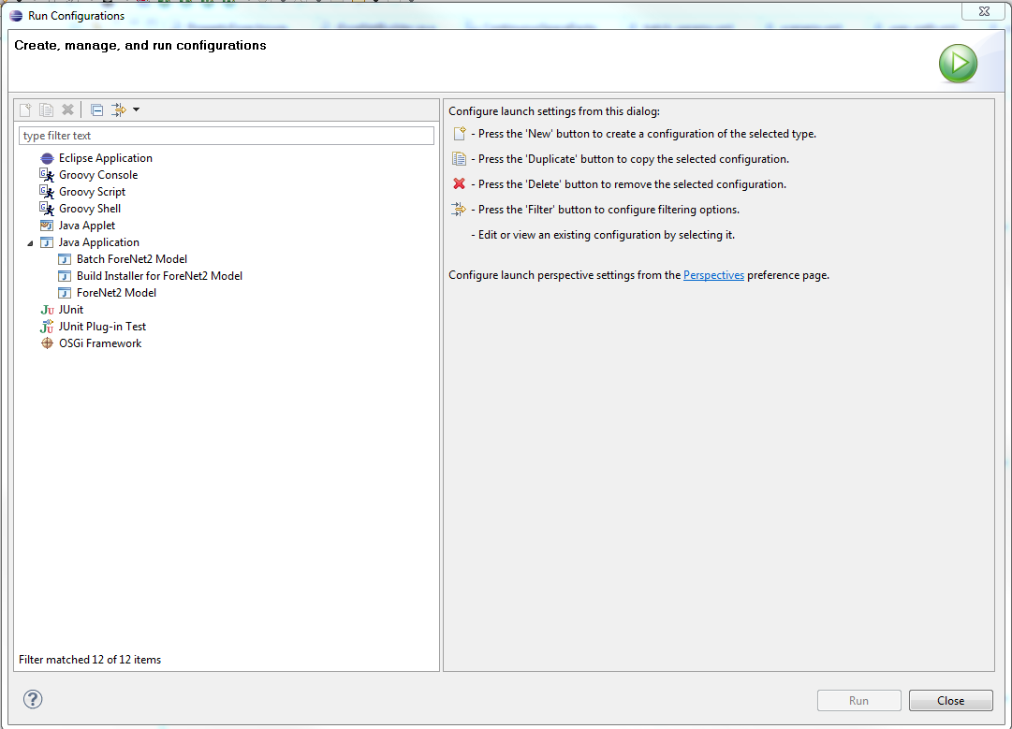

Slide 26
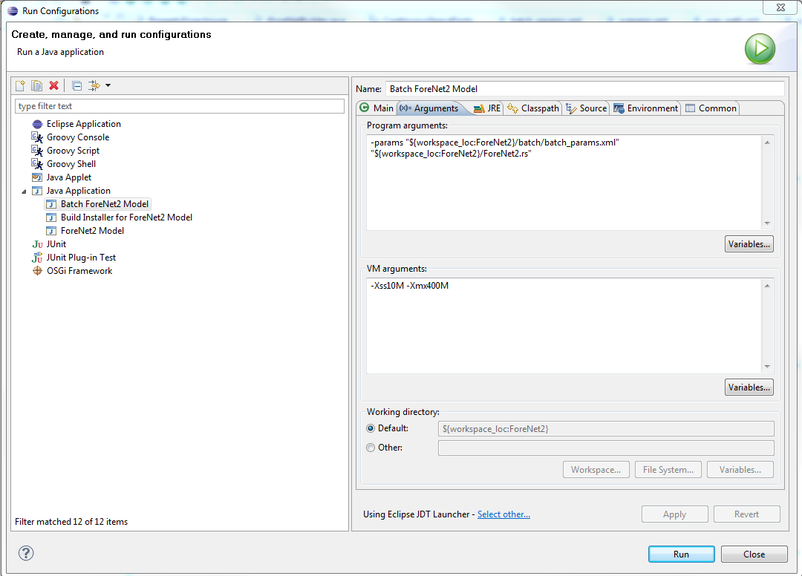

Slide 27
End Presentation

