Slide 1



MSIM895
ABMS
Introduction

Slide 2
Outline
Here is what is covered
Definition
History
Important Concepts
Related Subjects
Classic Examples
Software

Slide 3
Introduction
Agent-based Modeling and Simulation (ABMS)
The purpose of this lecture is to:
  Introduce ABMS
  Give an overview of its history
  Discuss some basic concepts and related subjects
  Introduce some classic examples
Notes:
Check go add-ins now for later.

Slide 4
Definition
There is no clearly accepted definition what agent-based modeling is. Multiple definition exist, for example:
  North and Macal
  Gilbert
Why?
  ABMS is a relatively new subject that is used by a lot of different groups, e.g., social scientist, computer scientist, operations researcher, biologist
    Each group has its own view on the world and its own terminology
Notes:
Check go add-ins now for later.

Slide 5
North and Macal
Agent-based simulation are built around agents. The characteristics of an agent being: adaptive, capability to learn, modify behaviors, autonomous, and heterogeneous
  North, Michael J., and Charles M. Macal. 2007. Managing Business Complexity: Discovering Strategic Solutions with Agent-Based Modeling and Simulation. New York: Oxford University Press
    Operations Researcher and Computer Scientist
    Focus on technical design of ABMS
Notes:
Check go add-ins now for later.

Slide 6
Gilbert
“Agent-based modeling is a computational method that enables a researcher to create, analyze, and experiment with models composed of agents that interact with an environment”
  Gilbert, Nigel. 2007. Agent-Based Models. Thousand Oaks, CA: Sage Publications
    Social Scientist
    Not use of words like simulation, adaption, etc.
Notes:
Check go add-ins now for later.

Slide 7
Definition Conflict
North and Macal’s definition focuses on the requirements of ABMS
  Not all agree with them
    N.B. Under their definition, the most famous ABMS, i.e., Schelling’s Segregation model, would not be an ABMS
Gilbert’s definitions focuses on the model’s purpose

Slide 8
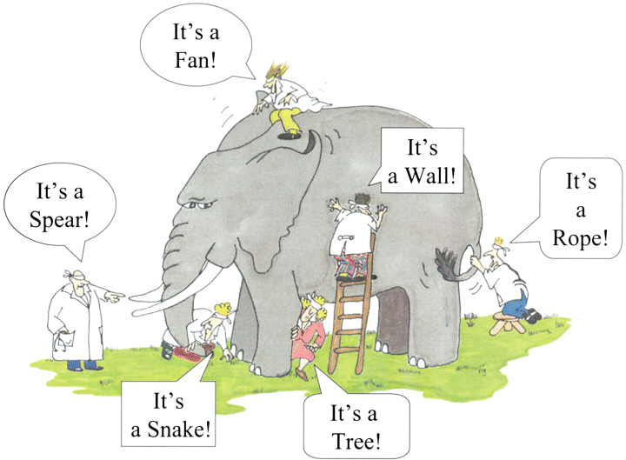

Slide 9
History

Slide 10
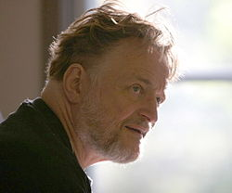
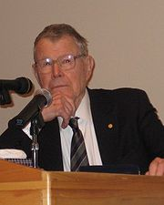
1970
1970
  Game of Life
    John Conways (British)
    Gardener, Martin. “Mathematical Games - The Fantastic Combinations of John Conway’s New Solitaire Game ‘Life’.” Scientific American, 1970
1971
  Schelling’s Segregation Model
    Schelling, Thomas C., 1971. Dynamic Models of Segregation. Journal Of Mathematical Sociology, 1(2), pp.143–186.
Notes:
Conway could publish work in 100 journals now!

Slide 11
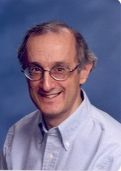
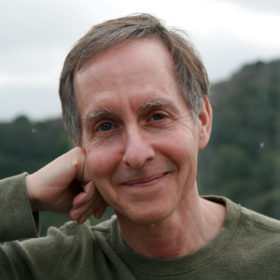
1980
1984
  Iterated Prisoner’s Dilemma
    Axelrod, Robert. 1984. The Evolution of Co-operation. Basic Books.
    Axelrod, Robert. 1997. The Complexity of Cooperation: Agent-based Models of Competition and Collaboration. Princeton: Princeton University Press.
1986
  Boids
    Craig W. Reynolds
      Reynolds, Craig W. “Flocks, Herds and Schools: A Distributed Behavioral Model.” In Proceedings of the 14th Annual Conference on Computer Graphics and Interactive Techniques, 25–34. SIGGRAPH ’87. New York, NY, USA: ACM, 1987.
    Tron (1982)
Notes:
http://en.wikipedia.org/wiki/Craig_Reynolds_(computer_graphics)
Axelrod is a politicial scientist
Reynolds was also a computer graphics guy and worked on the first version of Tron

Slide 12


1990
1991
  Coined term “agent”
    Holland, John H., and John H. Miller. “Artificial Adaptive Agents in Economic Theory.” The American Economic Review 81, no. 2 (1991): 365–370.
    John H. Miller
      See 2000s
    John Holland
      Father Genetic Algorithm
      Holland, John. 1996. Hidden Order: How Adaptation Builds Complexity. First Edition. Basic Books.
1996
  Sugarscape
  Epstein, Joshua M., and Robert L. Axtell. Growing Artificial Societies: Social Science from the Bottom Up. 1996. Brookings Press: Washington DC
  Formed AI ABM Society

Slide 13

1990
Societies
  North American Association of Computational Social & Organization Sciences (NACSOS)
    Was Computational & Mathematical Organization Theory
    Part of The Computational Social Science Society of Americas (CSSAS)
      http://computationalsocialscience.org/
    Died
  European Social Simulation Association (ESSA)
    Journal of Artificial Societies and Social Simulation (JASSS)
    Founder: Nigel Gilbert
      Gilbert, Nigel. 2007. Agent-Based Models. Thousand Oaks, CA: Sage Publications, Inc.

Slide 14
2000
Textbooks
  Generative Social Science
    Epstein, Joshua .M., 2007. Generative Social Science: Studies in Agent-Based Computational Modeling, Princeton University Press.
    “If you didn’t grow it, you didn’t explain it”
  Complex Adaptive Systems
    Miller, John H., and Scott E. Page. 2007. Complex Adaptive Systems: An Introduction to Computational Models of Social Life. Princeton University Press.

Slide 15
2000
Conferences
  Agent 20XY
  SwarmFest
  Autononmous Agents and Multiagent Systems (AAMAS)
  International Conference on Social Computing, Behavioral-Cultural Modeling, & Predication (SBP)
  Practical Application of Agents and Multi-agent Systems (PAAMS)
Notes:
PAAMS has died as of 2013

Slide 16
2010
www.openabm.org
  Network for Computational Modeling for SocioEcological Science (CoMSES Net)
Standardization
  Unified Modeling Language (UML)
  Overview, Design concepts, and Details (ODD)
You?

Slide 17
Important Concepts

Slide 18
Macro and micro
Micro level modeling considers each individual agent
Macro level modeling amalgamates agents into groups, flows or statistics (averages)
  Continuous simulation
What is an agent?
  The research questions determines what is the agent of interest
    Usually a human, vehicle or organization
    But a human is an amalgamation of cells, and cells are amalgamations of atoms, and atoms are … (don’t care)

Slide 19
Emergent Behavior
Emergent Behavior is observing macro-level phenomenon from micro-level behaviors
Emergence is an important concept for ABMS
  Why?
    It is the emergent macro behavior/phenomenon that makes ABMS a useful tool
  Example
    Observing a property market collapse due to individuals strategically defaulting

Slide 20
Emergence
Complex Adaptive Systems (CAS)
  Founding theory for ABMS
  Miller and Page 2007
  Complex vs. Complicated systems
Complicated Systems
  A complicated system is made up of elements that are independent of each other
    Removing one element does not alter the systems behavior apart from a direct result of what was removed.
Complex Systems
    A complicated system is made up of elements that are dependent of each other
    Removing one element fundamentally alters the system.

Slide 21
Emergence
Example (Miller and Page, 2007, p. 9)
  Removing a seat from a car makes it less complicated.
  Removing a timing belt from a car makes it less complex (and useless)

Slide 22
Emergence
Idea of complexity is in conflict with reductionist
  Reductionist hypothesis
    Get right simplifications then can understand everything.
      Extreme would be that everything can be communicated through applied physics
        Called “Greedy Reduction”
  Problems for emergent behavior
    Says things are only sum of parts so can look at them individually
    CAS view says need consider whole system to observe emergent behavior

Slide 23
A New Kind of Science?
Emergence has lead to a call for there to be a new kind of science:
  Traditional Science: Make hypothesis and test it with data from the real world
    e.g., Chemical X turns blue when added to water
  Axiomatic Science: Make hypothesis and test against existing theory
    Paradigm Shifts: Change theory if necessary
    e.g., Increased internet access means increased economic growth
  New Science: Make hypothesis and test with data from simulations built using existing theory and data

Slide 24
Adaption
Adaption is the ability to change behavior or self-organization based on environmental stimulus or collection of stimulus
  Ability to learn
  Natural Selection (for a species)
N.B. Does not always mean that the change is for the better

Slide 25
Adaption
Within an simulated agent, adaption can be modeled a number of different ways:
  Artificial Intelligence
    Can make the simulation more complex and hard to write code for
    e.g., reinforcement learning, genetic algorithms, neural networks
  Threshold Equations
    Allows for simple changes
    e.g., Agent waiting in line has some attribute called “impatience”; when impatience level reaches a certain threshold, agent leaves line.

Slide 26
Heterogeneity
Heterogeneity is defined as the quality of being diverse and not comparable in kind
  Homogeneity is opposite
    Homogeneity used when you need to amalgamate all the agents
      Continuous Simulation
      Macro Simulation
Hard to implement
    Does just labeling agents differently make them heterogeneous?
    What about giving the different spatial locations?
Notes:
No, because does not matter how label
If there locations can be interchanged without fundmentally affecting the agents, then no

Slide 27
Related Subjects

Slide 28
Related Subjects
“Standing to the shoulders of giants”
ABMS development has been dependent of other academic subjects
  Its roots are formed from
    Game Theory, Cellular Automata, DES, Multi-agent Modeling
  Each subject brings with it its own existing knowledge
    And its own baggage of expectations, terminology, and assumptions

Slide 29
Game Theory
Game Theory is the modeling of situations involving multiple decision-makers
  Von Neumann, John, and Oskar Morgenstern. 1944. Theory of Games and Economic Behavior. Princeton University Press.
  Thomas Schelling
    2005 Noble Prize for Game Theory
  Robert Axelrod
    Iterated Prisoner’s Dilemma
Notes:
Note all these names from earlier

Slide 30

Cellular Automata
Cellular Automata is a collection of "colored" cells on a grid of specified shape that evolves through a number of discrete time steps according to a set of rules based on the states of neighboring cells.
Von Neumann, John and Ulum, Stanislaw
  1940s
  Manhattan Project
Wolfram, Stephen.
  2002. A New Kind of Science. 1st ed. Champaign, IL: Wolfram Media.
  Mathematica
  www.wolframalpha.com
Notes:
Von neumann again

Slide 31
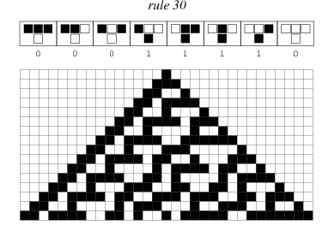

Slide 32
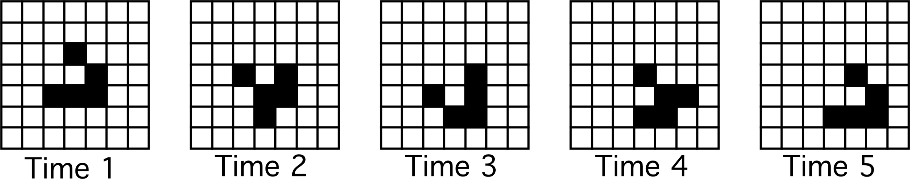
A glider
Notes:
Glider

Slide 33
Discrete Event Simulation
Discrete Event Simulation (DES) is when the operation of system is represented as an ordered sequence of events and changes of state in the system, it is event driven.
Can (and has) been argued that ABMS is just a subset of DES
  How else implement ABMS?
Notes:
But implementation is not the only factor of a paradigm.
By this argument DES is just a software nothing more….
Could impliment ABMS with real human actors. Would be cool to see.

Slide 34
Multi-agent Modeling
Computer Science subject
Concern with autonomous computer software agents interacting
From Wikipedia:
  “An agent-based model (ABM) (sometimes confused with the term multi-agent system or multi-agent simulation)
Notes:
So pleased someone but this on wikipedia. It is confused at LOT

Slide 35
Historical Examples

Slide 36
Segregation Model
Schelling’s Segregation Model (1971)
  Often quoted as first example of ABMS
  Developed model to explain the formation of social segregation in US cities
  Schelling did the work for this model using:
    Graph paper
    Nickels and Quarters
    NO computer

Slide 37
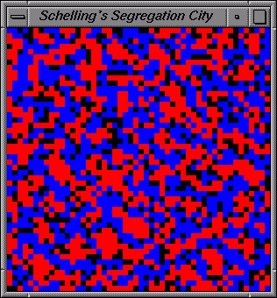

Slide 38
Segregation Model
Two types of agent: red and blue
Living in a grid with empty spaces
Rules of Segregation Model:
  If an agent finds the proportion of neighbors of the other type is greater than some “tolerance” threshold then they will move to a new random location
Results
  Schelling found that even for high tolerance thresholds segregation occurred
  What would happen if the agents were complete tolerant of neighbor type?

Slide 39
Game of Life
John Conways (1970)
Form of cellular automata
Conway called it “recreational mathematics”
  So did not publish
Idea was to try and replicate requirements for life
Important: the game of life was an abstraction of realty; a model
Notes:
AJC: wish I had published this.
It is the abstraction that makes a difference. The modeling part of M&S

Slide 40
Game of Life
Rules of Game of Life
  Survivals. Every agent with two or three neighboring agents survives for the next generation.
  Deaths. Each agent with four or more neighbors dies (is removed) from overpopulation. Every agent with one neighbor or none dies from isolation.
  Births. Each empty cell adjacent to exactly three neighbors--no more, no fewer--is a birth cell. A new agent is placed on it at the next move.

Slide 41
Boids
Craig W. Reynolds (1986)
Boids was an attempt to replicate flocking behavior of birds
  Was very successful
  Followed on by Social Force Dynamics for crowd modeling
“Boids” is pronounced like a New Yorker would say “birds”

Slide 43
Boids
Rules of Boids:
  Separation: Avoid Crowding
    Not allowed to get too close to neighbor
  Alignment: Steer Average Heading
  Cohesion: Steer to center of Mass
These rules are translated into forces which are amalgamated to choose new direction for the boid.

Slide 44
Sugar Scape
Epstein and Axtell (1996)
Abstract representation of a simple society
  The model follows agents that live, trade, reproduce, and die on a doughnut-shaped surface that contains growing sugar
Brahms
  Software tool derived from Sugarscape
Notes:
Know how make surface into a doughnut?

Slide 45
Software

Slide 46
ABMS Software
Anylogic
  Multi-paradigm
    Discrete Event Simulation
    System Dynamics
  XJ Technologies ($3500)
Brahms
  From Sugarscape
Mason
  Multi-Agent Simulator Of Neighborhoods... or Networks
  Java Based
  George Mason University

Slide 47
ABMS Software
Netlogo
  Most widely used
Repast Simphony
  Java Based
  Argonne National Lab
    Michael J. North & Charles Macal
Swarm
  Sante Fe Instituate
  Is dying

Slide 48
Comparison
Railsback, S.F., Lytinen, S.L. & Jackson, S.K., 2006. Agent-based Simulation Platforms: Review and Development Recommendations. SIMULATION, 82(9), pp.609–623
Paper says that:
  Netlogo is the easiest
  Repast is the quickest

Slide 49
References
Net Logo
  Uri Wilensky. 1999. Netlogo. Center for Connected Learning and Computer-Based Modeling, Northwestern University, Evanston, IL. http://ccl.northwestern.edu/netlogo/.
Repast Simphony
  North, M.J., T.R. Howe, N.T. Collier, and J.R. Vos, "A Declarative Model Assembly Infrastructure for Verification and Validation," in S. Takahashi, D.L. Sallach and J. Rouchier, eds., Advancing Social Simulation: The First World Congress, Springer, Heidelberg, FRG (2007)

Slide 50
End Presentation

