Slide 1



MSIM795/895
ABMS
Agent Behaviors – A Look at Agent_Zero

Slide 2
Outline
Agent Behaviors – A Look at Agent_Zero
Introduction
Model Overview
Agent Components
Agent_Zero implementation

Slide 3
Introduction
To model human behavior we have to capture
  The emotional
  The cognitive
  The social
Each one of these will be treated separately and then combined.

Slide 4
Introduction
The emotional is based on the Rescola-Wagner model of conditioning.
The cognitive is based on probability developed from local sampling.
The social is based on a network transmission model.

Slide 5
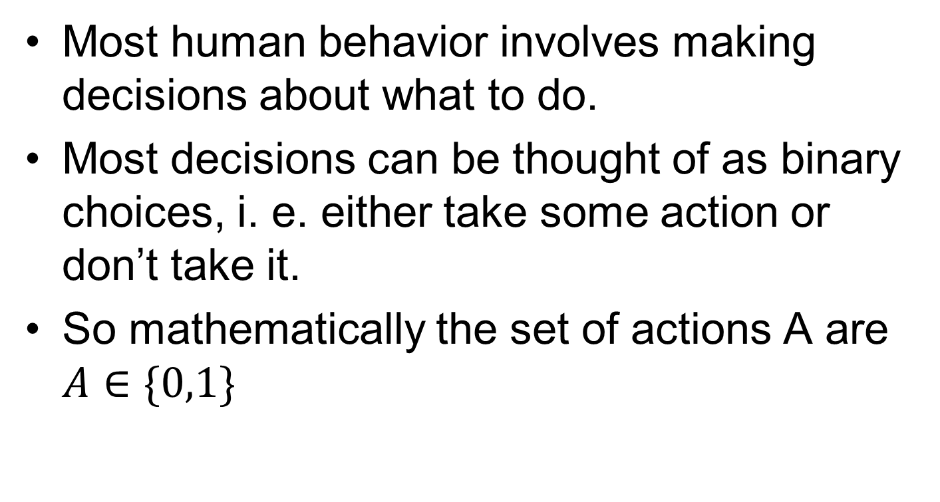
Model Overview
Most human behavior involves making decisions about what to do.
Most decisions can be thought of as binary choices, i. e. either take some action or don’t take it.
So mathematically the set of actions A are $A∈\{0,1\}$

Slide 6
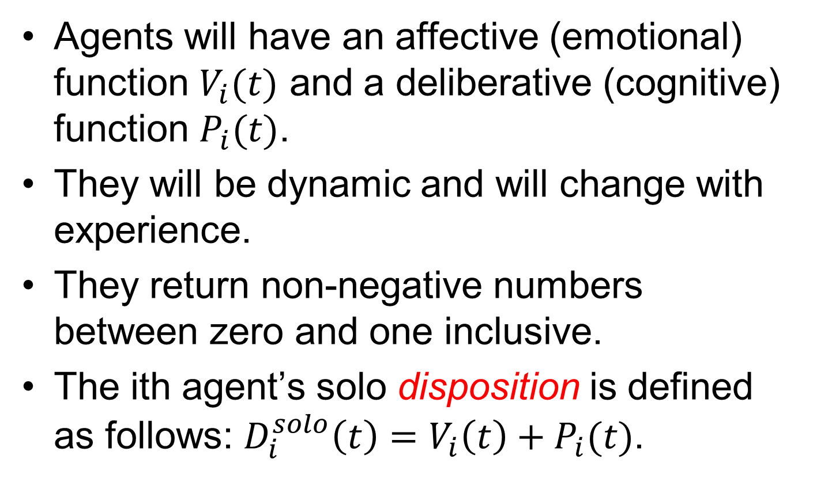
Model Overview
Agents will have an affective (emotional) function $V_{i}(t)$ and a deliberative (cognitive) function $P_{i}(t)$.
They will be dynamic and will change with experience.
They return non-negative numbers between zero and one inclusive.
The ith agent’s solo disposition is defined as follows: $D_{i}^{solo}\left(t\right)=V_{i}\left(t\right)+P_{i}(t)$.

Slide 7
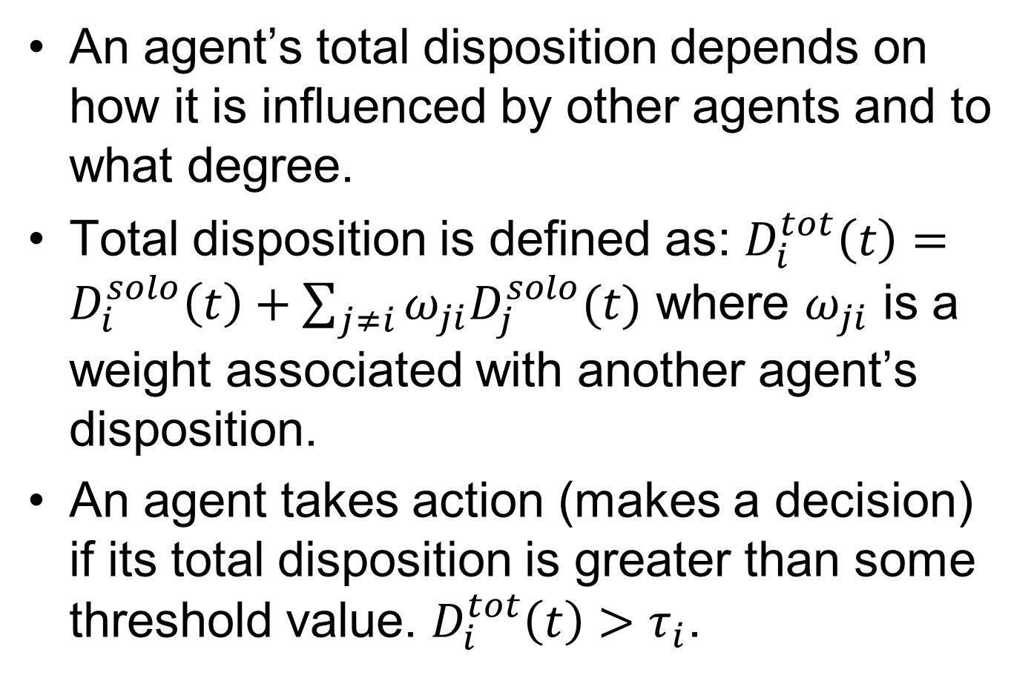
Model Overview
An agent’s total disposition depends on how it is influenced by other agents and to what degree.
Total disposition is defined as: $D_{i}^{tot}\left(t\right)=D_{i}^{solo}\left(t\right)+\sum_{j≠i}{ω_{ji}D_{j}^{solo}(t)}$ where $ω_{ji}$ is a weight associated with another agent’s disposition.
An agent takes action (makes a decision) if its total disposition is greater than some threshold value. $D_{i}^{tot}\left(t\right)>τ_{i}$.

Slide 8
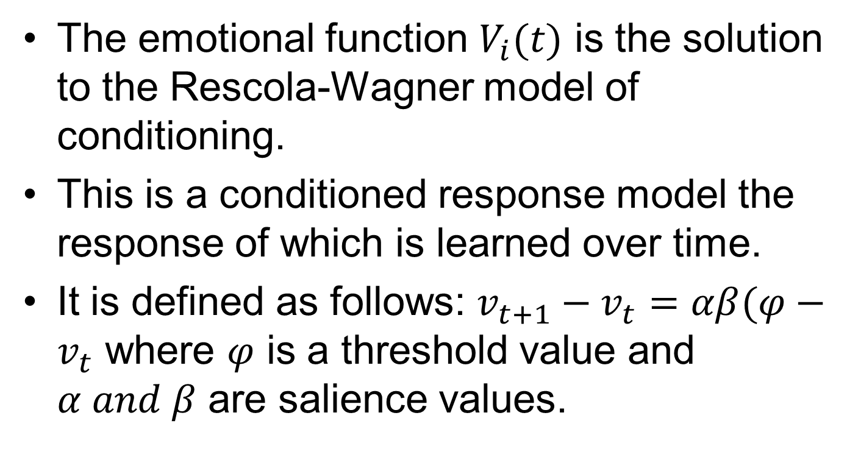
Emotional Component
The emotional function $V_{i}(t)$ is the solution to the Rescola-Wagner model of conditioning.
This is a conditioned response model the response of which is learned over time.
It is defined as follows: $v_{t+1}−v_{t}=αβ(φ−v_{t}$ where $φ$ is a threshold value and $α and β$ are salience values.
Notes:
Snake example, hurricane evacuation example.

Slide 9
Emotional Component
What this equation implies is that high surprise combined with high salience produces strong associative conditioning.
However this conditioning may not be permanent. It can decay with time in an exponential manner if not reinforced on a periodic basis.
So the Rescola-Wagner model must account for this observation.

Slide 10
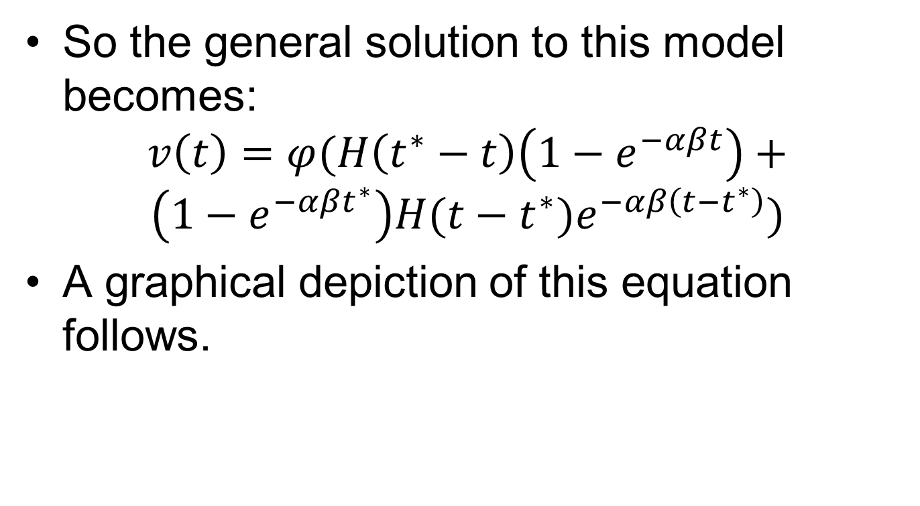
Emotional Component
So the general solution to this model becomes:
$$v\left(t\right)=φ(H\left(t^{∗}−t\right)\left(1−e^{−αβt}\right)+$$
$$\left(1−e^{−αβt^{∗}}\right)H(t−t^{∗})e^{−αβ\left(t−t^{∗}\right)})$$
A graphical depiction of this equation follows.
Notes:
Heaviside function – step change

Slide 11
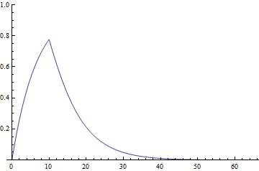
Emotional Component
Notes:
This graph also implies that conditioning and extinction are not symmetrical. The half life equation is $t_{1/2}=\frac{ln(2)}{αβ}$ .

Slide 12
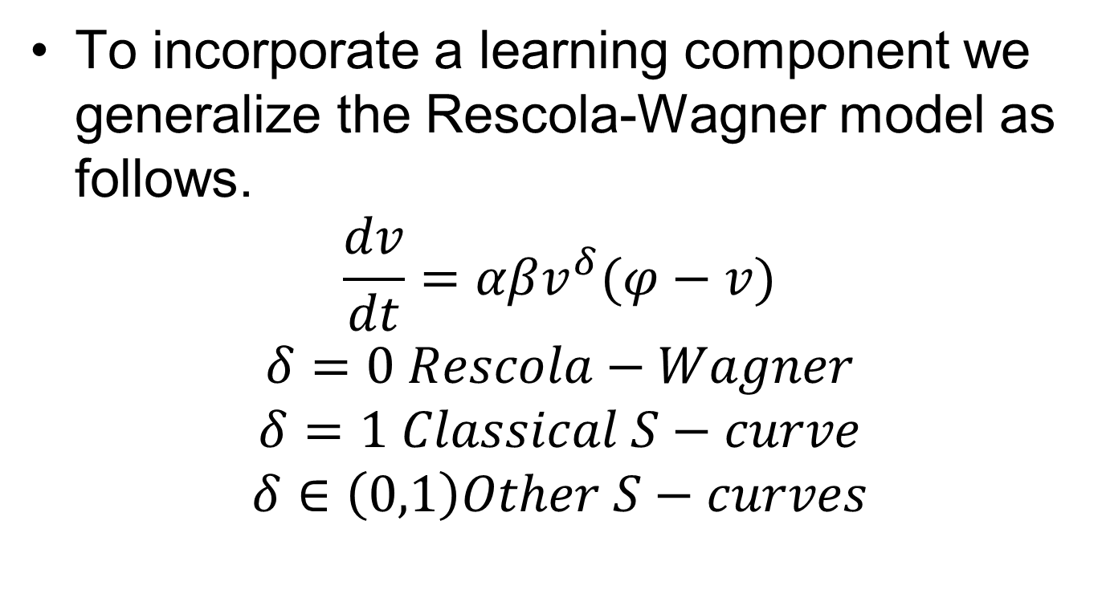
Emotional Component
To incorporate a learning component we generalize the Rescola-Wagner model as follows.
$$\frac{dv}{dt}=αβv^{δ}(φ−v)$$
$$δ=0 Rescola−Wagner$$
$$δ=1 Classical S−curve$$
$$δ∈\left(0,1\right)Other S−curves$$

Slide 13
Reason: the cognitive component
Reason is not assumed to be perfect.
It is controlled by bounded rationality, i. e. what is going on around your immediate sphere of perception.
This cognitive component is manifested in the form of a probability and is a counter to the emotional component. It represents the agent’s experience.
Graphically it looks like the following.
Notes:
You may want to attack but those around you are fleeing. You are being pulled on two directions and one direction will win out. Snake example learning which are poisonous and which are not. This is tied to learning.

Slide 14
Reason: the cognitive component
V-T
T
T-P
Notes:
The average (V+T)/2 must exceed the threshold.

Slide 15
Social Component
The social component connects the disposition of agents together through a network structure.
The agent first computes its solo disposition and then adds to that the weighted sum of the other agents solo disposition to compute its total disposition.
The agents will transition some dynamic path as the simulation proceeds.

Slide 16


Social Component
For a two agent model we have a threshold space that looks as follows.
$$τ_{2}$$
Person 1
Dynamic movement over time
+/-
+/+
$$τ_{1}$$
-/-
-/+
Person 2

Slide 17
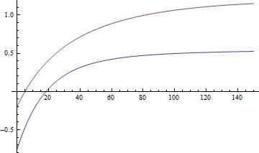

Social Component
$$D^{net}(t)$$
t

Slide 18
Social Component
For non-trivial forms of group decision we require three or more agents.
So we have to expand the social network to account for an arbitrary number of network connections.

Slide 19
Agent_Zero Implementation
Pseudocode for Agent_Zero
  Compute own affect
  Compute own local probability
  For each other agent in network
    Compute the weighted solo disposition
  Add the above-computed numbers
  Subtract own threshold
  If the result is positive, Act; otherwise don’t
  Apply own extinction rate to own affect
  Move
  Repeat

Slide 20
End Presentation

