Slide 1



MSIM695
ABMS
Building an Agent-Based Model in Netlogo

Slide 2
Outline
Here is what is covered
Netlogo environment and types of agents
Understanding contexts
Issuing agent commands
Getting information about your agents
Experimentation with Netlogo

Slide 3
Different Kinds of Agents
Patches
  Landscape (represents one square of a 2-D wrap-around grid)
  Do not move
  Have characteristics (e.g., pcolor)
  Identified by their integer coordinates (pxcor, pycor)
Notes:
Check go add-ins now for later.

Slide 4
Different Kinds of Agents
Turtles
  Move on top of patches
  Have decimal coordinates (xcor, ycor), orientation (heading), and identification number (who)
  No turtles when Netlogo sets up
Observer
  Overlooks model
  Creates world, populates it with turtles and patches, issues command.

Slide 5
Netlogo environment

Slide 6
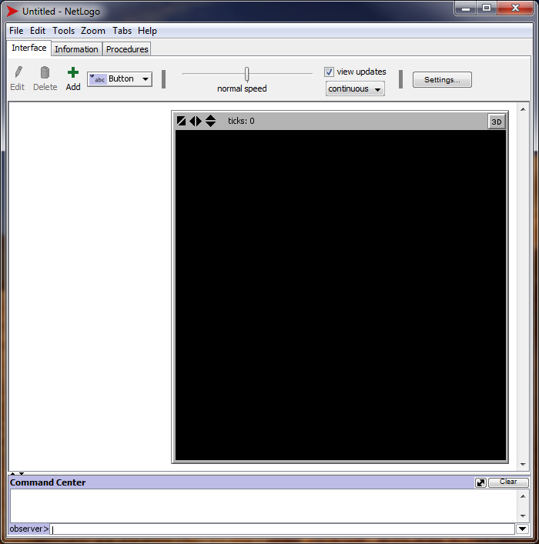
Netlogo at startup
Patches are here but
not visible

Slide 7
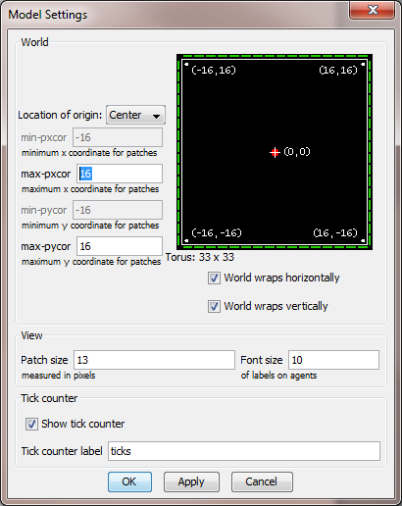
Default world is 33x33 grid
Default world shape is a torus
Patches are cells on grid (identified
by coordinates)
Can change location of “origin” (0,0)
patch.

Slide 8
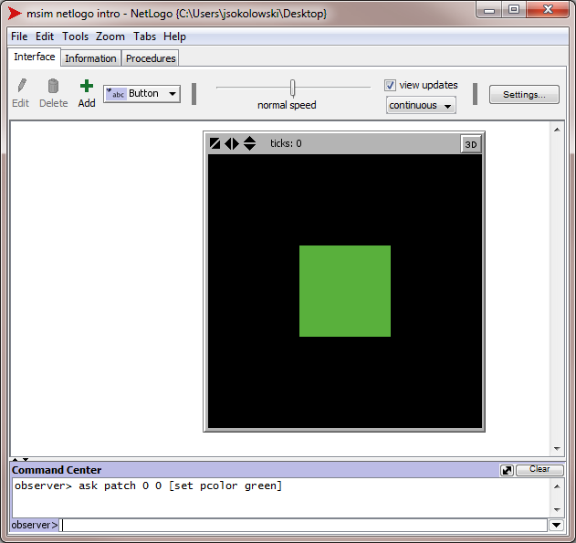
Click on Edit to
get setup window.
Set up the world
with max-pxcor and
max-pycor =1 and
patch size 100,
then execute the
command shown in
the Command Center.

Slide 9
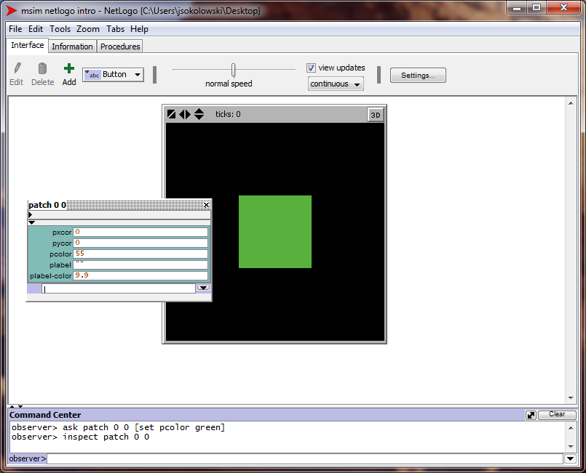
Issuing the
inspect
command
brings up
a data window
for the patch.

Slide 10
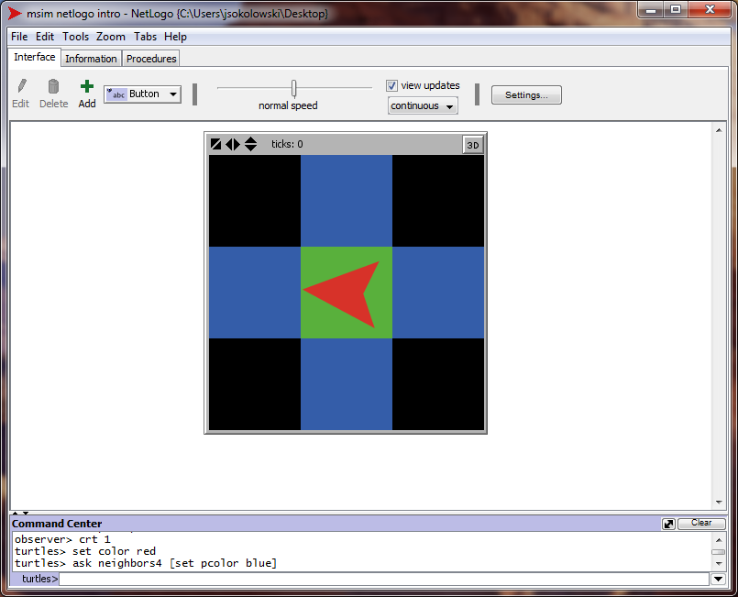
The Netlogo manual
covers command
format and short cuts.
Clicking here will
change who executes
the command.

Slide 11
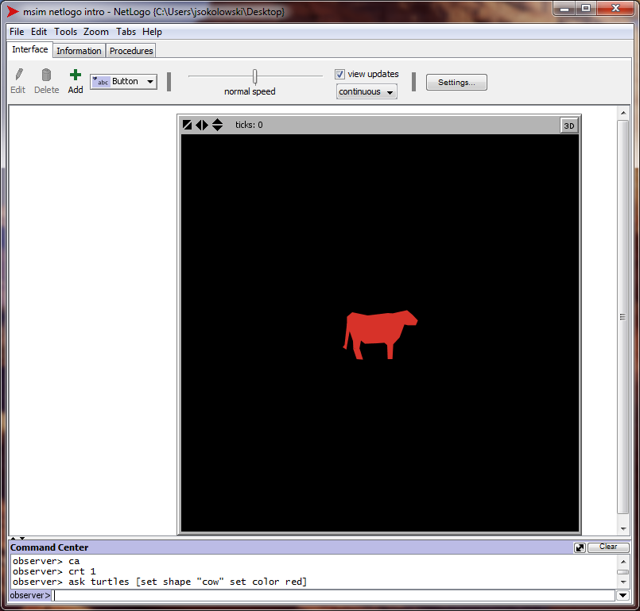
ca is clear all
crt 1 is create one
turtle

Slide 12
Contexts
All commands are context-specific
  Observer (clear-all, create-turtles)
  Turtles (jump, setxy)
  Patches (neighbors, sprout)
We can change who is issuing the command via the command center
To issue a command from a turtle or patch context, use the “ask” command

Slide 13
Features of Agent Commands
Built-in (primitives) vs. User-written (procedures)
  See Netlogo “dictionary” for full list of primitives
  Procedures typically written to apply to one type of agent (e.g., turtles)
  Standard format

Slide 14
Features of Agent Commands
Actions vs. output
  Commands may be some action for agent to carry out (create, jump, hatch)
  Commands may be some reporter to compute a value & return it (average-happiness, absolute-value, proportion-isolated)
Inputs (arguments) or not
  Inputs are values that can be used to carry out actions

Slide 15
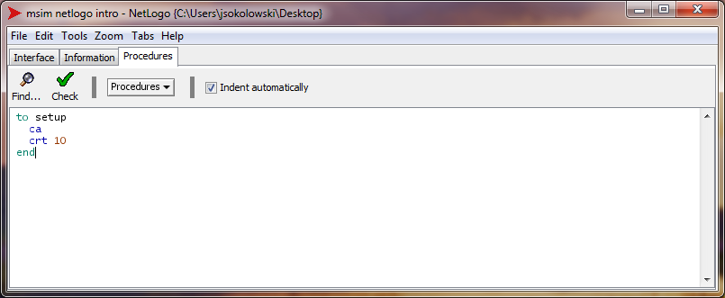
Click on the “Procedures” tab and enter the following…
Now go back to the interface & type “setup” in the command window…

Slide 16
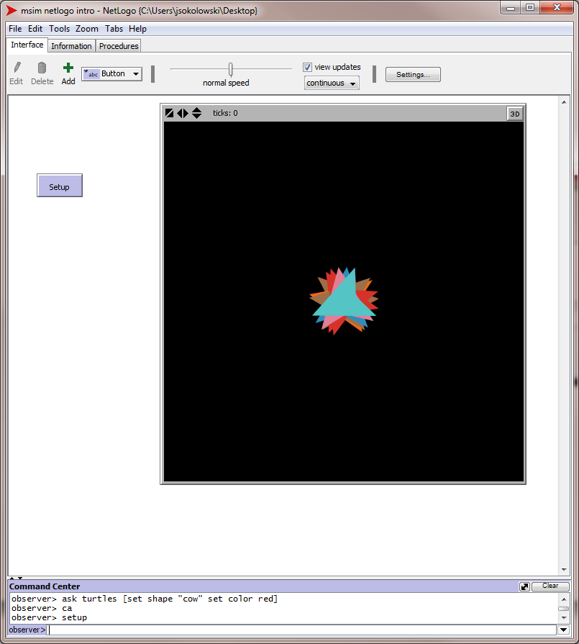
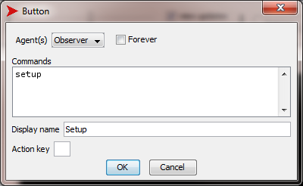
We can also execute the “setup” command via a button
Use the add symbol to
create a button on the interface.

Slide 17
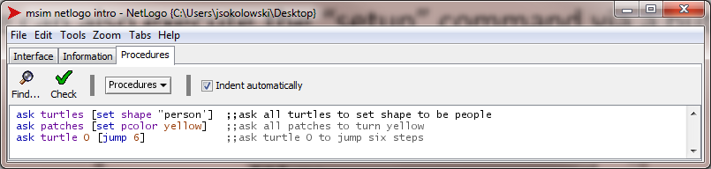
Using the Ask Command
Issues commands for specified patches or turtles
  All turtles or patches
  Subset of turtles or patches with some characteristic (keyword: with)
  Random sample of turtles or patches (e.g., n-of)

Slide 18
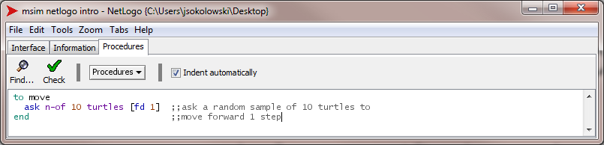
Using the Ask Command

Slide 19
Agentsets
Unordered set of agents
  All agents must be of the same type (e.g., turtles)
  Always presented in random order
  Used to construct subsets of agents (e.g., all turtles with color=red)
  Netlogo has built-in agentsets (turtles-here, turtles-at, turtles-with …)

Slide 20
Once you have your agentset…
Here are a few things you can do:
  Use ask? to make the agents in the agentset do something
  Use any? to see if the agentset has at least one agent that fits criteria
  Use all? to see if all agents in agentset fit some criteria
  Use count to find out how many agents are in agentset

Slide 21
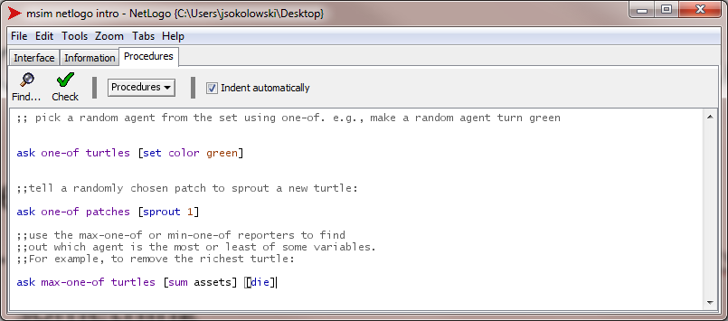

Slide 22
Breeds
Breed – a “natural” kind of agentset (other species than turtles)
  example
  A new breed comes with automatically derived primitives:
breed [wolves sheep]
create-<breed>
create-custom-<breed>
<breed>-here
<breed>-at
…

Slide 23
Breeds
  The breed is a turtle variable:
  A turtle agent can change breed:
ask turtle 5 [ if breed = sheep … ]
Ask turtle 5 [ set breed sheep ]

Slide 24
Lists
Ordered lists of things
  All items do not need to be of same type
  Lists cannot be modified, but they can be replaced
  Example:
let a-list [ 0 “a string” true]; a list of a number,
a string, and a boolean

Slide 25
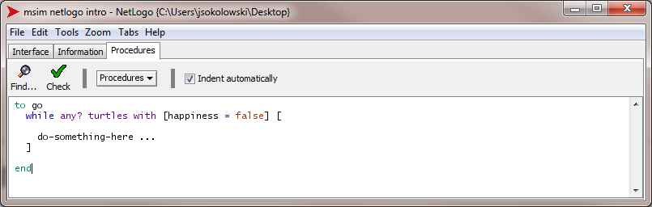
Timing and Scheduling
Time
  Measured in “ticks”
  Usually 1 tick = 1 run of “go” command
  Reset ticks using tick-reset command
  Current tick retrieved via ticks reporter
  Tick command advances the tick counter
Scheduling
  Usually 1 “step” of model contained in “go” procedure

Slide 26
Basic structure of a netlogo program

Slide 27
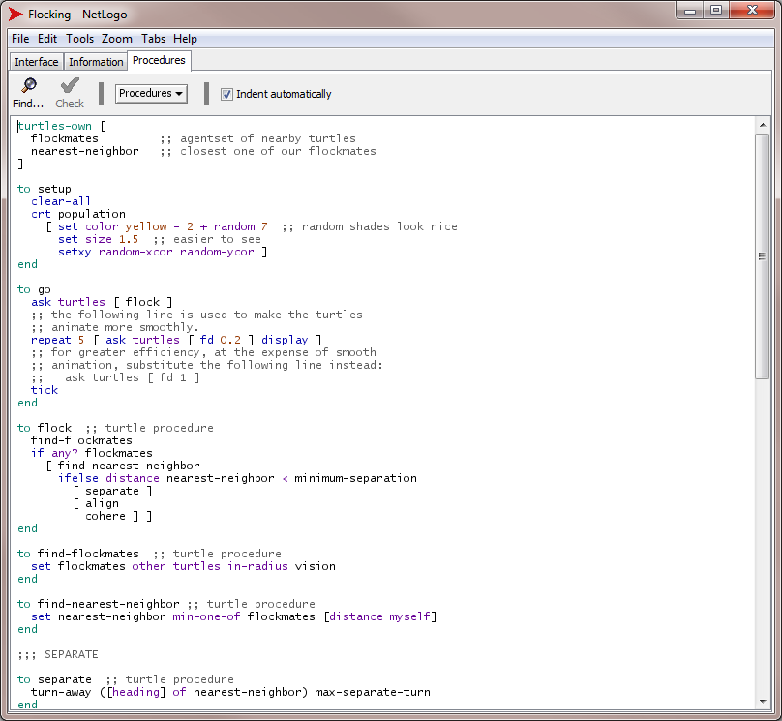
Global variables
usually come first
Setup method
comes next
Then Main
method
Followed by
Subroutines

Slide 28
Getting information about your agents

Slide 29
Reporters and Views
Reporters
  Report a result value (functions with return type)
  Example with 1 input argument:
to-report abolute-value [number]
ifelse number >= 0
[report number]
[report 0 – number]
end

Slide 30

Reporters and Views
Types of Views
  Monitors
  Plots
  Output text areas
Monitors – display the current value of variables

Slide 31
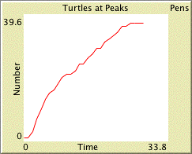

Reporters and Views
Plots – display the history of a variable’s value
Output text areas – log text info

Slide 32
Experimentation with netlogo

Slide 33
Experimentation
BehaviorSpace
  Software tool integrated with Netlogo that facilitates experimentation
  Sets up Netlogo to conduct multiple runs with different input variable values. Facilitates Monte Carlo simulation for data collection and analysis.

Slide 34
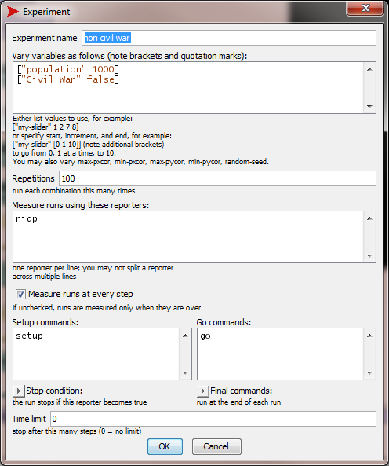
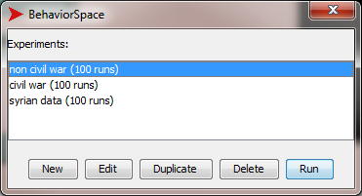
Setup different runs
Define run parameters

Slide 35
End Presentation

