Slide 1



MSIM695
ABMS
Artificial Intelligence in Agent-Based Models

Slide 2
Outline
Artificial Intelligence
Introduction
Agent Reasoning

Slide 3
Introduction
What is Artificial Intelligence (AI)?
  For the purposes of our course AI is the study and design of intelligent agents.
Why study AI for ABM?
  Agent-based modeling (ABM) includes endowing our agents with the ability to reason about their environment, learn from theirs and others behavior, and modify their behavior to better achieve their goals.

Slide 4
Introduction
The main areas of study of AI are:
  Reasoning, knowledge representation, planning, learning, perception, and mobility.
  For our purposes we will be concerned with all the above except mobility.
  These areas support the learning and evolution aspects of complex adaptive systems previously discussed.

Slide 5
Introduction
Approaches that address the main areas of study are statistical methods, computational intelligence, and traditional symbolic AI.
We will concentrate on the computational intelligence area because they provide capabilities to imbue intelligence in our agents beyond the traditional approaches of statistics and symbolic AI.

Slide 6
Agent Reasoning
Agents with state
  Agents whose decision making is influenced by history.
  They have some internal data structure that captures information about the environment and what has happened in the past.
See
Action
Next
State
Environment
Notes:
Check go add-ins now for later.

Slide 7
Agent Reasoning
Because agents are autonomous they must have some mechanism to reason about their environment. This reasoning forms the heart of the agent as far as its behavior is concerned.
We will look at several computational methods to implement reasoning.

Slide 8
Agent Reasoning
Finite state machines and Markov Chains
  FSMs consist of a set of states linked together by transition functions.
  States can have one or more actions to accomplish once that state is reached.
  The transition functions govern what state is visited next based on the occurrence of a particular event within the previous state.
  A Markov Chain is an adaption of a FSM where transitions among states are probabilistic in nature.

Slide 9
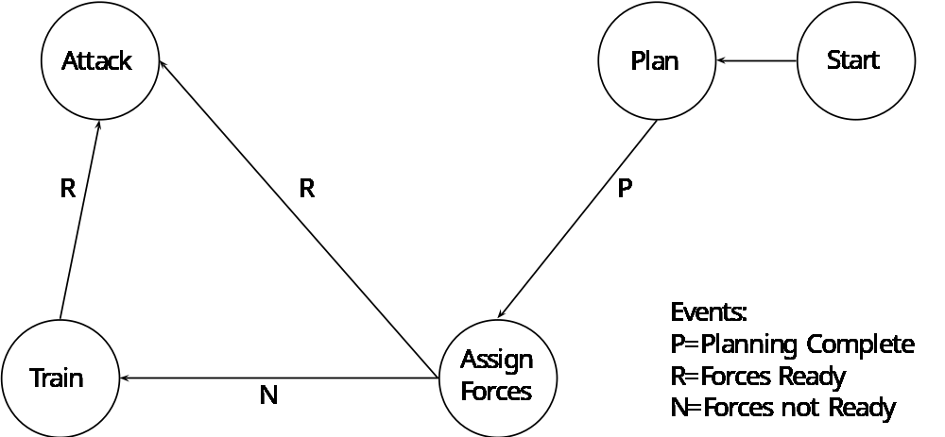
Agent Reasoning
Transitions
States

Slide 10
Agent Reasoning
Rule-based Models (Expert Systems)
  This method replicates reasoning by executing a base of knowledge containing If-Then logical constructs.
  These rules form the knowledge base of the agent. Developing a comprehensive knowledge base to allow the agent to respond to many different situations is a difficult task. This is the main thrust of knowledge engineering.

Slide 11
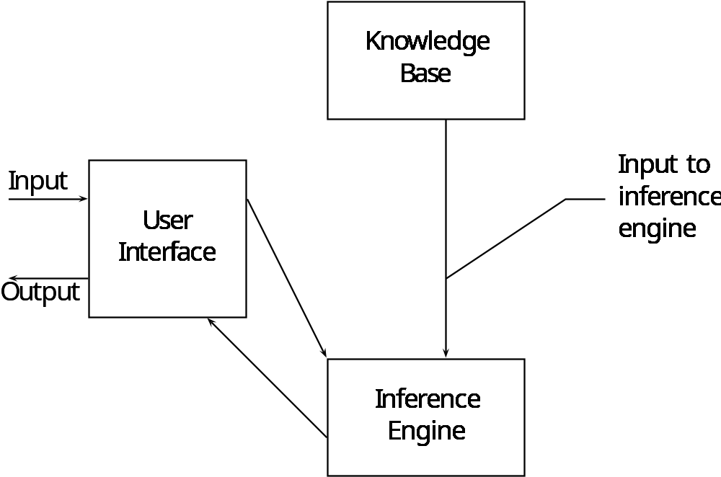
Expert System Structure

Slide 12
Agent Reasoning
Case Based Reasoning
  Here knowledge is represented as a compilation of individual cases. It is a store house of solutions to previous problems that can be used as a starting point to reason about new problems.
  A case contains three parts, problem-situation description, the solution, and the outcome.
  Specifying cases and developing a case index is the challenge for this type of model.

Slide 13
Agent Reasoning
Neural Networks
  NNs mimic the function of the human brain. They are composed of neurons arranged in layers. They take an input and compute an output based on how they have been trained to recognize that input.
  NNs are very good for pattern recognition tasks and reasoning about incomplete or noisy data.

Slide 14
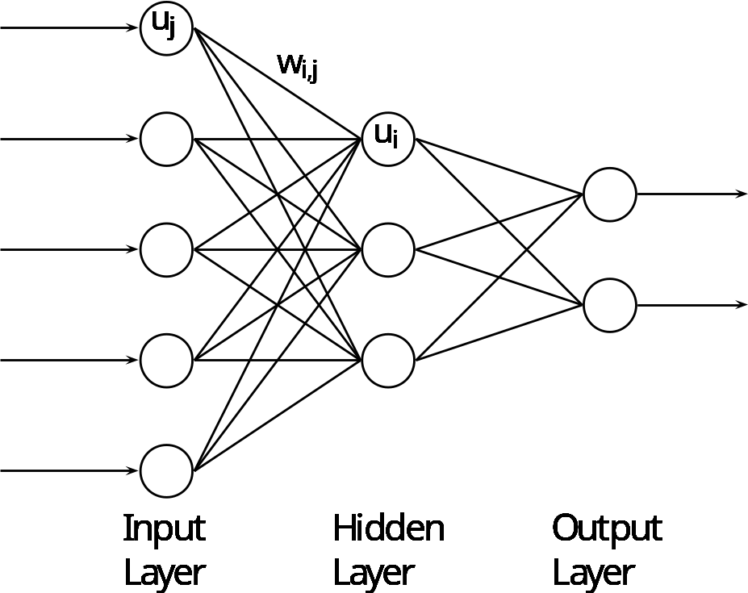
Neural Networks
Each neuron receives input values that are either continuous, falling in the interval [0,1] or [-1,1], or discrete values {0,1} or {-1,0,1}. An activation function associated with each neuron acts on these inputs to produce a single output value for that neuron.

Slide 15
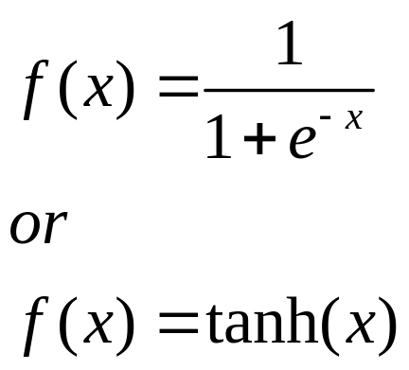
Neural Networks
Typical activation functions are:

Slide 16
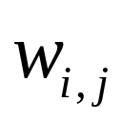

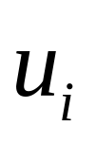

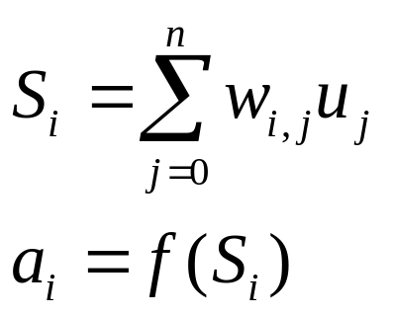
Neural Networks
Each connection has a numerical weight that specifies the influence of neuron on neuron . If the weight is positive, there is a positive influence and vice versa. Each neuron computes it activation value by taking as input to its activation function the weighted sum of all other neurons that are inputs to it.

Slide 17
Neural Networks
  Neural networks have to be taught to recognize specific sets of information.
  They go through a training process that adjusts each node’s weight to minimize the error in the network’s output as compared to the actual expected output.
  Once the network is trained it is relevant to that class of problem.

Slide 18
Agent Reasoning
Fuzzy Logic and Fuzzy Inference Systems
  Fuzzy logic is a revision to classical set theory that allows for a variable to have a degree of membership to a particular set.
  The degree of membership is based on some pre-defined function that characterizes that variable.
  Fuzzy inference rules are then used to reason about fuzzy values.
  Defuzzification converts fuzzy values to discrete values through a probability function.

Slide 19
Agent Reasoning
Genetic Algorithms (GA)
  GAs mimic the human genetic process of recombination and mutation to produce unique differences from generation to generation.
  Incorporating GAs into agents allows them to evolve with new characteristics and behaviors not previously programmed into their original design.
  The ability to evolve supports the complex adaptive behavior characteristics of agent-based models.

Slide 20
Genetic Algorithms
Creating a GA involves the following:
  Initialization – create an initial population usually with randomly selected characteristics
  Evaluation – each member of the population is evaluated against some fitness function that is predetermined by the modeler
  Selection – population members with characteristics that make them more fit are selected to move on to the next generation

Slide 21
Genetic Algorithms
  Crossover – new population members are created by combining characteristics from the most fit individuals.
  Mutation – random mutations occur in the population so that new characteristics that may make the individuals more fit are possibly created.
  Repeat – the above process is repeated until some preselected criteria is met.
  An example GA: http://math.hws.edu/xJava/GA/.

Slide 22
End Presentation

